Slide 1
Harmony Platform
Product Overview

Slide 2
Instructions
The deck is an extension of the Corporate POV deck for conversations that require a deeper dive into the solutions in our Harmony platform. It provides a high-level overview of each product; the key features, value props, and how it fits into the Harmony platform.
What the deck covers:
iPaaS
API Manager
App Builder
EDI
How to use the deck:
The deck is modular and can be used in its entirety or based on specific product conversations as required.
Questions? Reach out to productmarketing@jitterbit.com.

Slide 3
Instructions
Co-Branding This Deck To add your organization’s logo to the cover and footers of this presentation, you must edit the template using master slides (in Microsoft PowerPoint) or theme builder (in Google Slides). In each master slide you would like to co-brand, delete the placeholder box and replace it with your organization’s logo. Correct use can be seen in the example below:

Slide 4
Jitterbit iPaaS
Effortless connectivity with secure, scalable and AI-driven integrations

Slide 5
Table of Contents
1 | iPaaS
2 | API Manager
3 | App Builder
4 | EDI
Notes:
What are the different terms, what do they mean
What do we have
How do we stack up
Primer on AI
Education
Terminology
Basic AI
AI, Agent, that is an agent, agentic aI, agentic AI

Slide 6
Instructions
The deck is an extension of the Corporate POV deck for conversations that require a deeper dive into Jitterbit iPaaS. It provides a high-level overview of Jitterbit iPaaS features, value props, and how it fits into the Harmony platform. What the deck covers:
A brief overview of the Harmony platform
Industry trends driving the need for iPaaS
Features & benefits
Use case examples
Proof points
How to present it
Check out the talking points outlined in the Speaker Notes section of the deck. Use them as a guide to tailor your talk track to your audience and goals.
Add your photo and contact information to the last slide in the appropriate space.
The appendix slides include a customer case study and architecture slides. Use them as appropriate to make the message more impactful.. Questions? Reach out to productmarketing@jitterbit.com.

Slide 7
AI-Infused Low-Code Integration, Orchestration, Automation & App Development
iPaaS
API Manager
App Builder
EDI
Marketplace
Management Console
Build, manage and maintain integrations
Create, control and consume your APIs
Build, manage and maintain web and mobile applications
Build, manage and monitor exchange of business documents
Get certified pre-built integrations
Manage, monitor and administer projects in one place
Notes:
Harmony is an AI-infused low code integration, orchestration, automation and app development platform.
iPaaS solution that's AI-infused, where you build and maintain the integrations for your entire environment. Orchestrate workflows that trigger real-time integrations based on external events.
API Manager allows you to create, control and consume that data in the information in those integrations - all in the same platform. Expose and manage APIs using API Manager for real-time integrations.
App Builder (previously known as Vinyl) helps build enterprise applications via low-code or AI-infused approaches. Those 72% of applications that aren't all written for web and mobile - that may need to be rewritten for the current day or new ones. Ideal for internal or customer-facing applications.
Then Jitterbit EDI. Now that you have your applications, you may want to turn to the B2B or commercial landscape. EDI connects you to the long-trusted integration standard. And we have more than 1,000 trading partners built in. And all off the same platform.
Supporting the four cornerstone products we have a Marketplace, where we have over 400 pre-built integrations for the most popular systems, services and use cases.
FInally, the Management Console where you can manage the entire Harmony platform seamlessly in a single console.

Slide 8
89%
1000s
average number of discrete applications in an organization
of IT leaders report data silos are creating challenges for digital transformation
Integration + AI are breaking down data silos to accelerate digital transformation
51%
of B2B buyers cited poor integration with their existing tech stack as a reason to explore new vendors
85%
of workers expect AI to improve their jobs
Source: Elastic.io, ,Inbox Insight, Censuswide
Notes:
The growing number of applications in every enterprise is showing no signs of a slowdown and this is leading to data silos. Integration and AI together can help overcome these challenges and speed up your digital transformation initiatives.

Slide 9
What is Jitterbit iPaaS
The components of Jitterbit iPaaS
A low-code integration platform
Scalable, cloud-native solution
Enterprise-grade security and governance
Integration Studio
Integration designer to build and deploy integrations
Connectors
Interface for creating a connection to a data source
Management Console
Centralized interface to control, and manage integration projects and processes
Message Queue
Cloud-based multi-tenant message queuing service
Marketplace
Repository for prepackaged integrations
Notes:
Jitterbit iPaaS is at the forefront of today’s integration evolution. Our cloud-native architecture ensures security, compliance, scalability, flexibility, and seamless automation
and orchestration of applications and services. With an extensive range of pre-built connectors and adapters, Jitterbit iPaaS enables effortless connectivity between diverse
systems, both on-premises and in the cloud. Our intuitive interface and low-code development tools allow more teams than ever before to rapidly build and deploy integrations and automate processes and tasks, reducing the need for extensive coding and lowering technical barriers.

Slide 10
Making integration accessible to everyone
Integration Specialists
provides a scalable, easy-to-use platform to meet every integration requirement
Citizen Integrators
makes it easier to build integrations with AI and low-code
IT Administrators
provides flexibility to administer and secure integrations with ease
Notes:
Integration Specialist is responsible for designing, implementing, and managing the integration of systems, applications, and data across an organization. They ensure seamless communication between different platforms by developing APIs, middleware, and automation solutions. Their role involves troubleshooting integration issues, optimizing workflows, and collaborating with IT teams to improve system efficiency. Jitterbit iPaaS helps him by providing a robust integration platform that can meet complex to simple integration requirements.
Citizen Integrators are non-technical users who create integrations between software applications using low-code or no-code tools. They enable seamless data flow and process automation without deep programming knowledge, helping businesses streamline operations and improve efficiency. Jitterbit iPaaS is an AI-infused low-code platform that makes life of a citizen integrator easy so that they can create integrations for their departments with ease.
IT Administrators manage and maintain an organization's IT infrastructure, including networks, servers, security, and software systems. They ensure system performance, troubleshoot issues, and implement security measures to keep IT operations running smoothly. Jitterbit iPaaS provides a single console for administrators to manage the integration platform with ease and has a robust layered security foundation to meet any organization’s security requirements.

Slide 11
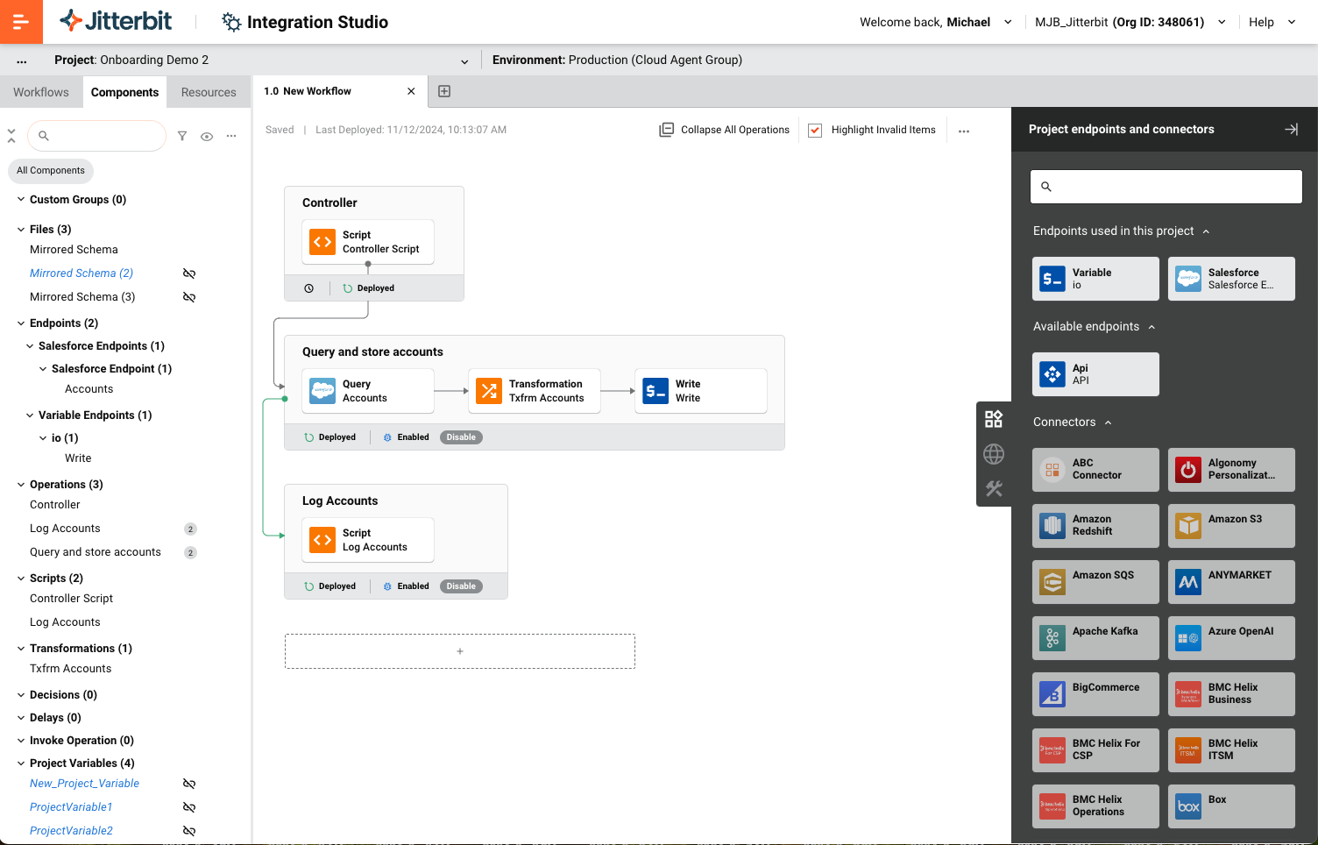
Accelerate automation with easy UI and pre-built integrations
Key Features
Modern graphical interface without complex coding requirements
Access hundreds of pre-built connectors, recipes and templates
Create and expose APIs in real-time from any integration using a simple interface with built-in security and governance
Multi-tenant message queuing service, fully integrated with the iPaaS platform
Benefits
An intuitive drag-and-drop interface to easily build and maintain integration workflows
Faster connectivity and workflow automation with pre-built and reusable integrations
Quickly deploy APIs in real-time via a unified platform for integration and API management
Notes:
The integration studio on Jitterbit iPaaS helps build and maintain integration workflows using an intuitive drag-and-drop interface. The platform provides the capability to process asynchronous messages with the built-in Message Queue Service. It also enables powerful data transformation logic with efficient mapping.

Slide 12
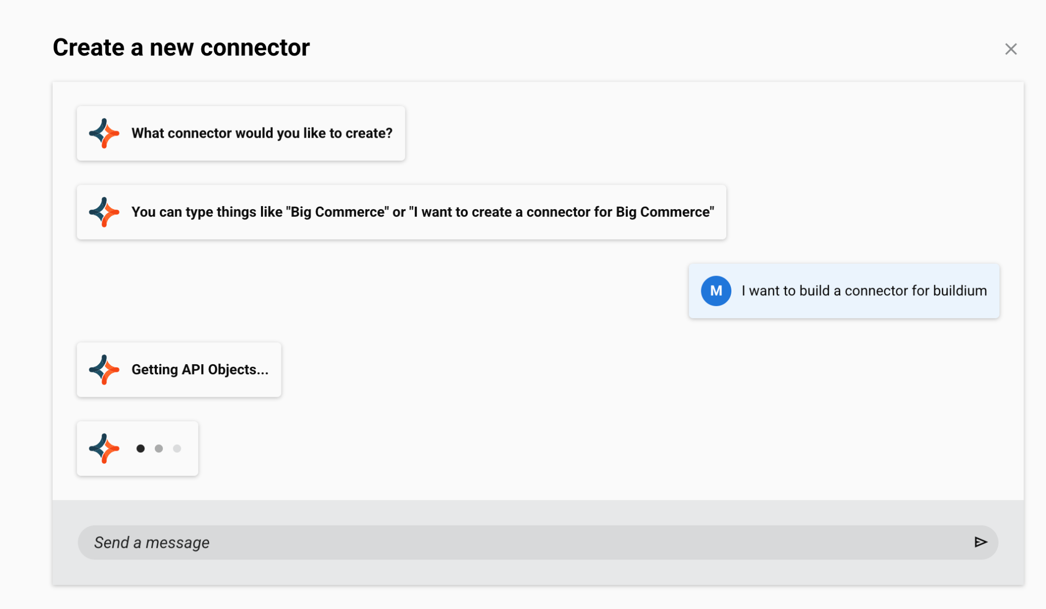
Deep-code to no-code connectivity to meet every requirement
Key Features
Create deep code-based connectivity with Connector SDK
Create custom REST-based connectors with a no-code interface with Connector Builder
Build a REST-based connector using natural language with Connector Builder AI Assistant
Benefits
Get full control and customization ability for complex integrations that can scale with evolving business needs
Reduce development time and allow non-technical users to set up integrations easily
Quickly create integrations with minimal setup and enable non-IT teams to build their integrations
Notes:
Meet every connectivity requirement with ease. Setup connectivity easily by building connectors with natural language with AI. Complex and custom integrations can be built easily using our drag and drop interface, saving you time and resources.

Slide 13
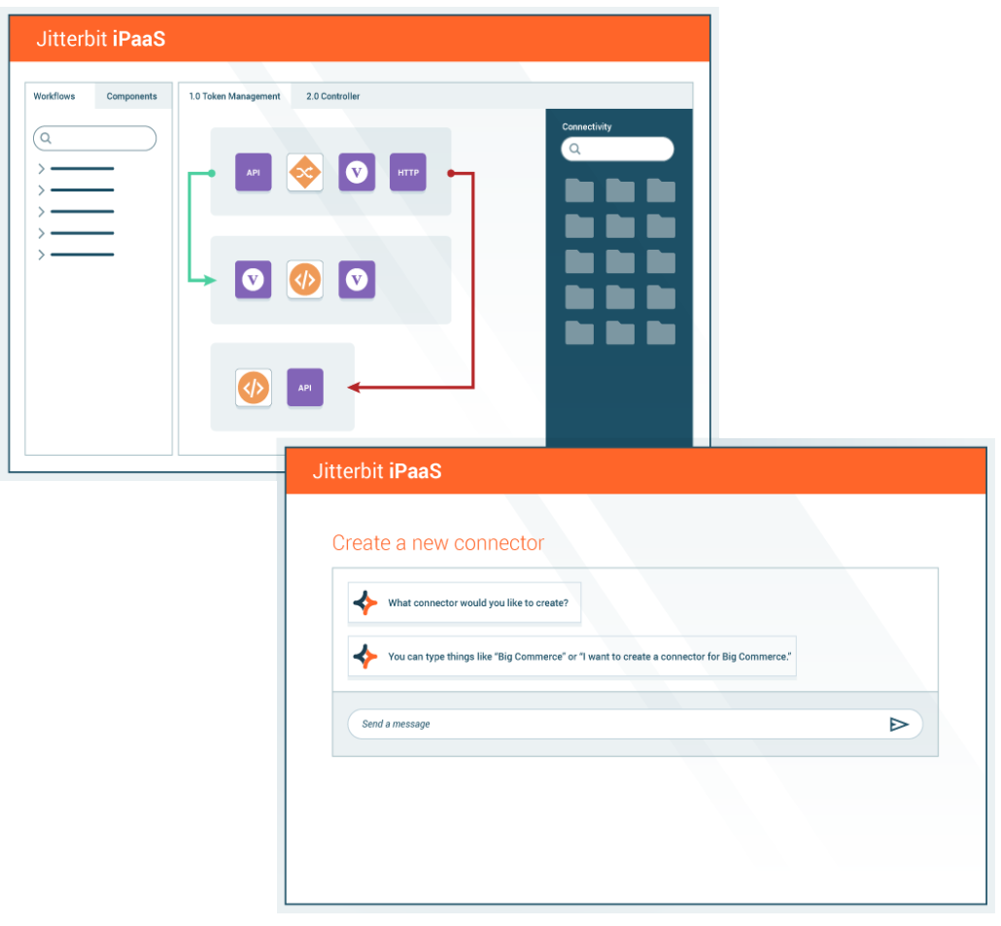
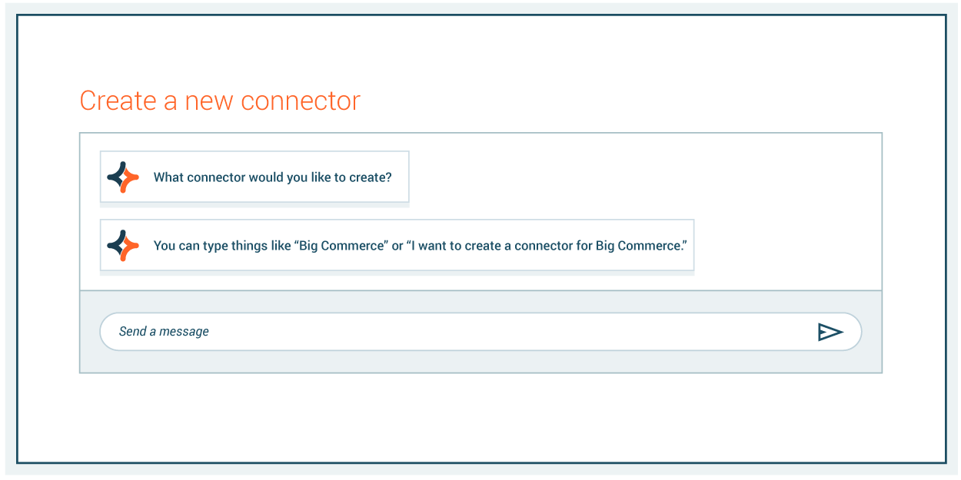
AI Assistant: Use natural language to build apps and connect systems
iPaaS AI Assistant
Create workflows & automate transformations effortlessly.
Build a connector
Map transformations
Create integrations

Slide 14
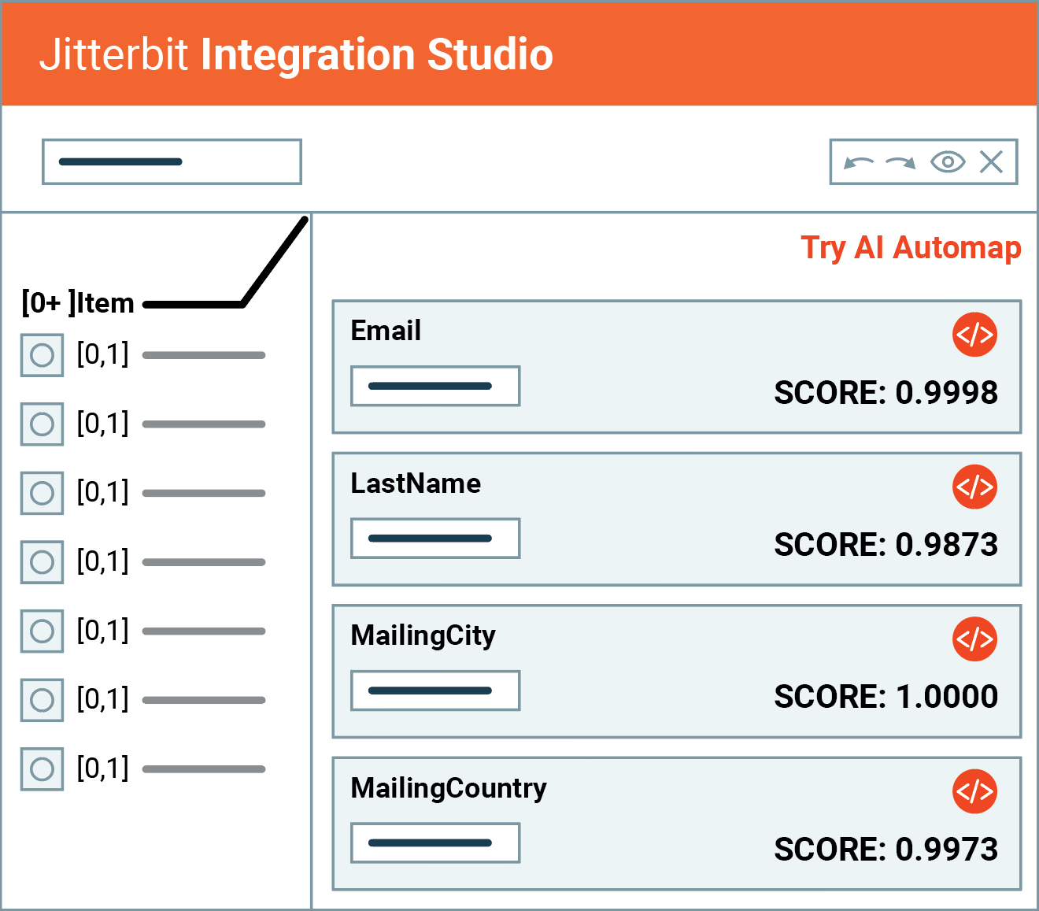
AI Assistant: Use natural language to map transformations
iPaaS AI Assistant
Create workflows & automate transformations effortlessly.
Build a connector
Map transformations
Create integrations

Slide 15
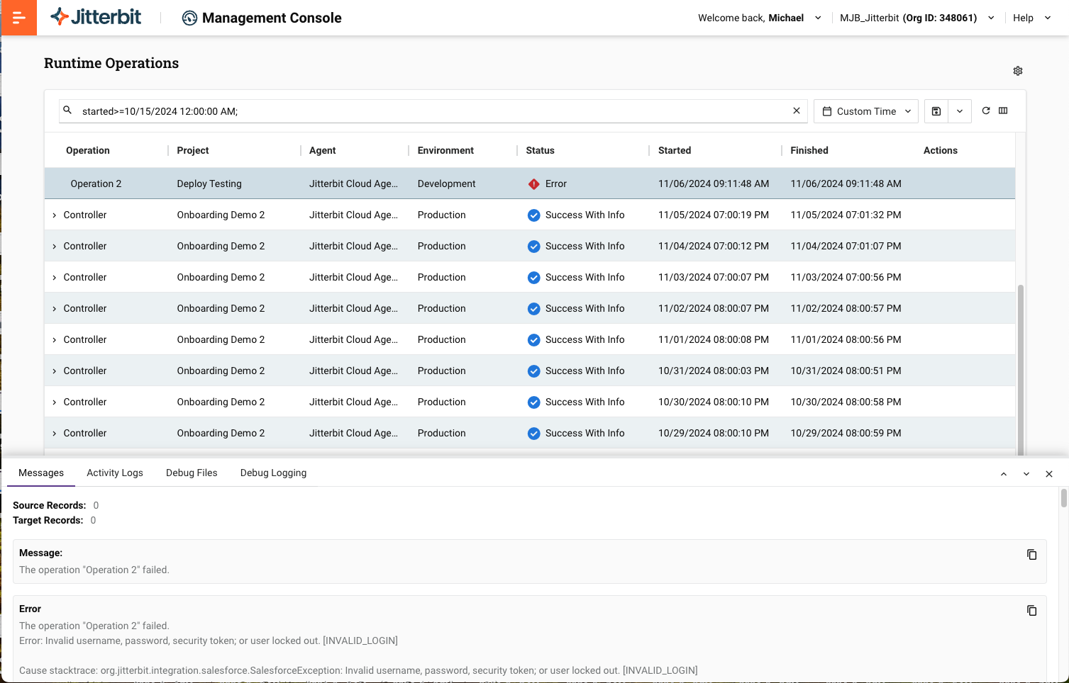
Manage through a single console and with reliable support and services
Key Features
Manage and monitor the integration projects for the entire organization through a single console
Use AI Chatbot to enrich and curate knowledge from internal systems
Award-winning customer service and support when and where it’s most critical
Benefits
Easily detect and diagnose the health of your integrations
Make natural language queries of Jitterbit docs and get precise and concise responses using a chatbot
Get tailored service and guidance from a team of experts to lighten the load on your IT department
Notes:
Monitor and manage the integration projects for the entire organization, online, from a single console. Maintain a clear view of your agents, environments and projects, setup real-time alerts and access a complete audit trail and view analytics to monitor the health of your integrations.

Slide 16
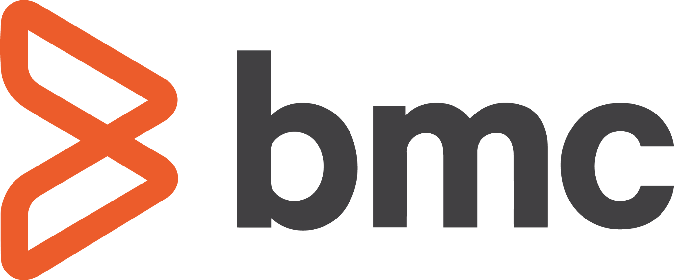
Use Case Examples
Systems
System Types
Business Processes
CRM
ERP
PLM
OMS
WMS
HRMS
ITSM
Databases
Files
and more…
Lead to Order
Order to Cash
Order to Fulfillment
Expense Mgmt
Hire to Retire
IT Service Mgmt
Procure to Pay
Asset Management
and more…
and more…
Notes:
Jitterbit iPaaS can build various types of integrations and automations across many systems such as Salesforce, NetSuite, SAP, etc., across any system type and for various business processes.

Slide 17
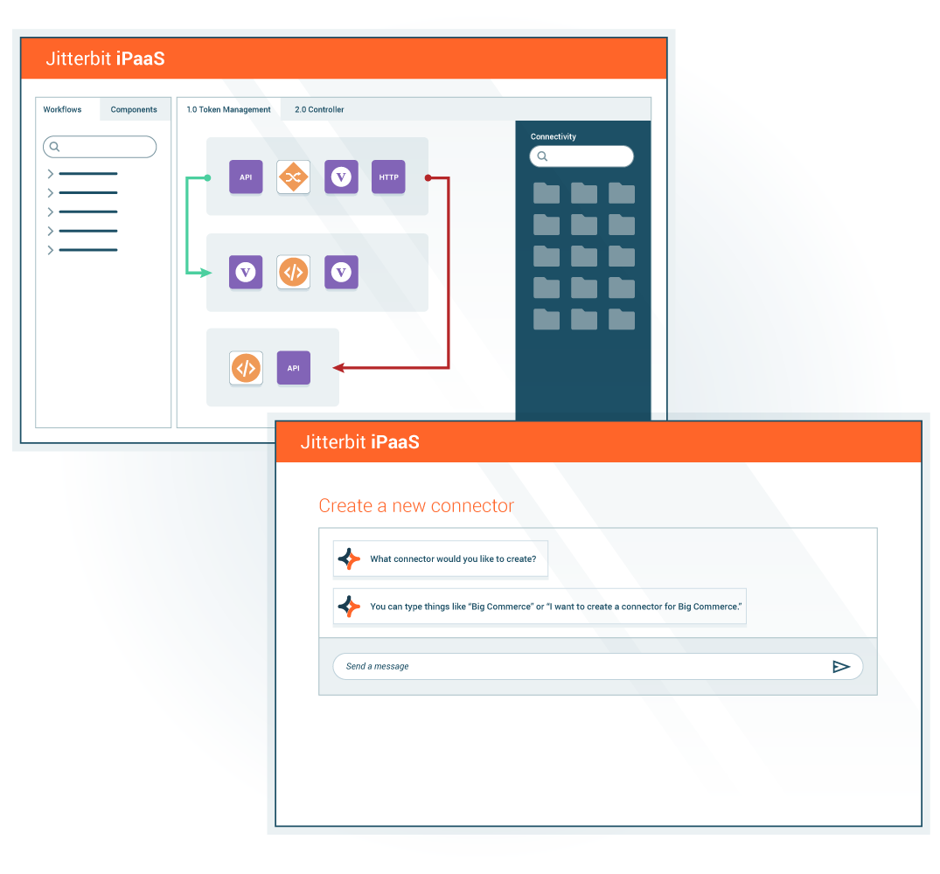
Integrate. Orchestrate. Automate.
Provide secure, scalable, cloud-native integration, enhancing operational efficiency through seamless connectivity across on-premises and cloud systems with over 250 connectors
Intuitive, low-code interface and AI-powered chatbots empower IT and business teams to accelerate deployment, reduce costs, automate processes, drive faster time-to-market, improve agility, and reduce technical barriers
Notes:
Accelerate digital transformation with an enterprise iPaaS that delivers secure, scalable, and AI-driven integrations, enabling seamless connectivity across your organization.
We start with integration and Jitterbit iPaaS. You can’t orchestrate or automate if you can’t integrate.
If you don’t have one of the 250 connectors, you can use SDK and soon with our AI-infused capabilities, customers can let AI build it for them.
Why is that important? You have to connect the 72% of systems and applications that aren’t integrated.
Values for integration - you can seamlessly work across it, drag and drop, go hybrid, AI, low-code. Whatever the customer needs.
Jitterbit delivers incredible time to value and future-proofs your business simultaneously.
Note: The corporate deck has an additional hidden slide for each product that aligns across the four differentiators. You may use these optional four slides as you see fit.

Slide 18
Proven benefits
10.5
1.8
99.99%
average months to ROI
average months to go-live
platform uptime and availability
400+
10 years
2024 CODiE Award
consecutively recognized in Gartner’s Magic Quadrant for iPaaS
pre-built integrations
best iPaaS
Source: G2, Gartner
Notes:
Source: 10.5 average months to ROI, 1.8 average months to go-live, 94% ease of doing business: G2

Slide 19
Integrate. Orchestrate. Automate.
Unified Platform
AI Infusion
Security First
Ease of Use
Faster Time to Value
Notes:
This is how the Jitterbit iPaaS aligns with the 5 differentiators of the Harmony platform
Unified Platform: Build, manage and maintain integrations that seamlessly work with APIM, App Builder and EDI.
AI Infusion: Use AI-powered assistants to build connectors. Map complex data with just one click leveraging AI-driven mapping.
Security First: Adhere to stringent standards, compliances and industry regulations. Prevent unauthorized access through customizable access controls and encryption of data in-transit and at-rest.
Ease of Use: Manage all your integration projects with drag-and-drop simplicity. Enable seamless integration across hybrid, cloud and on-premises applications.
Faster Time to Value: Quickly integrate diverse systems by enabling teams to collaboratively deploy and optimize workflows.

Slide 20
Thank You
First Lastname
Job Title Position
first.lastname@jitterbit.com
(877) 555-0987

Slide 21
iPaaS Appendix

Slide 22
Curvature
Technology
Challenge
Curvature needed to push data across systems in its quote to cash cycle quickly and efficiently to keep up with customer demand and meet internal SLAs. However, its legacy integration technology was outdated, unwieldy, and error-prone. That was coupled with a lack of visibility — they couldn’t see transactions and payloads quickly to diagnose issues. Simply keeping the system up and running required significant daily effort.
Solution
Curvature selected Jitterbit’s scalable iPaaS solution, Harmony, for its integration needs due to its balance of features and affordability. Within a tight two-month timeline, the Curvature successfully deployed Harmony to integrate critical business applications, including Salesforce and Oracle. By collaborating closely with Jitterbit, Curvature not only met the project deadline but also optimized several integrations, achieving enhanced scalability and automation beyond a simple system migration.
We have additional optimization efforts on the horizon – with Jitterbit, we can more seamlessly expand existing integrations and consider new ones.”
Kyle Anixter, Hardware IT Director, Curvature
Reduction in quote generation time
50%
Reduction in data processing errors
95%
Elimination of manual work/week
20 hours

Slide 23
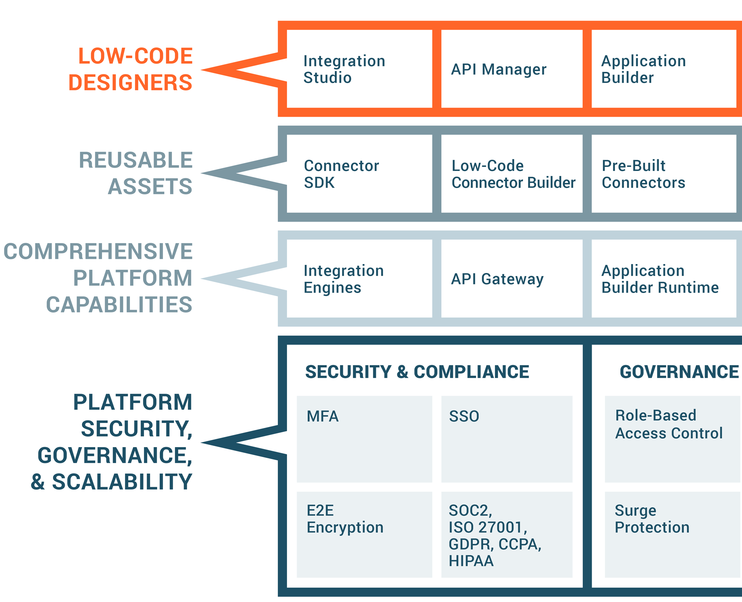
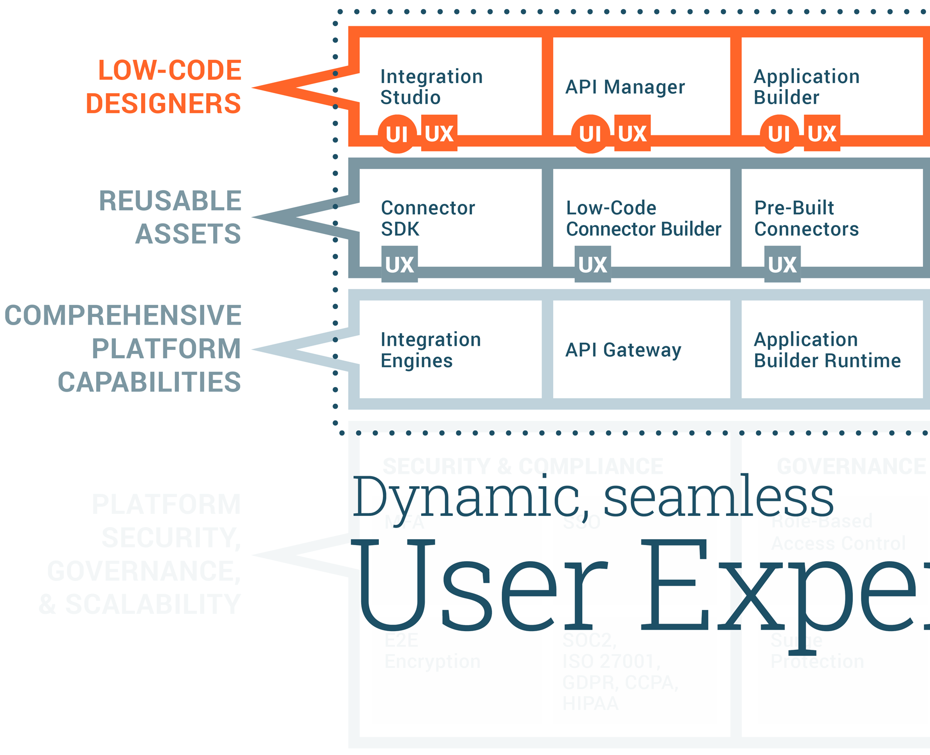
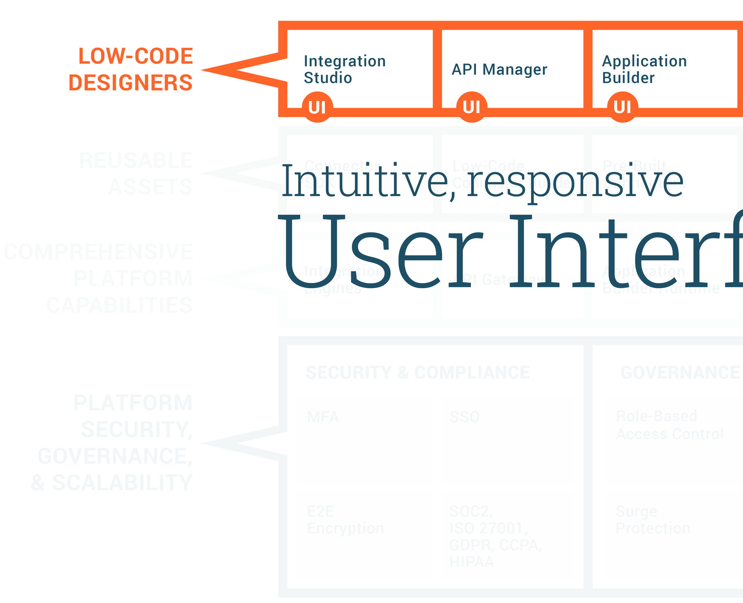
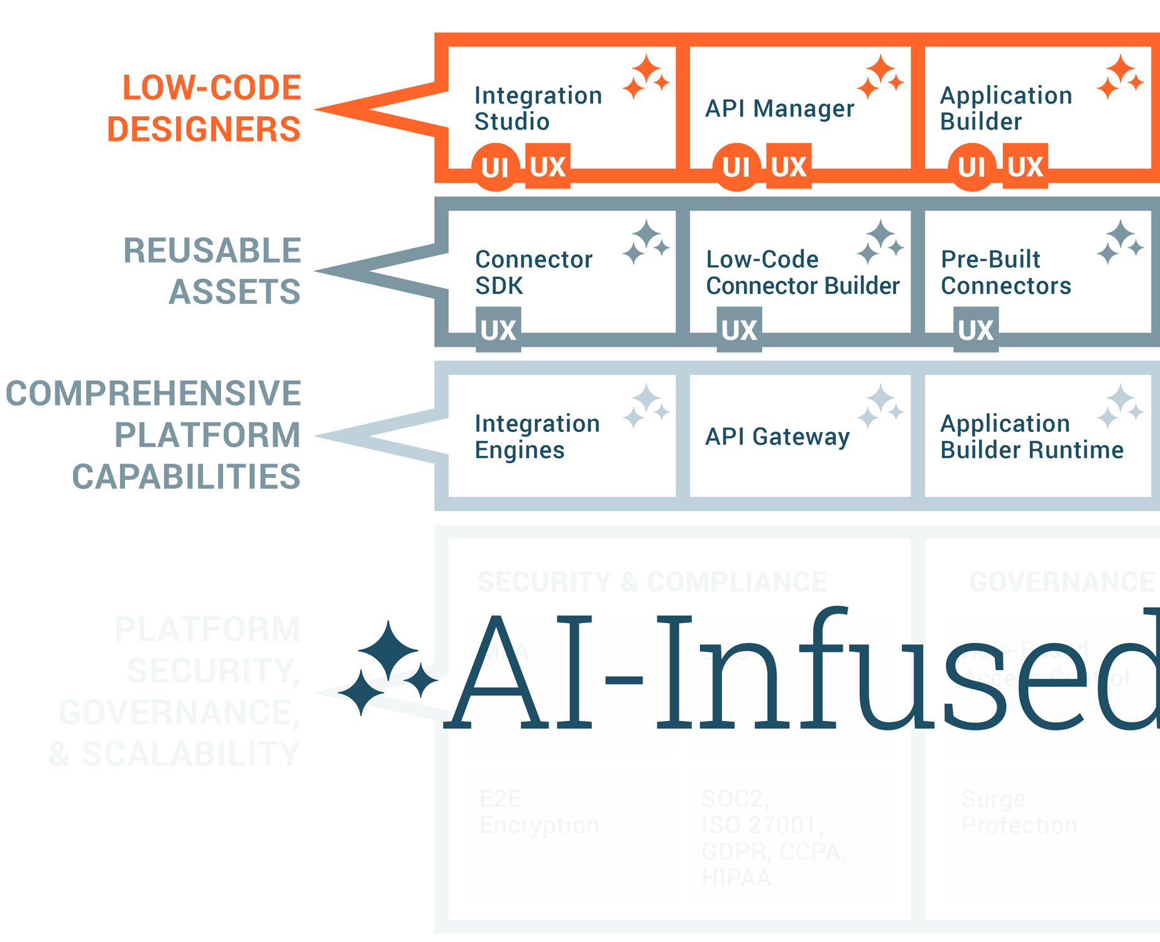
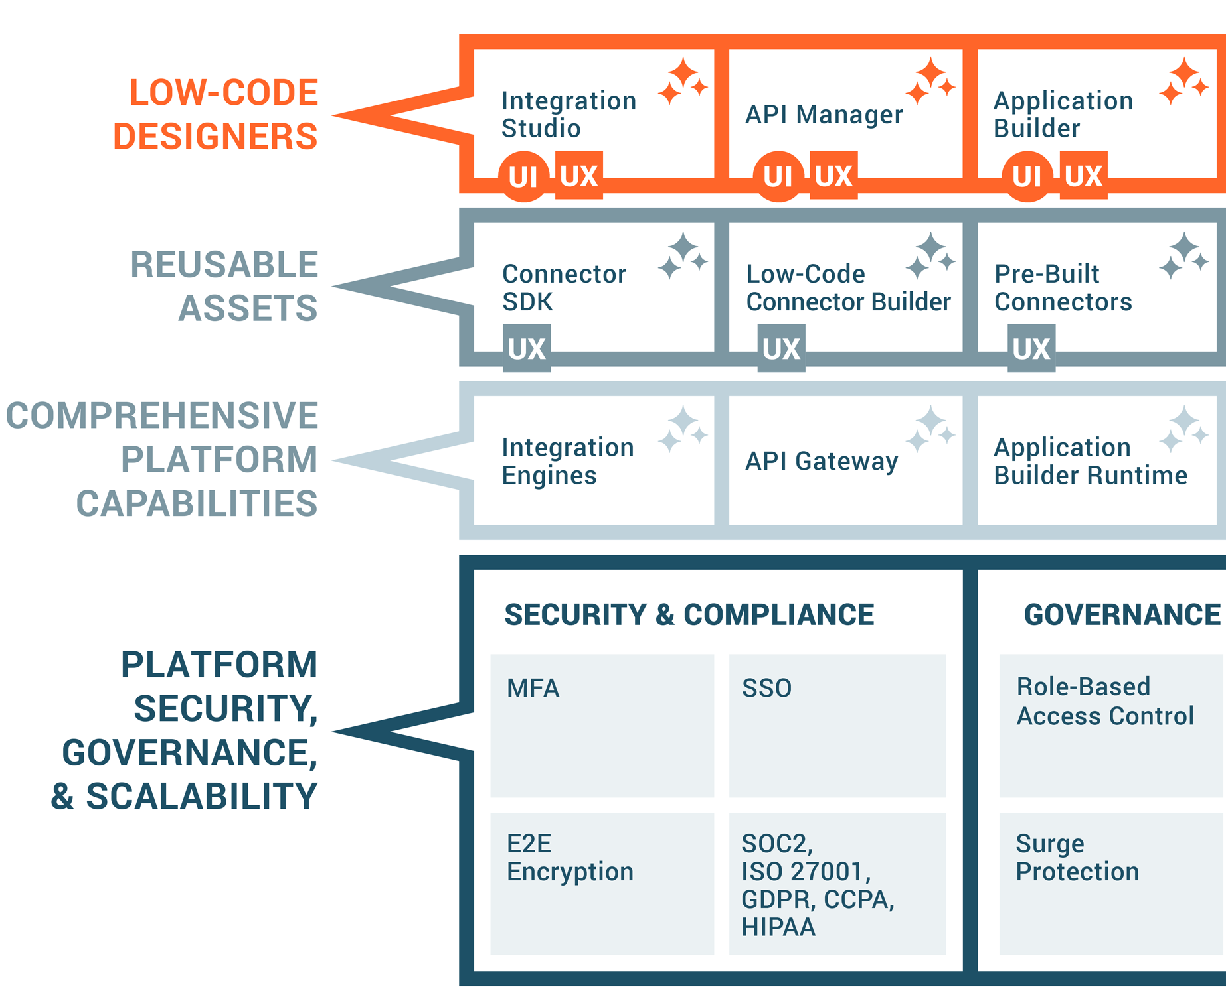
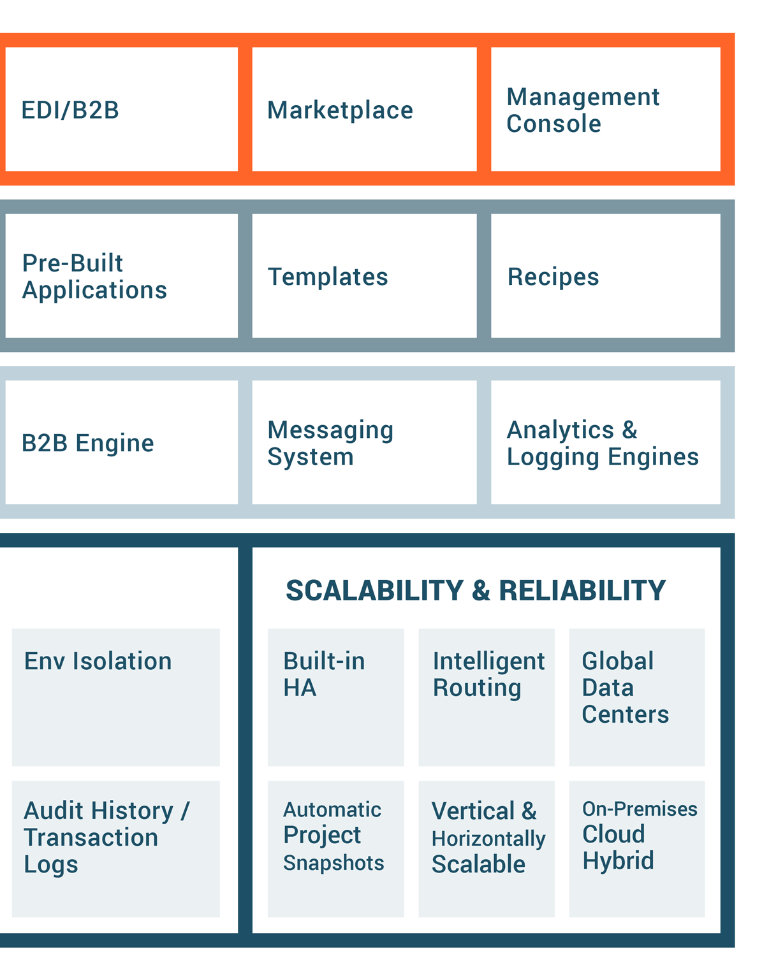
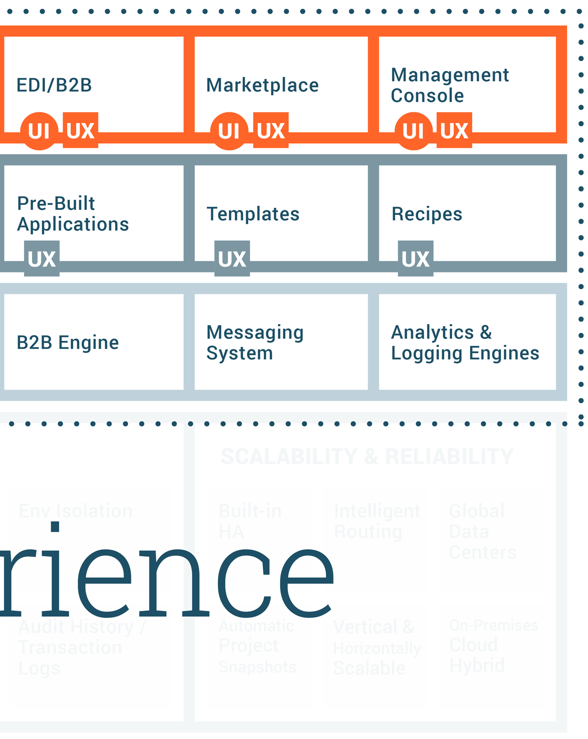
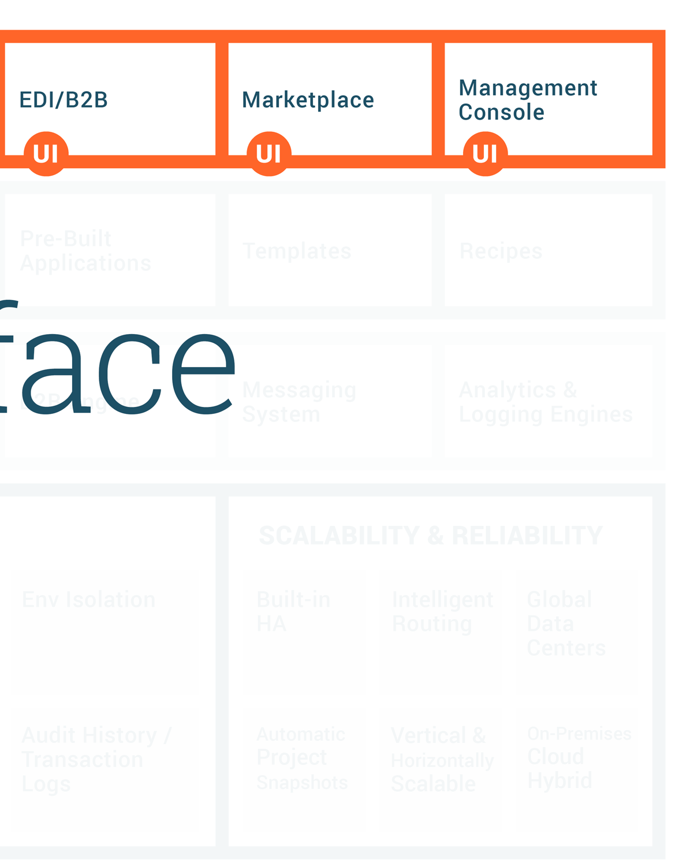
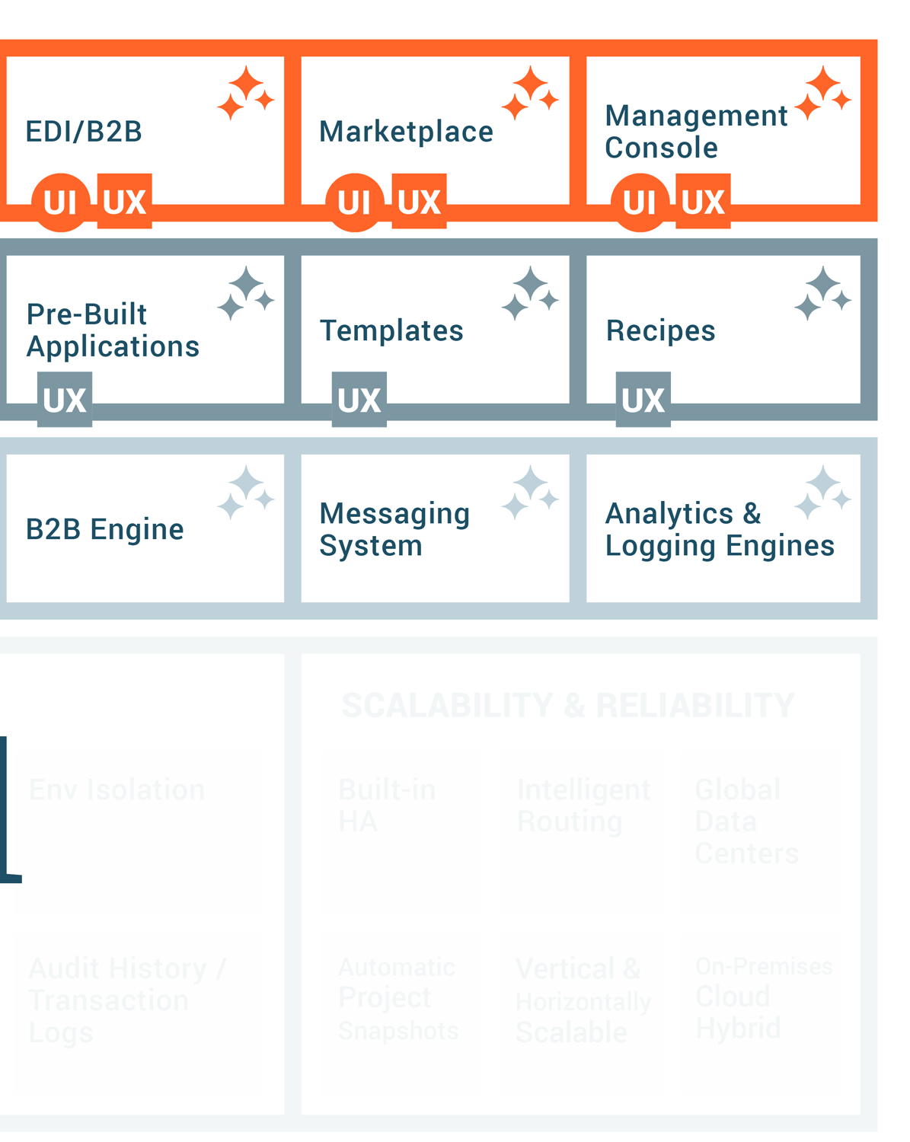
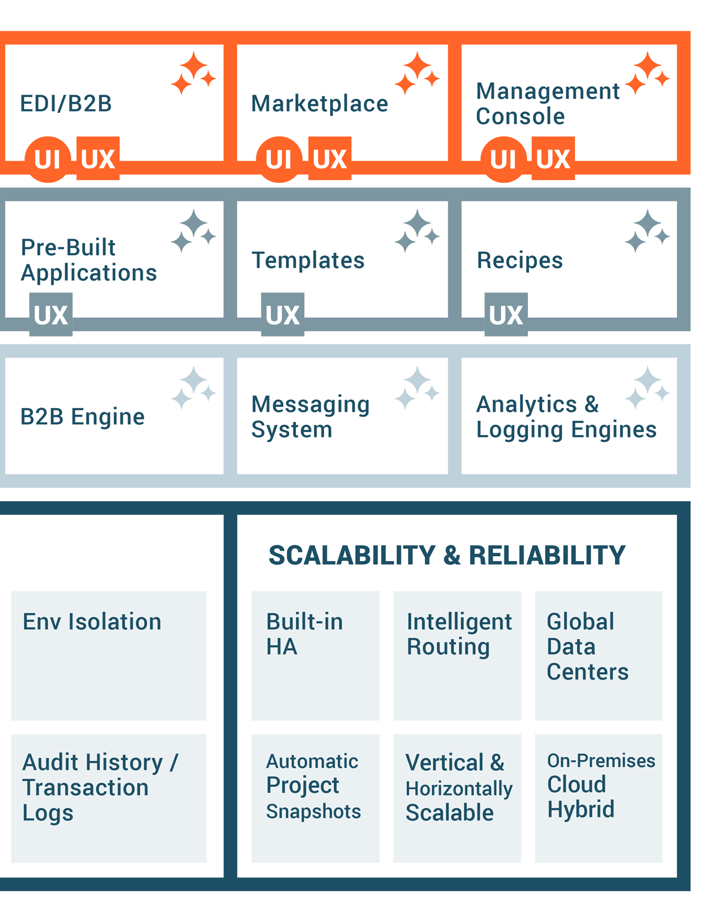
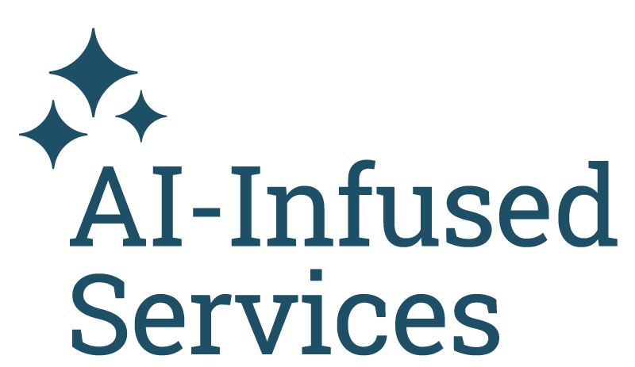
AI-infused low-code architecture
Notes:
Note: For a detailed breakdown of the this slide, please review Elevate Session 167: https://drive.google.com/drive/folders/1kNnTYXDj3bSmwwhth5Q0UZeJkRFa0oD9?usp=drive_link
Platform Capabilities
Low-Code Designers:
Across the top you have six boxes; they are the core UI components tied to the main products covered in the previous slide.
Our low-code designers are built using intuitive and responsive user interface principles, so we think of the user first, even though our audience is technical.
Note: the first box is labeled Integration Studio. It’s the new name for Cloud Studio. Integration Studio is more descriptive and relevant name than Cloud Studio
(Background: Cloud Studio made sense five years ago to distinguish it from our on-prem Design Studio; it’s a downloadable Java Integration Designer that many customers still use, and it's still very capable, but that made sense then when cloud interfaces were novelty.)
Reusable Assets:
Connectors SDK: Used by engineers and partners to build connectors. The connector SDK (software development kit), is used by our own engineers and our customers and partners like BMC to build connectors and make them available in the iPaaS Integration Studio. The SDK is targeted at more technical users.
Low-Code Connector Builder: Wizard-driven experience that any customer can use to create connectors with public REST APIs
Pre-Build Connectors & Applications: Jitterbit and our partners have built and made available today about 250 pre-built connectors, and that number continues to grow.
Recipes: Recipes are simple, unidirectional integrations between two endpoints, like syncing items from NetSuite to products like Salesforce. It's simple. It solves a simple integration use case that's easy for anyone to explain. Our Marketplace includes over 400 recipes and templates today.
Templates: Templates, on the other hand, are bi-directional integrations, so the syncing can go both ways that solve richer and more comprehensive use cases, like opportunity to order between a CRM like Salesforce and an ERP like NetSuite. They might include multiple projects within one template.
Platform Engines: This is where the actual work of running, monitoring and reporting — the integrations, applications, APIs, the B2B transactions — takes place as you would expect.
Integration engines: Run-time engines that run integrations in the cloud, on-premises, or hybrid environments. It’s the customers’ choice.
API Gateway: Manages API requests with options for cloud or on-premises deployment.
App Builder runtime: Manages run-time for thousands of applications customers using today. Entirely cloud-based.
B2B Engine: Handles EDI transactions, also cloud-based (no on-prem option)
Messaging System: Provides users with vital information, particularly if errors occur.
Analytics & Logging: Provides critical diagnostic information on usage and system performance, activity charts, etc.
AI-Infused Services:
AI-infused evolution started years ago.
Enhances ease of use and accelerates time to value.
Infuses AI capabilities into all core components like Integration Studio, API Manager, App Builder, and EDI.
Includes AI-powered assistants (currently in beta) for app and connector building, bringing conversational interfaces for fast and intuitive development.
AI Assistants:
App Builder AI Assistant: Build applications in minutes with a chatbot interface.
Connector Builder AI Assistant: Quickly create connectors for long-tail integrations.
Future AI capabilities: Ongoing development for all components, including real-time guidance through the JBAI chatbot.
Enterprise-Grade Security, Governance, and Scalability
Security and Compliance:
Multi-Factor Authentication (MFA) and Single Sign-On (SSO) for secure access.
End-to-end encryption ensures data security.
Compliance with standards like SOC 1/2, ISO 27001, GDPR, CCPA, and HIPAA.
Governance:
Role-based access control to manage user permissions.
Environment isolation ensures data protection in multi-tenant systems.
Audit history for detailed tracking, essential for industries like banking.
Scalability and Reliability:
High availability (HA) with redundancy and failover mechanisms.
Global data centers ensure consistent service with intelligent routing and load balancing.
Automatic backups and scalable infrastructure allow vertical and horizontal scaling.
Flexibility for deployment: Choose between cloud, on-premises, or hybrid models.

Slide 24
Jitterbit’s layered security foundation
Jitterbit manages the security of the Harmony platform by applying a hybrid framework based on NIST, CISA, CSA, and CERT recommendations.
LOGICAL SECURITY
MFA*
WAF*
Access Control
IDS & IPS
Secure Database
DDOS Monitoring & Mitigation*
FIPS 140-2 Auth
SSO
E2E Encryption
ORGANIZATIONAL SECURITY
Personnel Policy
Penetration Testing
OWASP Checks
Secure SDLC
FIPS 140-2 Auth
SSO
E2E Encryption
PHYSICAL SECURITY
Intrusion Detection*
Video Surveillance
Secure Cloud Redundancy
Biometric Controls
GLOBAL ACCREDITATION & COMPLIANCE
* Provided via AWS security controls.
Notes:
Jitterbit manages the security of the Harmony platform by applying a hybrid framework based on NIST, CISA, CSA, and CERT recommendations. This framework is categorized into three key layers.
Logical Security Logical security is comprised of all the security measures taken within the Harmony platform. These include the system architecture; major components; Harmony users, organizations, and roles; Harmony environments and access control; Harmony data storage; and Harmony security topologies.
Physical Security Physical security involves the hosting of Harmony on cloud infrastructure. This section describes infrastructure compliance; physical and environmental security; high availability and fault tolerance; network security; secure design principles; change management; load balancing security; data storage; and data durability and reliability.
Organizational Security Organizational security covers operational best practices of leading cloud-computing providers around the world. This includes confidentiality; the personnel policy; internal team-specific operating procedures and policies; reporting of system status; identity and access management; patch management and high availability; and capacity management.
In addition, Jitterbit develops and improves its applications by using sound software-development lifecycle (SDLC) practices, including, but not limited to, :
Identifying vulnerabilities from outside sources to drive change and code improvement.
Applying hardware and software patches. Jitterbit is responsible for code changes and Amazon Web Services (AWS) is responsible for providing hardware patches; our virtual environment allows us to apply code changes and hardware patches without any downtime.
Providing secure authentication and logging capabilities.
Ensuring that Personal Identifiable Information (PII) is not used in test environments.
Following secure coding practices according to an SDLC policy and addressing the security training needs for the development team.
Checking for security flaws as prescribed by the Open Web Application Security Project (OWASP), such as injection flaws, buffer overflows, cryptographic errors, error handling, etc.
Assessing for vulnerabilities on every release.
Conducting annual penetration testing.

Slide 25
Jitterbit Harmony: A unified AI, low-code platform
Empowering organizations to compose AI agents and automate business transformation
Knowledge Base Agent
Employee Agent
Sales Agent
Service Agent
Custom Agents
Third-Party Agents

Slide 26
Jitterbit API Manager
Simplifying API management for seamless integration

Slide 27
Instructions
The deck is an extension of the Corporate POV deck for conversations that require a deeper dive into Jitterbit APIM. It provides a high-level overview of Jitterbit API features, value props, and how it fits into the Harmony platform. What the deck covers:
A brief overview of the Harmony platform
Industry trends driving the need for this solution
Product overview
APIM personas/user profiles
Features & benefits
APIM flow diagram
APIM Use cases
Proof points
How to present it
Check out the talking points outlined in the Speaker Notes section of the deck. Use them as a guide to tailor your talk track to your audience and goals.
Add your photo and contact information to the last slide in the appropriate space.
The appendix slides include a customer case study, architecture slides, in-depth features tables, and more.
Questions? Reach out to productmarketing@jitterbit.com.
Notes:
add a description of each persona, what is important for each of them, and what role they play

Slide 28
AI-Infused Low-Code Integration, Orchestration, Automation & App Development
iPaaS
API Manager
App Builder
EDI
Marketplace
Management Console
Build, manage and maintain integrations
Create, control and consume your APIs
Build, manage and maintain web and mobile applications
Build, manage and monitor exchange of business documents
Get certified pre-built integrations
Manage, monitor and administer projects in one place
Notes:
Harmony is an AI-infused low code integration, orchestration, automation and app development platform.
iPaaS solution that's AI-infused, where you build and maintain the integrations for your entire environment. Orchestrate workflows that trigger real-time integrations based on external events.
API Manager allows you to create, control and consume that data in the information in those integrations - all in the same platform. Expose and manage APIs using API Manager for real-time integrations.
App Builder (previously known as Vinyl) helps build enterprise applications via low-code or AI-infused approaches. Those 72% of applications that aren't all written for web and mobile - that may need to be rewritten for the current day or new ones. Ideal for internal or customer-facing applications.
Then Jitterbit EDI. Now that you have your applications, you may want to turn to the B2B or commercial landscape. EDI connects you to the long-trusted integration standard. And we have more than 1,000 trading partners built in. And all off the same platform.
Supporting the four cornerstone products we have a Marketplace, where we have over 400 pre-built integrations for the most popular systems, services and use cases.
FInally, the Management Console where you can manage the entire Harmony platform seamlessly in a single console.

Slide 29
84%
of businesses say integrations are a “key requirement” for their customers (2024 State of Integrations Report)
70%
of apps are Disconnected from one another and the core business (Salesforce)
APIM empowers teams to design, secure, and deploy APIs, driving business agility
90%
of B2B buyers say integration with existing tech heavily influences vendor shortlisting (Inbox Insight)
85%
of workers expect AI to improve their jobs (Censuswide)
Notes:
https://www.partnerfleet.io/blog/valuable-integration-statistics-to-know
https://www.salesforce.com/uk/news/stories/connectivity-report-2023/
https://www.inboxinsight.com/b2b-tech-buyer-behavior-stats/
https://www.jitterbit.com/press-release/ai-unleashing-new-skills-and-opportunities-for-office-workers/

Slide 30
Jitterbit API Manager - Product Overview
What is it?
A cloud-based API management solution
Fully integrated into Jitterbit iPaaS
An extended service offering on top of Jitterbit iPaaS subscription
What are the components of API Manager?
API Builder and Publisher
API Logs and Analytics
API Gateway
API Portal
Enables efficient creation and publishing of APIs
Provides monitoring and insights into API performance and usage
Manages and remediates API calls for secure and reliable access
Enables consumers to discover and access available APIs

Slide 31
Supporting User Profiles
Integration Specialists
Expose integrations as APIs
Citizen Integrators
Empower users with AI to create and publish APIs
IT Administrators
Provides flexibility to administer and secure APIs with ease
Notes:
add a description of each persona, what is important for each of them, and what role they play

Slide 32
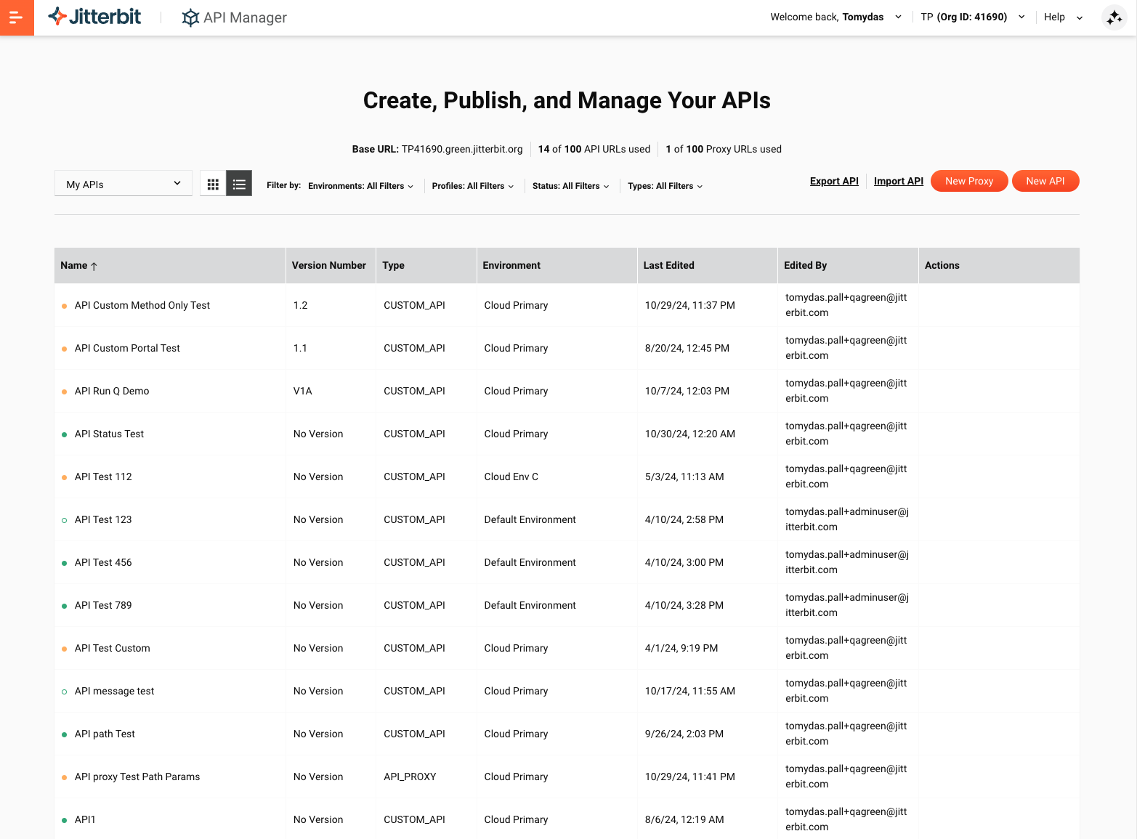
Streamline API Creation & Real-Time Integration
Key Features
My APIs - Provide a centralized page to create, import and maintain APIs
Publish as an API - Enable Integration Studio users to easily publish an operation as an API in a few clicks
Portal Manager - Auto-generate and customize OpenAPI documentation, and interactively test APIs within the same page
Benefits
Simplify Workflow API Creation - Easily design and build iPaaS workflows as APIs for seamless connections
Supercharge Automation - Expose integrations and workflows as APIs to drive real-time automation and deliver operational efficiency
Facilitate Real-time Integration - Ensure accurate and timely data exchange across systems for optimized operations
Notes:
Simplified API Creation from iPaaS: Easily design and build iPaaS integrations and workflows as APIs for seamless connections.
Automation Through API-Exposed Workflows: Enable automation by securely and effortlessly exposing integrations and workflows as APIs, driving operational efficiency.
Real-Time Integration with APIs: Facilitate real-time integration by leveraging APIs, ensuring timely data exchange and system connectivity.
real time integration and automation 1st three of kunals
control
Security

Slide 33
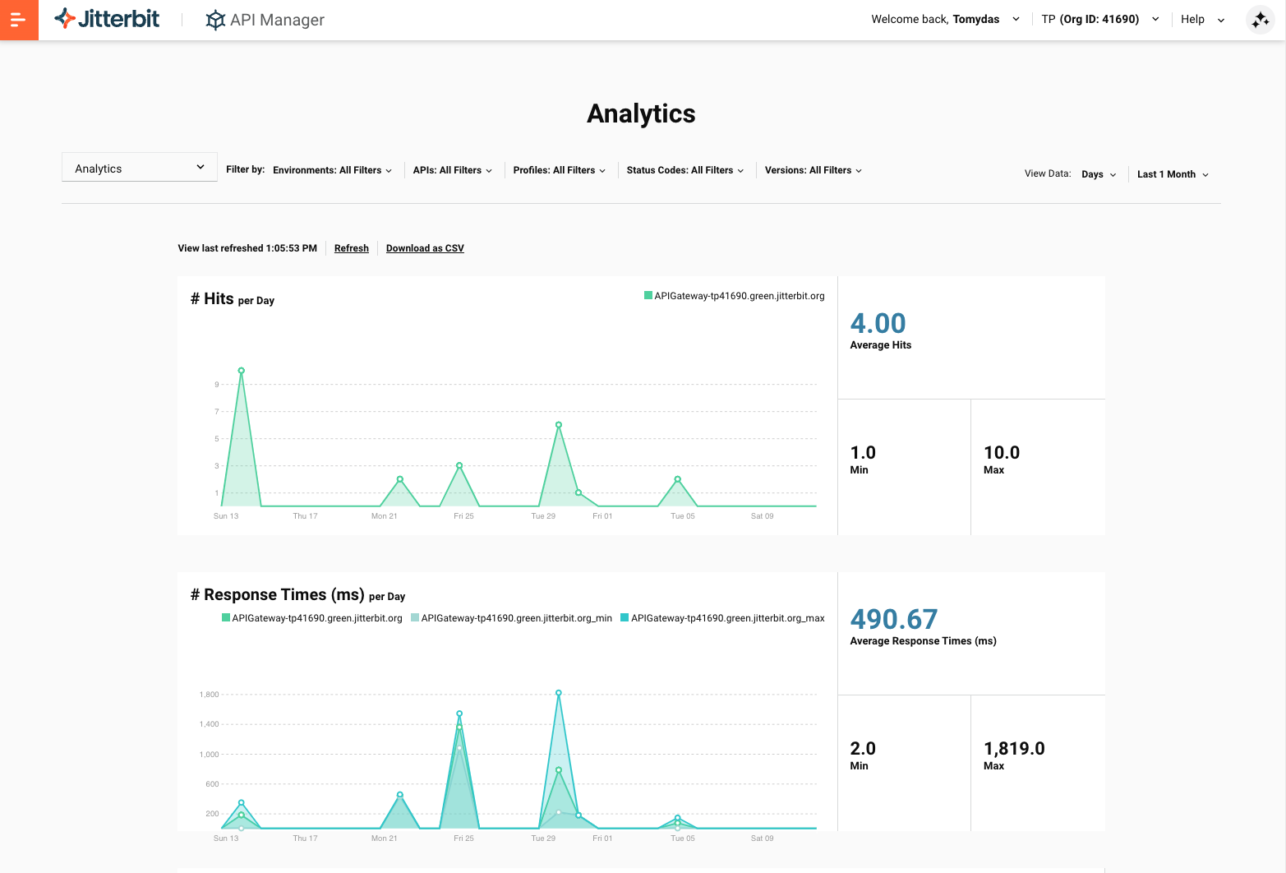
API Management and Real-Time Monitoring
Key Features
API Logs - Access detailed records of API calls, including time, IP addresses, and access data
Analytics - Access metrics on API usage and performance, for monitoring and analysis
API Manager - Monitor the health and status of APIs in a simple UI
Benefits
Real-Time API Performance Monitoring - Gain actionable insights to improve API performance and scalability.
Issue Identification and Troubleshooting - Ensure uninterrupted API operations through comprehensive logging
Manage the complete API lifecycle - Robust security controls and comprehensive user authentication from any device

Slide 34
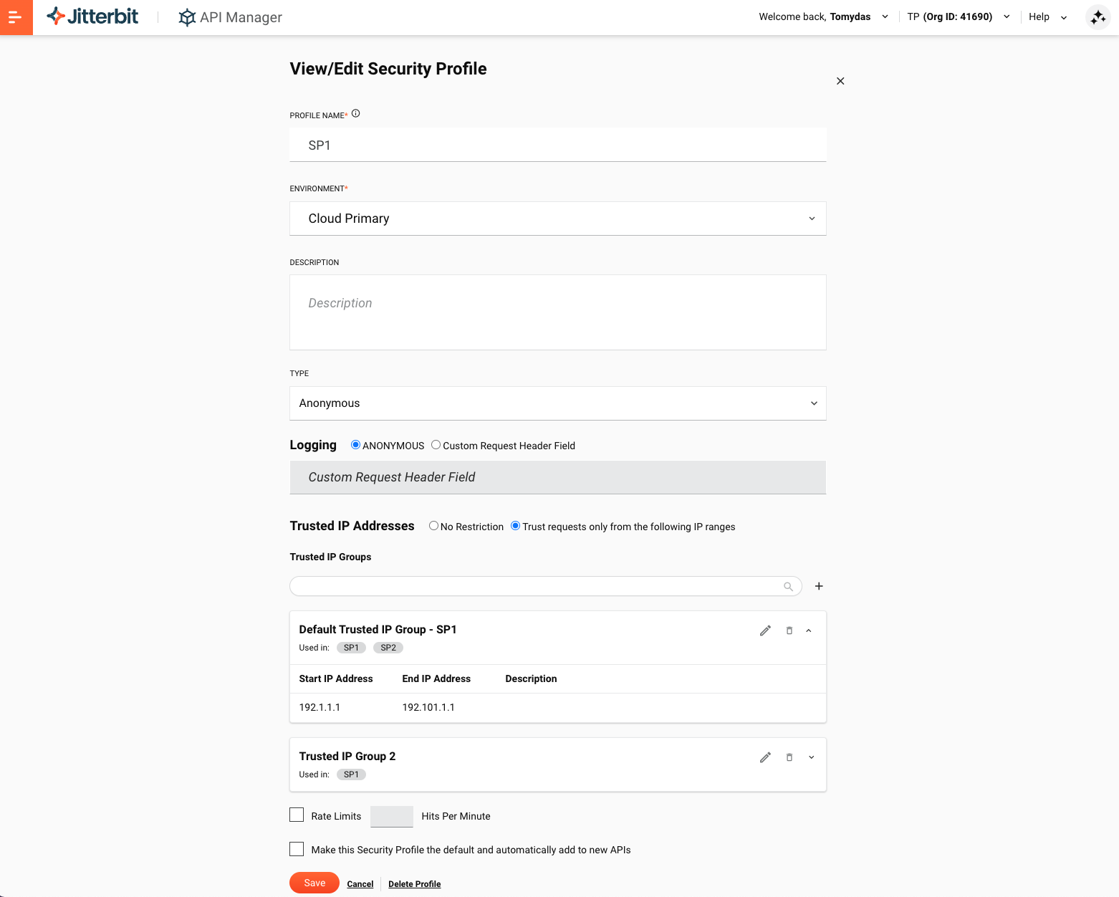
Comprehensive API Security and Risk Management
Key Features
Security Profiles - Enable administrators to manage security policies for API access based on schemes and profiles
Trusted IP Groups - Enable administrators to enforce IP level access control to the APIs
Private API Gateway - Leverage tools to deploy, test, administer security, and manage traffic of Private API Gateway
Benefits
Enhance API Access Control - Minimize the risk of unauthorized access and protect sensitive data
Secure Data Transmission - Safeguard internal and external communication channels from potential security breaches
Risk Management and Monitoring - Identify vulnerabilities and respond swiftly to security incidents, ensuring secure and compliant APIs

Slide 35
Jitterbit APIM a fully integrated API Management solution
APIM
iPaaS
APIs
Integration/Design Studio
Projects
Security Profiles
3rd party APIs
Operations
API Logs
Operation Logs
Analytics
EDI Connector
Jitterbit EDI
Portal Manager
Connectors
API Consumers
API Portal
App Builder

Slide 36
Jitterbit API Manager Customer Use Cases
Internal Collaboration and Data Sharing
Unified Solutions
Partner Integration
API-as-a-Service
Secure Public Access to Internal Data
Streamline data sharing across teams by exposing internal processes as APIs enhancing departmental collaboration, e.g., e-commerce and inventory management.
Create composite APIs to combine data from multiple sources, creating innovative solutions like optimized commuter routes that merge real-time traffic and transit information.
Securely integrate with partners, enabling seamless data exchange and enhanced partner services, such as social media data access for third-party apps.
APIs as services, implementing usage-based pricing models for data access, such as offering real-time stock market data to subscribed developers.
Create public APIs to expand access to data and services, allowing external developers to leverage resources like weather data in their applications.

Slide 37
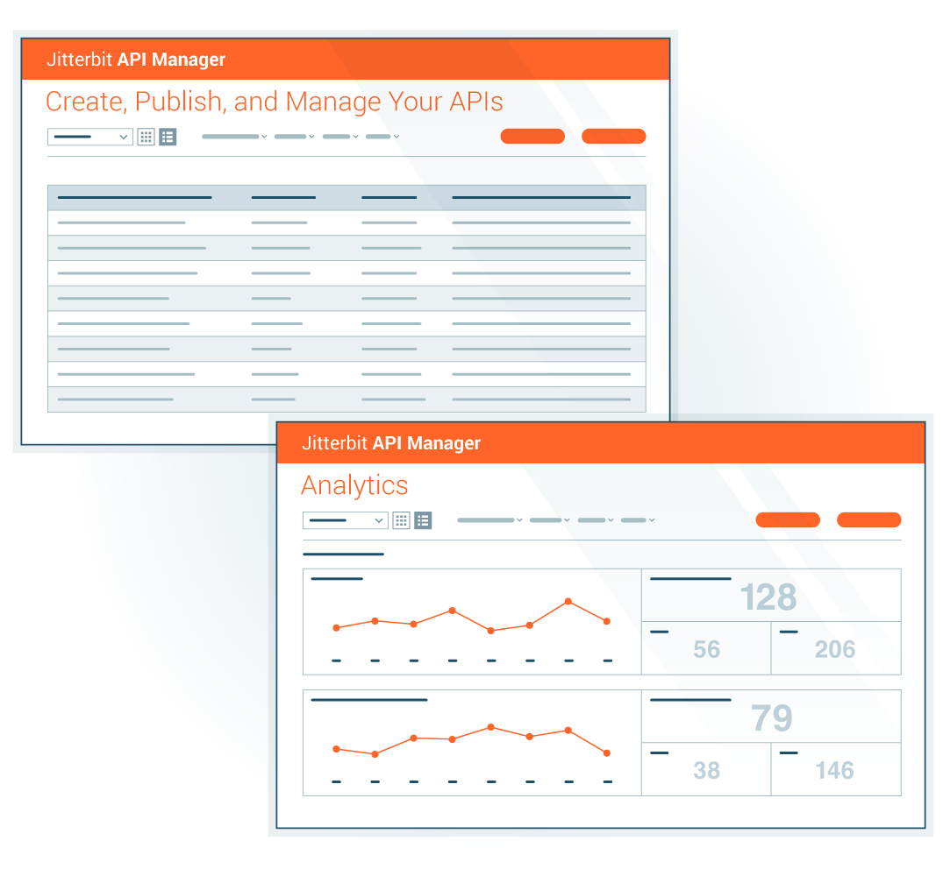
Enable real-time operations
Quickly expose integrations as APIs with an easy-to-use wizard
Accelerate digital transformation by streamlining API creation, control and consumption
Empower IT and business users to rapidly build, secure, and manage APIs from iPaaS integrations, driving real-time workflow automation
A centralized approach offers comprehensive control, visibility, and security over API lifecycle management, fostering innovation and agility
Notes:
Empower real-time workflows with an API manager that delivers comprehensive control, visibility, and security over the entire API lifecycle.
Now that you’ve got your systems integrated, you can use API Manager to expose the APIs easily and quickly.
That’s what APIM allows you to do in an automated way.
Sold almost exclusively to iPaaS customers; tight integration with iPaaS
It’s the next step to workflow automation and true digital transformation. Faster with APIs and easier to do (we have the awards and use cases to prove it). Time to value.
It’s future proof - you don’t have to purchase something else. Just turn it on. Click the build. It helps you scale your business.

Slide 38
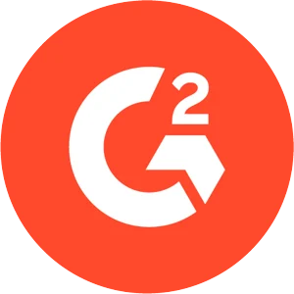
Awards and industry recognition
10 consecutive years recognized in Gartner’s Magic Quadrant for iPaaS
4.6 out of 5 stars
2024 SIIA CODiE Award winner in the iPaaS category for a second year in a row
31 ‘Leader’ and ‘High Performer’ badges in 2024 G2 Fall report
Notes:
We have the accolades, too
With Gartner, 10 consecutive years in the top right or visionary quadrant. This is invite-only. Jitterbit is a respected name in this space.
The Harmony platform takes us to that next level.
Great reports on G2 … 4.6 out of 5 Stars
Won two consecutive CODiE awards for iPaaS.

Slide 39
Enable real-time operations
Unified Platform
AI Infusion
Security First
Ease of Use
Faster Time to Value
Notes:
Simplify B2B/EDI workflows
Unified Platform: Use APIs in applications built with our App Builder or within your existing systems.
AI Infusion: Generative AI-powered assistant accelerates development, management and maintenance.
Security First: Adhere to stringent standards, compliances and industry regulations. Prevent unauthorized access through customizable access controls and encryption of data in-transit and at-rest
Ease of Use: Create APIs from any integration using a simple, intuitive interface with built-in security and governance.
Faster Time to Value: Quickly transform iPaaS integrations into reusable APIs. Empower both IT and business users to build APIs with zero coding.

Slide 40
Thank You
Tomydas Pall
Product Manager
tomydas.pall@jitterbit.com
(877) 555-0987

Slide 41
API Manager Appendix

Slide 42
Jitterbit
Retail
Challenge Jitterbit continues to grow and expand its offering and operations. With that growthy, Jitterbit faced a complex series of connectivity projects, including the integration of its Salesforce CRM system with its NetSuite ERP application and the onboarding of business data from its recent expansion in the Asia Pacific (APAC) region. To perform the integration and smoothly incorporate the acquisition data, the company employed its own proven technology.
Solution By building integrations for its key business systems, Jitterbit transformed time-consuming tasks that previously involved significant manual effort.The newly integrated systems and automated workflows provide immense time savings for Jitterbit team members. Streamlining processes and automatically syncing order data between CRM and ERP systems, Jitterbit was able to cut time spent creating orders and invoices in half. Greater overall efficiency allows Jitterbit to do more with less, keeping its teams lean even as its business grows and thrives.
Outcomes
Automated core sales and accounting workflows
Increased forecasting accuracy and reporting globally
Onboarded new acquisitions quickly and efficiently
“By streamlining processes and automatically syncing order data between our CRM and ERP systems, we cut the time to create orders and invoices in half.”
Notes:
Jitterbit’s Internal Transformation with Its Own Technology
Accelerating Core Workflows & Enhancing Data Visibility
Streamlined sales and accounting operations through integration.
Enabled seamless onboarding of acquisition data.
Improved real-time data visibility across global operations.
Challenge: Growing Business, Increasing Integration Needs
Jitterbit needed to integrate CRM (Salesforce) with ERP (NetSuite).
Business expansion in APAC required data migration.
Manual processes slowed order management and decision-making.
Solution: Leveraging Jitterbit’s Own Platform
Reengineered order management workflows for automation.
Integrated Salesforce and NetSuite to eliminate manual data entry.
Automated syncing of customer, order, and financial data.
Benefits: Efficiency, Scalability, and Growth
50% time reduction in creating orders and invoices.
Lean operations—without integration, backend support needs would double.
Standardized processes for easier onboarding post-acquisition.
Future Outlook: Expanding Data Capabilities
Plans to integrate data into a warehouse for advanced analytics.
Continued use of Jitterbit technology to scale operations seamlessly.

Slide 43
AI-infused low-code architecture
Notes:
Note: For a detailed breakdown of the this slide, please review Elevate Session 167: https://drive.google.com/drive/folders/1kNnTYXDj3bSmwwhth5Q0UZeJkRFa0oD9?usp=drive_link
Platform Capabilities
Low-Code Designers:
Across the top you have six boxes; they are the core UI components tied to the main products covered in the previous slide.
Our low-code designers are built using intuitive and responsive user interface principles, so we think of the user first, even though our audience is technical.
Note: the first box is labeled Integration Studio. It’s the new name for Cloud Studio. Integration Studio is more descriptive and relevant name than Cloud Studio
(Background: Cloud Studio made sense five years ago to distinguish it from our on-prem Design Studio; it’s a downloadable Java Integration Designer that many customers still use, and it's still very capable, but that made sense then when cloud interfaces were novelty.)
Reusable Assets:
Connectors SDK: Used by engineers and partners to build connectors. The connector SDK (software development kit), is used by our own engineers and our customers and partners like BMC to build connectors and make them available in the iPaaS Integration Studio. The SDK is targeted at more technical users.
Low-Code Connector Builder: Wizard-driven experience that any customer can use to create connectors with public REST APIs
Pre-Build Connectors & Applications: Jitterbit and our partners have built and made available today about 250 pre-built connectors, and that number continues to grow.
Recipes: Recipes are simple, unidirectional integrations between two endpoints, like syncing items from NetSuite to products like Salesforce. It's simple. It solves a simple integration use case that's easy for anyone to explain. Our Marketplace includes over 400 recipes and templates today.
Templates: Templates, on the other hand, are bi-directional integrations, so the syncing can go both ways that solve richer and more comprehensive use cases, like opportunity to order between a CRM like Salesforce and an ERP like NetSuite. They might include multiple projects within one template.
Platform Engines: This is where the actual work of running, monitoring and reporting — the integrations, applications, APIs, the B2B transactions — takes place as you would expect.
Integration engines: Run-time engines that run integrations in the cloud, on-premises, or hybrid environments. It’s the customers’ choice.
API Gateway: Manages API requests with options for cloud or on-premises deployment.
App Builder runtime: Manages run-time for thousands of applications customers using today. Entirely cloud-based.
B2B Engine: Handles EDI transactions, also cloud-based (no on-prem option)
Messaging System: Provides users with vital information, particularly if errors occur.
Analytics & Logging: Provides critical diagnostic information on usage and system performance, activity charts, etc.
AI-Infused Services:
AI-infused evolution started years ago.
Enhances ease of use and accelerates time to value.
Infuses AI capabilities into all core components like Integration Studio, API Manager, App Builder, and EDI.
Includes AI-powered assistants (currently in beta) for app and connector building, bringing conversational interfaces for fast and intuitive development.
AI Assistants:
App Builder AI Assistant: Build applications in minutes with a chatbot interface.
Connector Builder AI Assistant: Quickly create connectors for long-tail integrations.
Future AI capabilities: Ongoing development for all components, including real-time guidance through the JBAI chatbot.
Enterprise-Grade Security, Governance, and Scalability
Security and Compliance:
Multi-Factor Authentication (MFA) and Single Sign-On (SSO) for secure access.
End-to-end encryption ensures data security.
Compliance with standards like SOC 1/2, ISO 27001, GDPR, CCPA, and HIPAA.
Governance:
Role-based access control to manage user permissions.
Environment isolation ensures data protection in multi-tenant systems.
Audit history for detailed tracking, essential for industries like banking.
Scalability and Reliability:
High availability (HA) with redundancy and failover mechanisms.
Global data centers ensure consistent service with intelligent routing and load balancing.
Automatic backups and scalable infrastructure allow vertical and horizontal scaling.
Flexibility for deployment: Choose between cloud, on-premises, or hybrid models.

Slide 44
Jitterbit’s layered security foundation
Jitterbit manages the security of the Harmony platform by applying a hybrid framework based on NIST, CISA, CSA, and CERT recommendations.
LOGICAL SECURITY
MFA*
WAF*
Access Control
IDS & IPS
Secure Database
DDOS Monitoring & Mitigation*
FIPS 140-2 Auth
SSO
E2E Encryption
ORGANIZATIONAL SECURITY
Personnel Policy
Penetration Testing
OWASP Checks
Secure SDLC
FIPS 140-2 Auth
SSO
E2E Encryption
PHYSICAL SECURITY
Intrusion Detection*
Video Surveillance
Secure Cloud Redundancy
Biometric Controls
GLOBAL ACCREDITATION & COMPLIANCE
* Provided via AWS security controls.
Notes:
Jitterbit manages the security of the Harmony platform by applying a hybrid framework based on NIST, CISA, CSA, and CERT recommendations. This framework is categorized into three key layers.
Logical Security Logical security is comprised of all the security measures taken within the Harmony platform. These include the system architecture; major components; Harmony users, organizations, and roles; Harmony environments and access control; Harmony data storage; and Harmony security topologies.
Physical Security Physical security involves the hosting of Harmony on cloud infrastructure. This section describes infrastructure compliance; physical and environmental security; high availability and fault tolerance; network security; secure design principles; change management; load balancing security; data storage; and data durability and reliability.
Organizational Security Organizational security covers operational best practices of leading cloud-computing providers around the world. This includes confidentiality; the personnel policy; internal team-specific operating procedures and policies; reporting of system status; identity and access management; patch management and high availability; and capacity management.
In addition, Jitterbit develops and improves its applications by using sound software-development lifecycle (SDLC) practices, including, but not limited to, :
Identifying vulnerabilities from outside sources to drive change and code improvement.
Applying hardware and software patches. Jitterbit is responsible for code changes and Amazon Web Services (AWS) is responsible for providing hardware patches; our virtual environment allows us to apply code changes and hardware patches without any downtime.
Providing secure authentication and logging capabilities.
Ensuring that Personal Identifiable Information (PII) is not used in test environments.
Following secure coding practices according to an SDLC policy and addressing the security training needs for the development team.
Checking for security flaws as prescribed by the Open Web Application Security Project (OWASP), such as injection flaws, buffer overflows, cryptographic errors, error handling, etc.
Assessing for vulnerabilities on every release.
Conducting annual penetration testing.

Slide 45
Jitterbit Harmony: A unified AI, low-code platform
Empowering organizations to compose AI agents and automate business transformation
Knowledge Base Agent
Employee Agent
Sales Agent
Service Agent
Custom Agents
Third-Party Agents

Slide 46
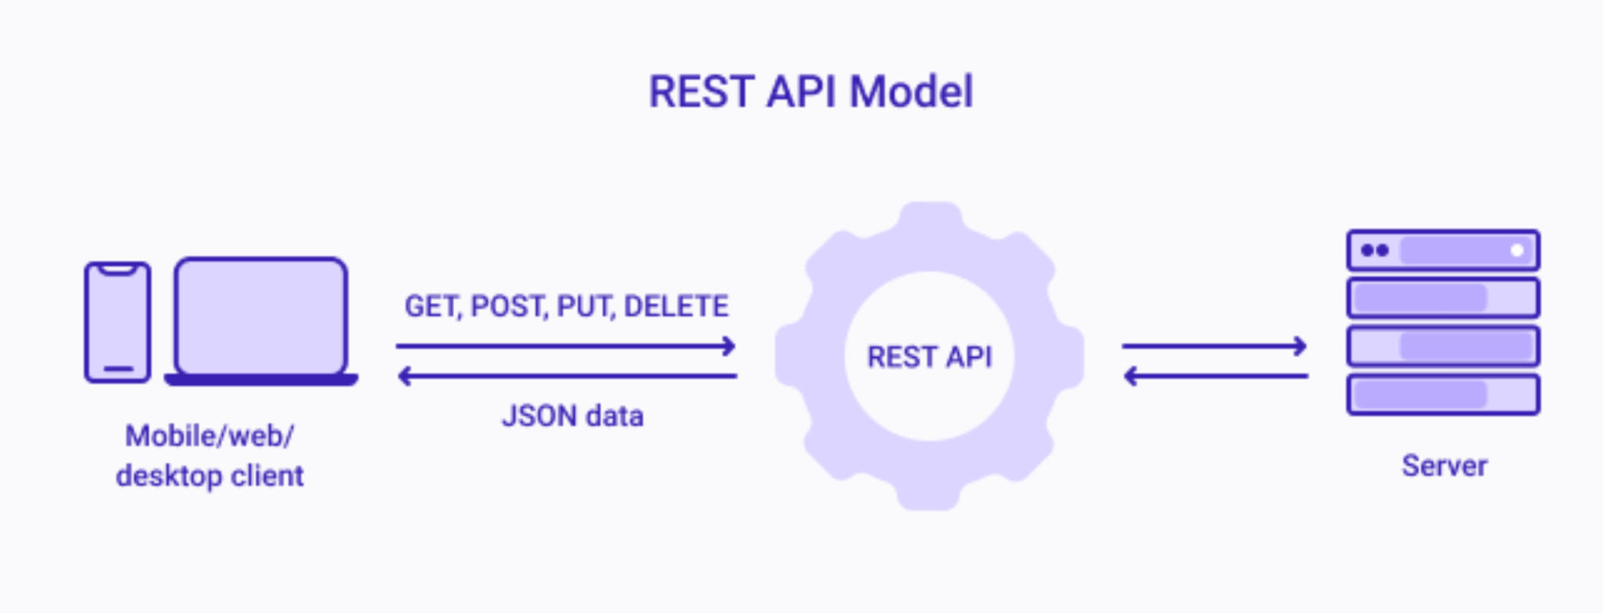
APIM Terminology - REST APIs
What are REST APIs?
REST API stands for Representational State Transfer Application Programming Interface
It is a standardized way for different web applications to communicate with each other
REST APIs enables machine to machine communication by sending requests and receiving responses in a standardized format (HTTP protocol)
The response to a REST API request is typically in a standardized format such as JSON or XML
Example Flow:
CLIENT -> Request -> SERVER
To whom: http//abc.com/api/users —- Endpoint URL
Method: GET
What resource is needed: List of users
Authorization: Access Token
CLIENT <- Response <- SERVER
JSON file: List of users

Slide 47
Key Product Features
Function | Feature | What does it provide?
Create APIs | My APIs | Provides a centralized page to create, import and maintain APIs. Integration
 | Publish as an API | Enables Cloud studio users to easily publish an operation as an API .
Publish APIs | Portal Manager | Enables users to auto-generate and customize OpenAPI documentation for APIs.
 | Portal | Enable API consumers to access api documentation and interactively test
Secure APIs | Security Profiles | Enables administrators to manage and enforce security policies for APi access.
 | Trusted IP Groups | Enables administrators to enforce IP level access control to the APIs.
Monitor APIs | API Logs | Provides tracking, debugging information, aiding troubleshooting, and security.
 | Analytics | Provides metrics on API usage and performance, aiding in monitoring and analysis.
Manage Access | API Groups | Enable administrators to enforce access policies for API collections
 | External Users | Enable administrators to control API access for external users
System Administration | Private API Gateway | Tools to deploy, test, administer security, and manage traffic of Private API Gateway

Slide 48
Jitterbit App Builder
DRAFT
Low-code, AI-infused application development
Notes:
Training:

Slide 49
Instructions
The deck is an extension of the Corporate POV deck for conversations that require a deeper dive into Jitterbit App Builder. It provides a high-level overview of Jitterbit App Builder features, value props, and how it fits into the Harmony platform. What the deck covers:
A brief overview of the Harmony platform
Industry trends driving the need for App Builder
App builder personas/user profiles
Features & benefits
Use case examples
Proof points
How to present it
Check out the talking points outlined in the Speaker Notes section of the deck. Use them as a guide to tailor your talk track to your audience and goals.
Add your photo and contact information to the last slide in the appropriate space.
The appendix slides include a customer case study, architecture slides, and more. There is also a vertical use case slide that covers a multitude of different industries (retail, finance, marketing, and others). For example, if you are talking to prospect/customer in retail you would want to point out the use cases that fall under that category to make the message more impactful. Questions? Reach out to productmarketing@jitterbit.com.

Slide 50
AI-Infused Low-Code Integration, Orchestration, Automation & App Development
iPaaS
API Manager
App Builder
EDI
Marketplace
Management Console
Build, manage and maintain integrations
Create, control and consume your APIs
Build, manage and maintain web and mobile applications
Build, manage and monitor exchange of business documents
Get certified pre-built integrations
Manage, monitor and administer projects in one place
Notes:
Training: your audience has likely already seen the corporate deck where you have introduced the Harmony platform. This slide prefaces the App Builder deck to level set and remind them that App Builder is one product of an AI-infused integration, orchestration, automation and app dev platform
Harmony is an AI-infused low code integration, orchestration, automation and app development platform.
iPaaS solution that's AI-infused, where you build and maintain the integrations for your entire environment. Orchestrate workflows that trigger real-time integrations based on external events.
API Manager allows you to create, control and consume that data in the information in those integrations - all in the same platform. Expose and manage APIs using API Manager for real-time integrations.
App Builder (previously known as Vinyl) helps build enterprise applications via low-code or AI-infused approaches. Those 72% of applications that aren't all written for web and mobile - that may need to be rewritten for the current day or new ones. Ideal for internal or customer-facing applications.
Then Jitterbit EDI. Now that you have your applications, you may want to turn to the B2B or commercial landscape. EDI connects you to the long-trusted integration standard. And we have more than 1,000 trading partners built in. And all off the same platform.
Supporting the four cornerstone products we have a Marketplace, where we have over 400 pre-built integrations for the most popular systems, services and use cases.
FInally, the Management Console where you can manage the entire Harmony platform seamlessly in a single console.

Slide 51
Low-code and AI are essential to meet the ever rising app development demand
93%
1 in 3
engineering roles unfulfilled each year
businesses report gaps in IT skills jobs market
70%
of new business applications will use low-code / no-code technologies by 2025
85%
of workers expect AI to improve their jobs
Source: BCG, Morgan McKinley, Gartner, Censuswide
Notes:
Training:
Why are customers/prospects interested in App Builder?
the demand for applications is not slowing down
IT departments are looking to become more efficient with their time
IT departments have skill gaps which inhibit their ability to meet customer expectations
IT departments and business analysts believe that low code infused with AI can make them better at their jobs by solving complex problems quickly
SOURCE:
bcg.com/publications/2023/addressing-the-engineering-talent-shortage & morganmcjinley.com/uk/article/skill-shortage-impacts-technology-growth-in-uk
Gartner Research: Low-Code and No-Code Technologies:: https://www.gartner.com/en/newsroom/press-releases/2021-11-10-gartner-says-cloud-will-be-the-centerpiece-of-new-digital-experiences
Censuswide Research for Jitterbit: https://www.jitterbit.com/press-release/ai-unleashing-new-skills-and-opportunities-for-office-workers/

Slide 52
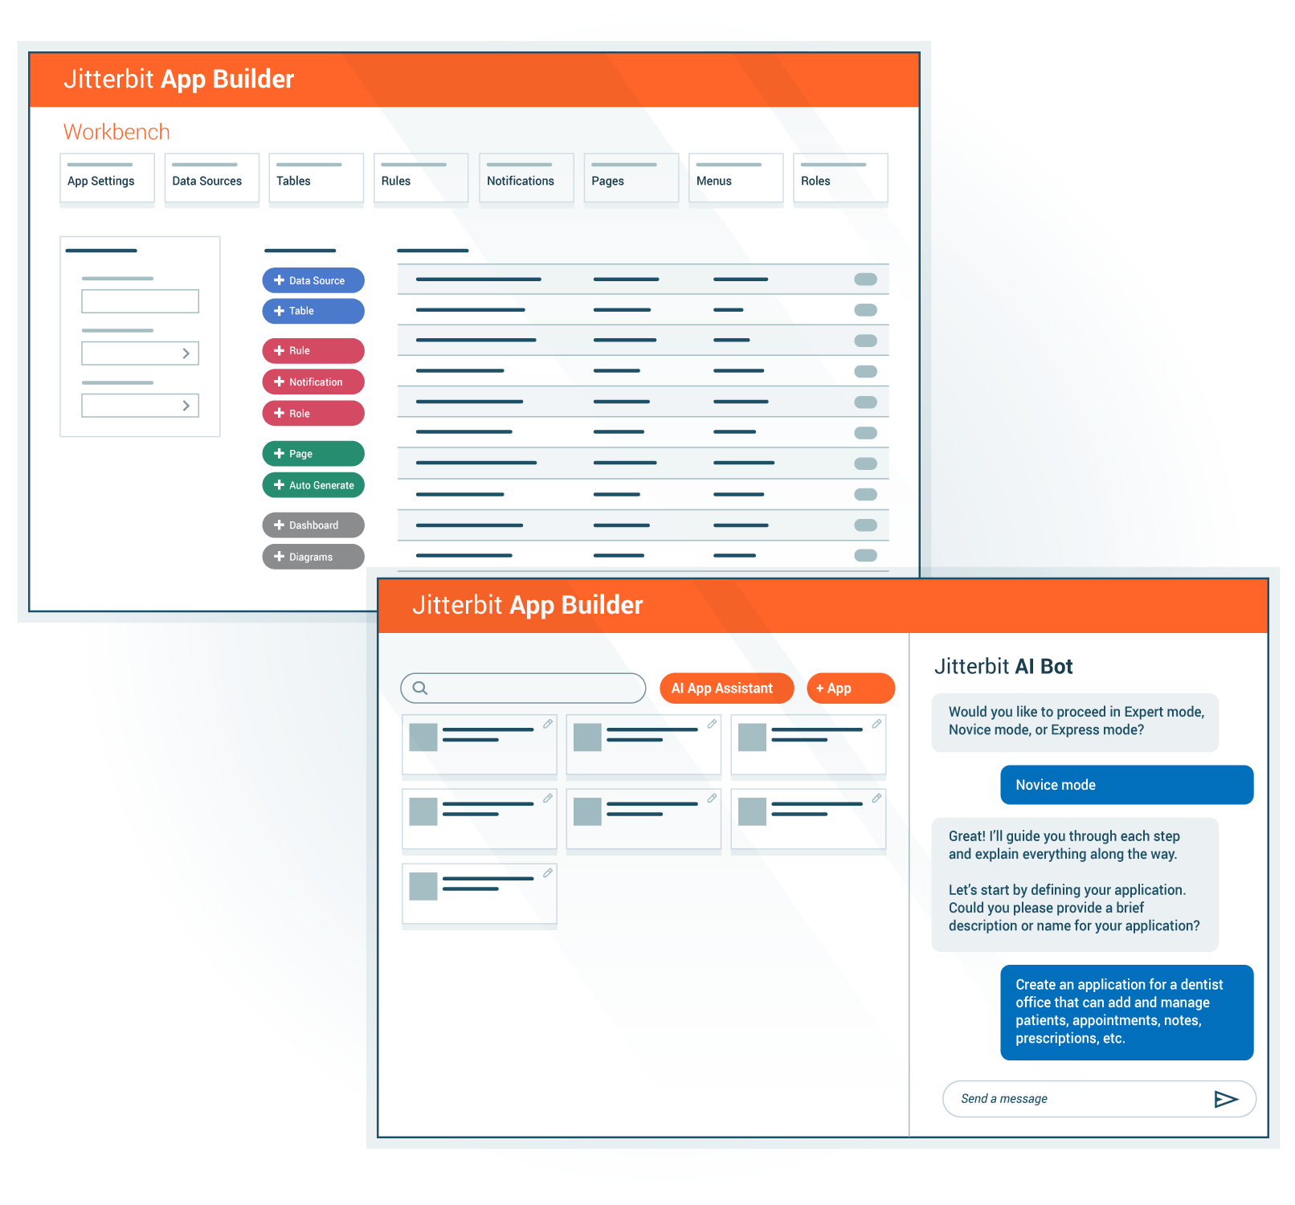
Accelerate application development
Empower IS/IT and line-of-business teams to collaborate to build scalable, secure, and compliant enterprise applications fully integrated into your tech stack — using AI and low-code technology
Solve complex business problems at scale simply and quickly with web, mobile or system applications that run on any device
Enable organizations to build, maintain and optimize enterprise-grade applications with low-code and AI approaches using just natural language processing (NLP)
Notes:
Training:
This slide introduces App Builder as an accelerator to application development. Two keys points to get across on this slide
while you can build simple form apps, app builder was designed to solve complex business problems and meet the expectations mature enterprises have when it comes to security, compliance, scalability and infrastructure.
App Builder is AI infused, whether you are building new applications or enhancing existing applications. Jitterbit AI is there to accelerate your pace of innovation.
Jitterbit App Builder empowers teams to easily create and deploy secure custom web and mobile applications that integrate data and functionality from multiple disparate systems. Organizations can build user interfaces, portals, workflows, and map out decision-making processes quickly though a low-code interface, enabling both professional developers and business users to deliver custom solutions at velocity.
Solve complex business problems at scale simply and quickly with web, mobile and offline applications that run on any device
Operate as a system for your business processes
Resource constraints - if you’re a line of business owner who has the expertise, go to IS/IT department with an idea - mobile app, web app, etc. What do you think you’re going to hear?
Here’s what is unique about our AI-infusion on App Builder - you have three levels:
Express level: Fast track
Novice: Guides you through the databases and asks you about your business
Expert: For the savvy user or dev
It's a time-saver that cuts down tasks by a factor of 1,000 — what would normally take months or weeks is now days. Think of the training requirement.

Slide 53
Key layers of Jitterbit App Builder applications
Common UI/UX
Render on ANY Device
Integrate on other Platforms
Patented Responsive Design
Run on Any Device
PAGES
TABLES
PANELS
RULES
Expose apps via REST APIs
DATA
EDITING
Desktop, Phone and Tablet
Business Logic
Manage and Simplify ANY Level of Complexity
AI-infused
Data-Driven
Development and Process Flow
Cross-Data Source Data Manipulation Create, Read, Update and Delete
Business Rules for UI, Workflows, Validations, Defaults and Notifications
Fully integrated Security through User Roles, Data Reach and Edit State Management
Data First
Connect to ANY Data Source
APIs
REST, SOAP
File Systems Local, Cloud
On-Premise ERP, HR, Financial
Cloud CRM, Marketing, Email
No SQL Social, Audit, IoT
New Data Models Augmented or Standalone
Endpoint APIs
Patented Lite Integration – Bi-Directional and Real Time
Notes:
Training:
App Builder is used to build applications. This shows that each application has three primary components which the developers will customzie
UI: these are the pages, forms, tables, charts, calendars, etc. that make up the front end of the application. app builder runs on any device
Logic: businesses have complex rules which need to be followed. each application contains logic to satisfy the requirements of the business process. this might include validating data meets a requirement, moving data from one system to another, calling an API to receive or send data to another application or send a notification to a user that some event occurred
Data: Any application relies on data to function. App BUilder integrates with Harmony through APIM endpoints but can also directly connect to any system the customer has and can be used to create new databases for data which does not currently have a system of record
Applications built in App Builder have three key layers - each layer is infused with AI to accelerate the development
Data - connect to any system you have to bring data together
App Builder does not replicate or cache data, it reads it in real time as the user requests it
no matter what data you connect to, in App Builder the data is shown to the developer as tables, rows and columns for a consistent experience no matter what the source is
Business logic - build rules, CRUDS, validations, workflows, notifications, schedules/jobs, row level security and read/write security roles
because all data sources are tables, rows, and columns developers are able to master all data sources/systems in your company - learn how to build a rule in App Builder and you can do it against any source
we have not run into logic that is too complex for App Builder
UI/UX - build beautiful experiences for your end users - the layout of pages respond to the device the user is on
build forms, grids, tiles, charts or even completely custom CSS/HTML pages
when users use the application, translations happen automatically for a better user experience
deploy your app on the app store using our mobile wrapper

Slide 54
Making app development accessible to everyone
Developer
helps build and connect applications with ease
End-users
creates great customer and employee experiences
Administrators
provides flexibility to administer and secure applications with ease
Notes:
Training:
App Builder is designed for three primary user personas
Developers: these are IT professionals and/or tech savvy line of business users who use the product to build applications
End users: these are the employees, vendors, partners or customers who use the applications built by developers. They will provide input to developers for future enhancements/requirements which developers will build into the app
Admins: this will be an individual or team of IT professionals who monitor the application’s overall health and performance to ensure end users are not interrupted
IT Developers design, build, and maintain software applications and systems. They write code, troubleshoot issues, and collaborate with teams to develop efficient and scalable solutions that meet business needs. Jitterbit App Builder with it’s low-code approach to app development saves considerable time and resources for IT developers and increase their productivity.
End-user is the person who directly interacts with and uses the application to accomplish a task. They are the final recipient of a service or application, typically without involvement in its development or implementation. In Jitterbit’s context these are typically our customers’ customer (internal or external). Jitterbit App Builder creates great customer experiences to meet any requirement.
IT Administrators manage and maintain an organization's IT infrastructure, including networks, servers, security, and software systems. They ensure system performance, troubleshoot issues, and implement security measures to keep IT operations running smoothly. With Jitterbit App Builder, they can easily manage, monitor and analyze the performance of their applications.

Slide 55
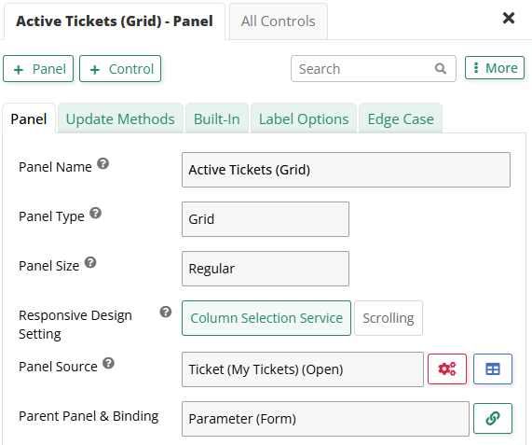
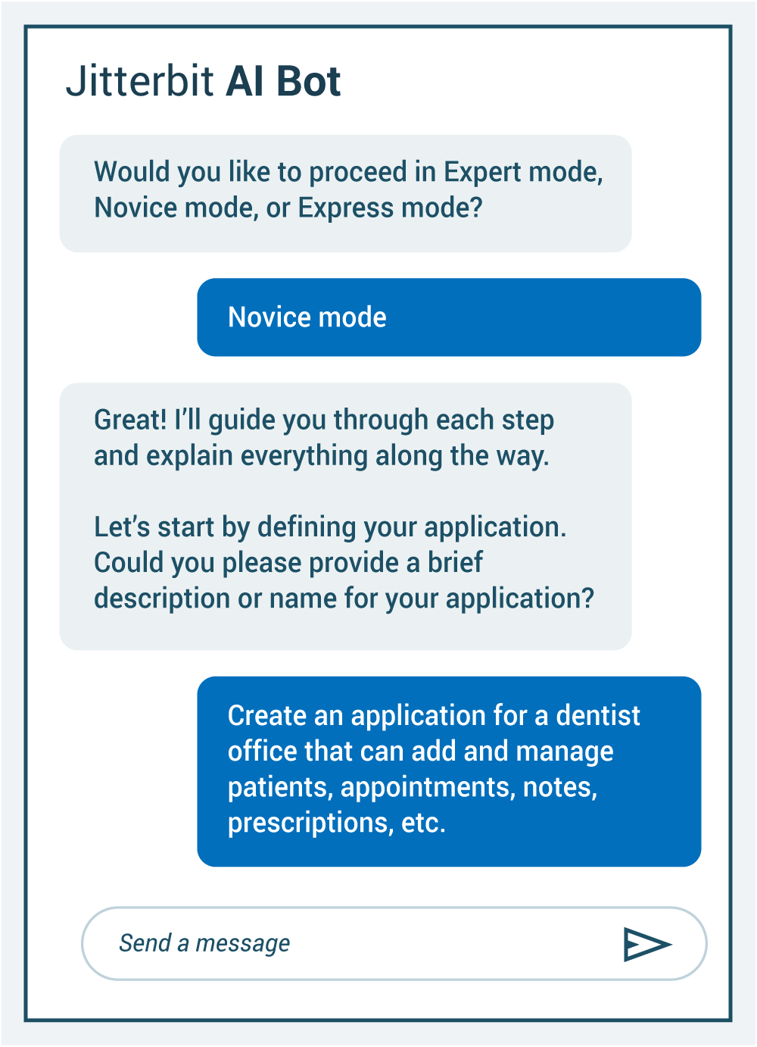
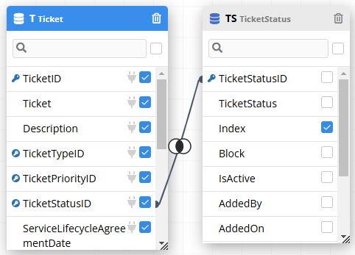
Build and connect applications with ease
Key Features
Build and modify apps in natural language with AI
Create applications easily using an intuitive design interface
Built-in integration to connect to all systems and all data, in real time
Define business logic on any data source without coding using standardized syntax
Benefits
Make it easy for anyone to create professional applications, saving time and simplifying the development, prototyping and testing process
Turn your ideas into apps instantly — just by describing them in plain language
No more manual updates or data silos — get accurate, up-to-date information whenever you need it
Easily create complex business logic without needing to code
Notes:
Training:
This slide covers the features and benefits for the developer persona. The keys are easy to use, AI infused, connected to their systems and a standard way of adding logic on any data source
We focus on three primary user personas: the developer, the application end user, and the system administrator
For the developer we want them to be able to built and connect applications with ease - That starts with an AI infusion to build apps from scratch using natural language processing
Developers can also edit applications in real time with our live designer which pops out on the page so you can see and edit your application in real time
Developers will also experience guided wizards when creating things like applications, pages, data sources and more.
Data is the most important part of any application, developers can connect to their systems using a simple form and control how authentication should be handled for each data source.
New features and requirements from stakeholders will often mean adding or modifying the logic of an application, App Builder gives the developer a visual way of modifying rules and logic to keep complex logic simple.

Slide 56
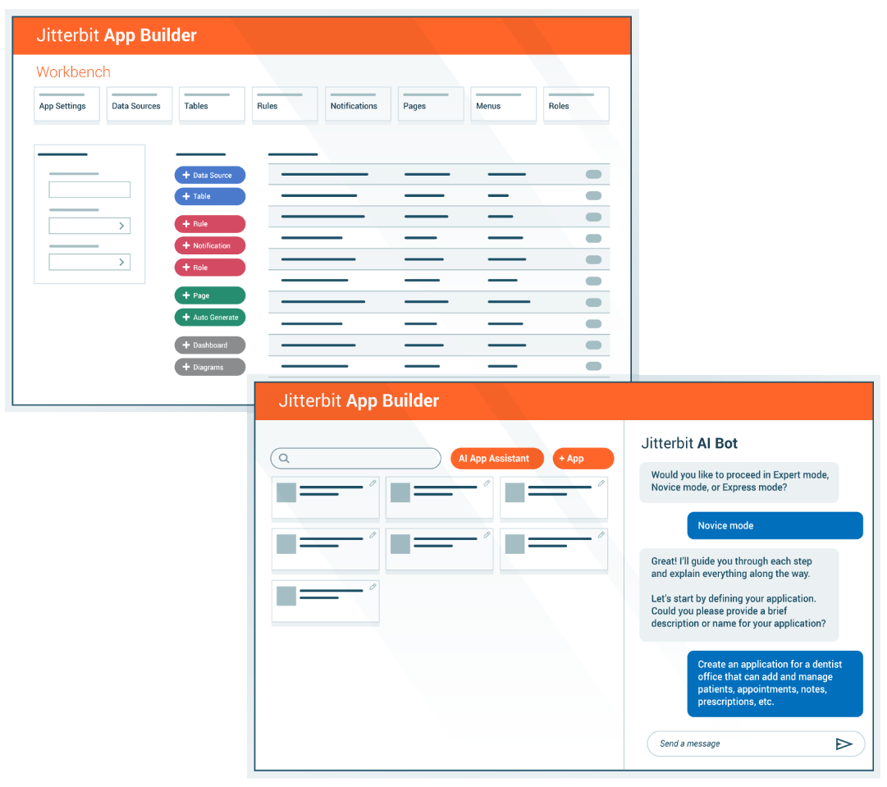
AI Assistant: Use natural language to build apps and connect systems
App Builder AI Assistant
Turn low-code into ‘absolutely no code’ using natural language.
Build applications
Create app UI
Modify apps

Slide 57
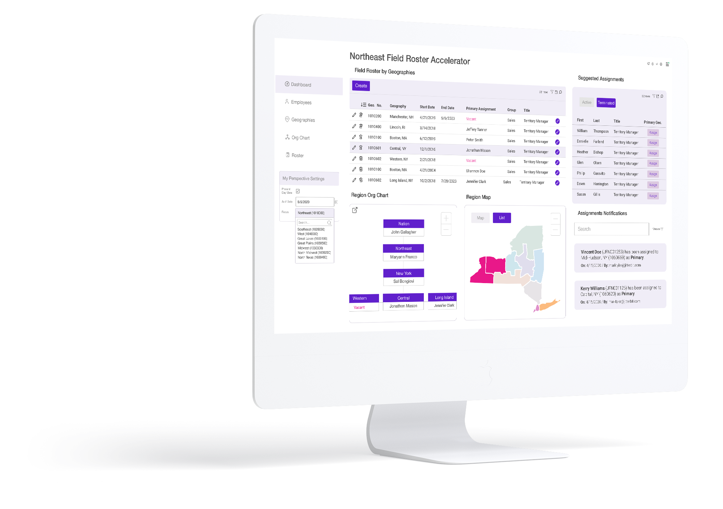
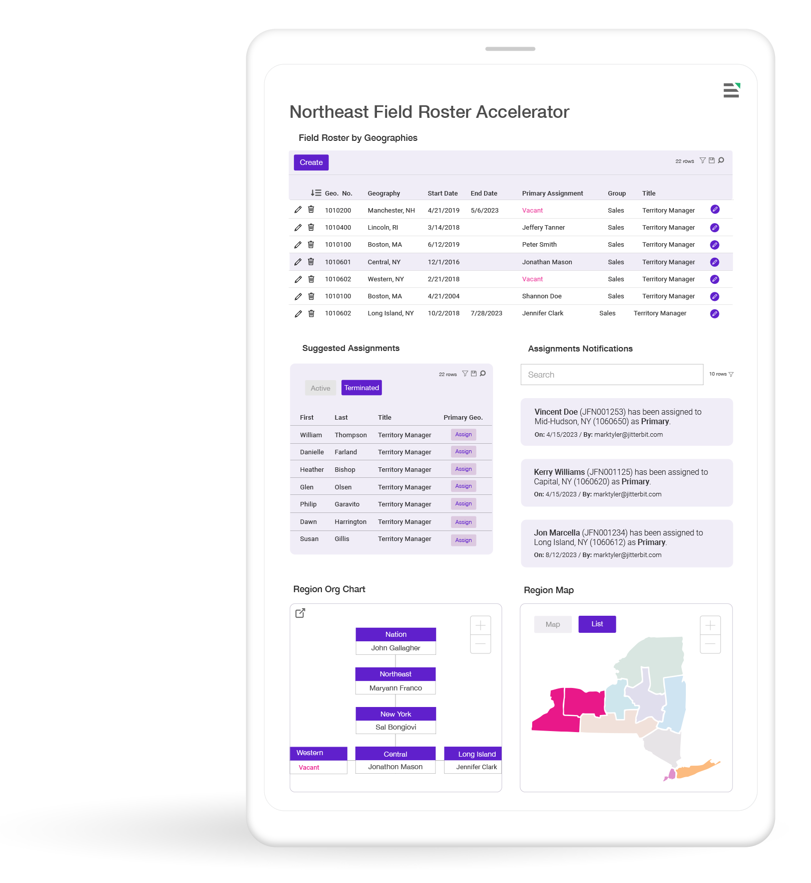
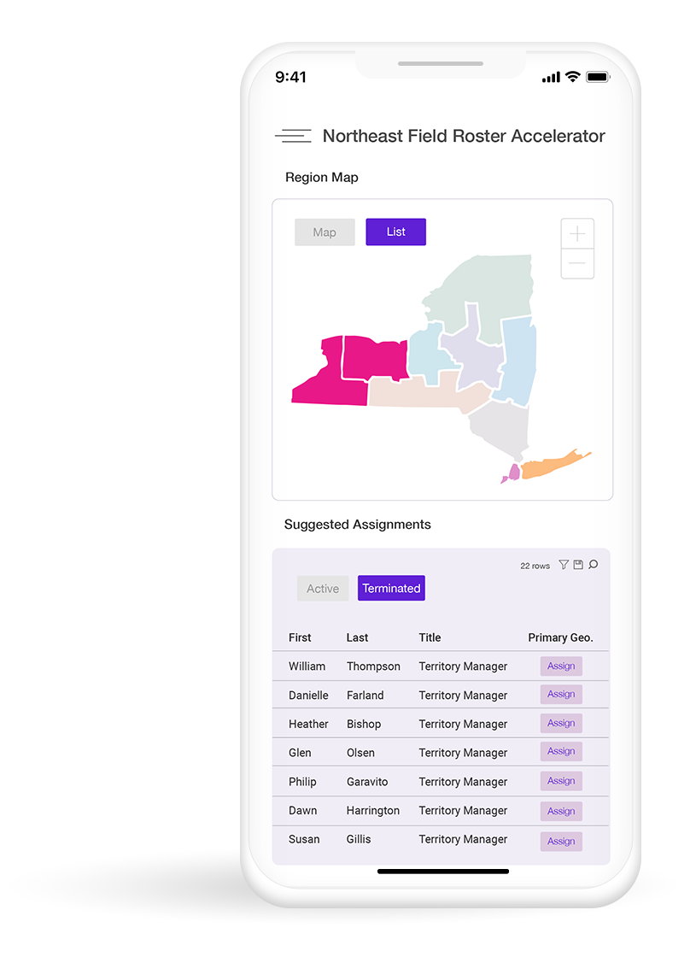
Create great experiences for end-users
Key Features
Use applications on any device using a single code base that adapts to any screen size
Run your apps without an internet connection with Offline Mode
Automatic language translation
Customize the ‘look and feel’ of the applications
Benefits
Create a seamless experience on any screen size — no extra development needed
Stay productive anywhere, even without an internet connection
Access your app in the language you prefer for greater ease and clarity
Create a personalized user experience that aligns with your brand
Notes:
Training:
This slide covers the benefits for end users. desktop/mobile, offline, language translations and custom styling to make their experience using apps great
For application end-users, App Builder provides many key capabilities including…
App Builder applications are designed to run on any device. Developers have a single code base that responds to the screen size of the device the end user is on, enabling businesses to operate anywhere. It also translates your applications and their data automatically to over 60 supported languages.
The absence of an internet connection can pose significant challenges in certain scenarios, but with the offline applications feature, App Builder helps businesses overcome these obstacles by providing reliable access to their information without an internet connection.
Overall, App Builder helps create great experiences for application end-users by responsive design automatic translations and a personalized user experience..

Slide 58
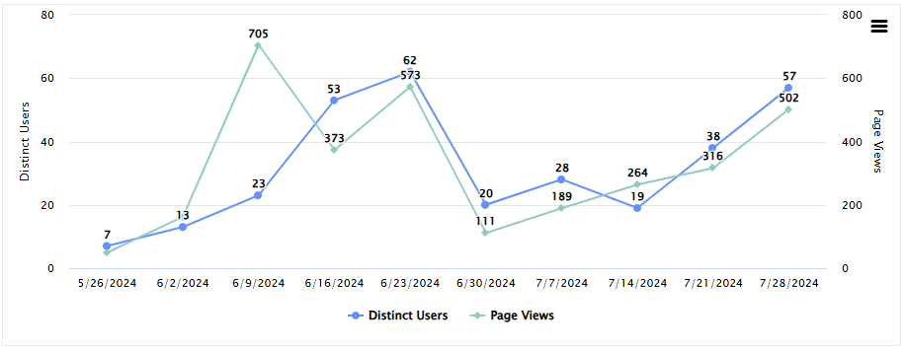
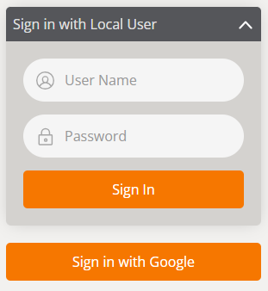
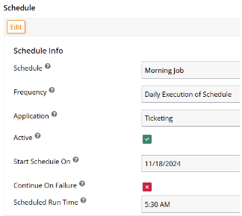
Administer and secure applications flexibly
Key Features
Comply with stringent compliance and security requirements
Customizable role-based access controls and encryption of data in-transit and at-rest
Easily manage and monitor servers and schedules, and access logs for troubleshooting
Deploy in your enterprise cloud or on-premise
Benefits
Protect sensitive data and meet industry standards and compliances for peace of mind
Prevent unauthorized access and protect data with robust security features provided
Simplify troubleshooting and ensure smooth operations with clear monitoring tools.
Deploy flexibly where it works best for your business
Notes:
Training:
Features/benefits for admins: app builder has all the features to ensure compliance and security are met, the application can be monitored, role based access controls are available and the deployment options are flexible
For the system administrator, App Builder provides the required administration and security capabilities. The App Builder operations adhere to the stringent standards of SOC 1 Type II and SOC 2 Type II. Your applications can be built in compliance with industry best practices and regulations, including HIPAA, PCI and GxP. Protecting sensitive data is our top priority, which is why we offer comprehensive support to prevent unauthorized access through customizable access controls and encryption of data in-transit and at-rest.

Slide 59
Use case examples
Sales
Retail
Manufacturing
Marketing
Customer Service
Construction
TYPE OF APPS
Media
Dashboards
Analytics
Forms
Workflow
Mobile
Complex Systems
HR
Finance
Financial Services
and more…
Lifesciences
IT Ops
Purchasing
Entertainment
Healthcare
Facilities
Notes:
Jitterbit App Builder can build various types of end-user apps across many business functions such as sales, marketing, finance, HR, etc. and also across many diverse industries.

Slide 60
Proven benefits
10.5
1.8
2024 Bronze Stevie Award
average months to ROI
average months to go-live
business technology category
2024 CODiE Award Finalist
94%
93+%
best no-code / low-code platform
ease of doing business
support agent rating
Source: G2 and Jitterbit Internal Survey
Notes:
Source: 10.5 average months to ROI, 1.8 average months to go-live, 94% ease of doing business: G2
Source: 90%+ support agent rating: Jitterbit Internal Survey

Slide 61
Accelerate application development with AI
Create scalable, secure and compliant enterprise applications with a low-code app building platform infused with AI.
Unified Platform with AI Infusion
AI Agents
Security First
Ease of Use
Faster Time to Value
Notes:
This is how the Jitterbit App Builder aligns with the 5 differentiators of the Harmony platform
Unified Platform: Build applications with integrations created in our iPaaS, APIs built using our APIM, or by connecting to your existing data sources and APIs through a simple wizard.
AI Infusion: Leverage an AI-powered assistant to create applications using natural language, empowering business teams to accelerate solution development.
Security First: Comply with stringent standards and industry regulations. Prevent unauthorized access through customizable access controls and encryption of data in-transit and at-rest.
Ease of Use: Empower technical and business teams to build applications that seamlessly connect to any data source using a low-code designer.
Faster Time to Value: Create applications quickly and efficiently with no code for fast deployment of solutions tailored to specific business needs.

Slide 62
Thank You
First Lastname
Job Title Position
first.lastname@jitterbit.com
(877) 555-0987

Slide 63
App Builder Appendix

Slide 64
Darn Tough
Manufacturing
Challenge Darn Tough Vermont needed to move its business to the cloud and modernize its manufacturing processes. They wanted assurance that there wouldn’t be any interruption of business services and a future-proof flexible solution that would allow them to integrate with their new cloud ERP system.
Solution Darn Tough leveraged Vinyl’s data migration applications and expertise to move from Infor VISUAL® ERP (an on-premise solution) to Infor® M3 (a cloud-based ERP system). After the successful migration, Darn Tough’s demands pivoted, and they needed to augment M3 to modernize their manufacturing processes quickly. They improved accuracy and efficiency in their production ecosystem by utilizing Vinyl’s API capabilities.
Connects with 3rd Party ERP and Other Software
Modernizes Quality Control Audit from Binders to Digital
Product Structure Updater Saves Days of Data Entry into M3
Master Data Management and Governance Improved Data Quality and Faster Item Creation
Manufacturing Process Tracking Tracks Where an Order is in the Process
With Vinyl, we can deploy solutions much faster, and they are easier to support. It has also been nice having the Vinyl team available to quickly build solutions when we don't have the internal bandwidth.”
JIM DECKER / CTO
Number of Apps
14
Number of Users
150
Data Sources
2
Avg. Time to Production
4
Weeks
Notes:
Success stories: https://docs.google.com/presentation/d/1lZFZt4eEfLZ0wkKgn07b28dvbnknLC2lMDrK8VHgiu0/edit#slide=id.g2fc0f0e79b1_2_34
UI/UX look book: https://docs.google.com/presentation/d/13fabp0tK-QC1rSX0hEGuesVdHikLZ61OHrn--CZ8h6o/edit?usp=drive_link

Slide 65
AI-infused low-code architecture
Notes:
Note: For a detailed breakdown of the this slide, please review Elevate Session 167: https://drive.google.com/drive/folders/1kNnTYXDj3bSmwwhth5Q0UZeJkRFa0oD9?usp=drive_link
Platform Capabilities
Low-Code Designers:
Across the top you have six boxes; they are the core UI components tied to the main products covered in the previous slide.
Our low-code designers are built using intuitive and responsive user interface principles, so we think of the user first, even though our audience is technical.
Note: the first box is labeled Integration Studio. It’s the new name for Cloud Studio. Integration Studio is more descriptive and relevant name than Cloud Studio
(Background: Cloud Studio made sense five years ago to distinguish it from our on-prem Design Studio; it’s a downloadable Java Integration Designer that many customers still use, and it's still very capable, but that made sense then when cloud interfaces were novelty.)
Reusable Assets:
Connectors SDK: Used by engineers and partners to build connectors. The connector SDK (software development kit), is used by our own engineers and our customers and partners like BMC to build connectors and make them available in the iPaaS Integration Studio. The SDK is targeted at more technical users.
Low-Code Connector Builder: Wizard-driven experience that any customer can use to create connectors with public REST APIs
Pre-Build Connectors & Applications: Jitterbit and our partners have built and made available today about 250 pre-built connectors, and that number continues to grow.
Recipes: Recipes are simple, unidirectional integrations between two endpoints, like syncing items from NetSuite to products like Salesforce. It's simple. It solves a simple integration use case that's easy for anyone to explain. Our Marketplace includes over 400 recipes and templates today.
Templates: Templates, on the other hand, are bi-directional integrations, so the syncing can go both ways that solve richer and more comprehensive use cases, like opportunity to order between a CRM like Salesforce and an ERP like NetSuite. They might include multiple projects within one template.
Platform Engines: This is where the actual work of running, monitoring and reporting — the integrations, applications, APIs, the B2B transactions — takes place as you would expect.
Integration engines: Run-time engines that run integrations in the cloud, on-premises, or hybrid environments. It’s the customers’ choice.
API Gateway: Manages API requests with options for cloud or on-premises deployment.
App Builder runtime: Manages run-time for thousands of applications customers using today. Entirely cloud-based.
B2B Engine: Handles EDI transactions, also cloud-based (no on-prem option)
Messaging System: Provides users with vital information, particularly if errors occur.
Analytics & Logging: Provides critical diagnostic information on usage and system performance, activity charts, etc.
AI-Infused Services:
AI-infused evolution started years ago.
Enhances ease of use and accelerates time to value.
Infuses AI capabilities into all core components like Integration Studio, API Manager, App Builder, and EDI.
Includes AI-powered assistants (currently in beta) for app and connector building, bringing conversational interfaces for fast and intuitive development.
AI Assistants:
App Builder AI Assistant: Build applications in minutes with a chatbot interface.
Connector Builder AI Assistant: Quickly create connectors for long-tail integrations.
Future AI capabilities: Ongoing development for all components, including real-time guidance through the JBAI chatbot.
Enterprise-Grade Security, Governance, and Scalability
Security and Compliance:
Multi-Factor Authentication (MFA) and Single Sign-On (SSO) for secure access.
End-to-end encryption ensures data security.
Compliance with standards like SOC 1/2, ISO 27001, GDPR, CCPA, and HIPAA.
Governance:
Role-based access control to manage user permissions.
Environment isolation ensures data protection in multi-tenant systems.
Audit history for detailed tracking, essential for industries like banking.
Scalability and Reliability:
High availability (HA) with redundancy and failover mechanisms.
Global data centers ensure consistent service with intelligent routing and load balancing.
Automatic backups and scalable infrastructure allow vertical and horizontal scaling.
Flexibility for deployment: Choose between cloud, on-premises, or hybrid models.

Slide 66
Jitterbit’s layered security foundation
Jitterbit manages the security of the Harmony platform by applying a hybrid framework based on NIST, CISA, CSA, and CERT recommendations.
LOGICAL SECURITY
MFA*
WAF*
Access Control
IDS & IPS
Secure Database
DDOS Monitoring & Mitigation*
FIPS 140-2 Auth
SSO
E2E Encryption
ORGANIZATIONAL SECURITY
Personnel Policy
Penetration Testing
OWASP Checks
Secure SDLC
FIPS 140-2 Auth
SSO
E2E Encryption
PHYSICAL SECURITY
Intrusion Detection*
Video Surveillance
Secure Cloud Redundancy
Biometric Controls
GLOBAL ACCREDITATION & COMPLIANCE
* Provided via AWS security controls.
Notes:
Jitterbit manages the security of the Harmony platform by applying a hybrid framework based on NIST, CISA, CSA, and CERT recommendations. This framework is categorized into three key layers.
Logical Security Logical security is comprised of all the security measures taken within the Harmony platform. These include the system architecture; major components; Harmony users, organizations, and roles; Harmony environments and access control; Harmony data storage; and Harmony security topologies.
Physical Security Physical security involves the hosting of Harmony on cloud infrastructure. This section describes infrastructure compliance; physical and environmental security; high availability and fault tolerance; network security; secure design principles; change management; load balancing security; data storage; and data durability and reliability.
Organizational Security Organizational security covers operational best practices of leading cloud-computing providers around the world. This includes confidentiality; the personnel policy; internal team-specific operating procedures and policies; reporting of system status; identity and access management; patch management and high availability; and capacity management.
In addition, Jitterbit develops and improves its applications by using sound software-development lifecycle (SDLC) practices, including, but not limited to, :
Identifying vulnerabilities from outside sources to drive change and code improvement.
Applying hardware and software patches. Jitterbit is responsible for code changes and Amazon Web Services (AWS) is responsible for providing hardware patches; our virtual environment allows us to apply code changes and hardware patches without any downtime.
Providing secure authentication and logging capabilities.
Ensuring that Personal Identifiable Information (PII) is not used in test environments.
Following secure coding practices according to an SDLC policy and addressing the security training needs for the development team.
Checking for security flaws as prescribed by the Open Web Application Security Project (OWASP), such as injection flaws, buffer overflows, cryptographic errors, error handling, etc.
Assessing for vulnerabilities on every release.
Conducting annual penetration testing.

Slide 67
Jitterbit Harmony: A unified AI, low-code platform
Empowering organizations to compose AI agents and automate business transformation
Knowledge Base Agent
Employee Agent
Sales Agent
Service Agent
Custom Agents
Third-Party Agents

Slide 68
Use Case Examples
Sales | Marketing | Services | Human Resources | Finance | Retail
Customer Account (CRM) Field Roster Accelerator Loan Documents Partner Agreements Provisioning Referral Agreements Reseller Agreements Sales Order Processing Sales Support Special Deal Terms Support Agreements / Renewals | Advertising Contracts Brand Licensing Agreements Customer Communication Approval Event Registration Event Vendor Agreements Mass Mailing / Email Approval Media Plan Sign-Off Press Release Approvals Promotion Agreements Rebate Agreements Sponsorship Agreements | Account Change Compliance EFT Authorization Field Service Independent Agency Licensing New Policy Applications Policy Cancellations/ Suspensions Self-Service Requests Service / Work Orders Suspensions Terms Change | Background Checks Benefits Admin Contractor Agreements Covid-19 Tracing, Wellness Diversity (DEI) Employee Policy Distribution, Signature Non-Disclosure / Candidate NDAs Offer Letters / New Hire Paperwork On / Off Boarding Checklist Performance Appraisal PTO Management | Asset Transfer / Retirement Audit Sign-Off Capitalization Management Consumer Account Opening Deposit Products Expense Processing Grant Applications Inventory Sign-Off Invoice Processing Policy Management Sales / Use Tax Return | Consumer Snapshots Customer Pickup Workflow Direct to Consumer (DTC) Allocation Discount Monitor Inventory Reporting / Analytics Made to Measure Merchandising Purchase Order Tracking Third Party Logistics (3PL) Validation Vendor File Management Wholesale Bookings / Sales
IT / Operations | Legal | Facilities | Product Management | Procurement | Healthcare
Access Management Asset Tracking Authorization Change Requests Incident Reporting Maintenance Authorization Production Change Authorization Project Budget Approvals Real Estate Approval Requirements Sign-Off | Affidavits Board Minutes Contract Management Engagement Letters Equity Trade Requests Internal Compliance IP Licensing Memoranda of Understanding NDAs Patent Applications Summons | Asset System Dashboards Equipment Tracking Hazard Signaling / Notifications Incident Tracking Inspection Management Meter Monitoring / Maintenance Preventative Maintenance Schedule Maintenance Space Occupancy Dashboards Stock Monitoring / Usage Walk Around Checklists Work Safety / Compliance Management | Beta / SDK Agreements Change Management Code Review Reporting Developer Program Enrollment New Offering Announcement New Product Evaluation Policy Approval Product Development Methods Release Management Release Scope Commitment Requirements Acceptance | Invoice Processing Master Services Agreement Purchase Order Rate Cards RFP Sign-Off Service Level Agreements Software License Agreements Statement of Work Subcontractor Agreements Supplier Compliance Termination Letters Vendor Contracts | Checklists Documentation Feedback Insurance Reporting / Data Management Management / Organization Review (MOR) Support Requests Project Management Provider Reporting Recall Services Trip Reporting Value Based Care (VBC) Services

Slide 69
Jitterbit EDI
Simplifying EDI management for seamless integration

Slide 70
Instructions
The deck is an extension of the Corporate POV deck for conversations that require a deeper dive into Jitterbit EDI. It provides a high-level overview of Jitterbit EDI features, value props, and how it fits into the Harmony platform. What the deck covers:
A brief overview of the Harmony platform
Industry trends driving the need for this solution
EDI personas/user profiles
Product Overview
Features & benefits
EDI product flow diagram
Proof points
How to present it
Check out the talking points outlined in the Speaker Notes section of the deck. Use them as a guide to tailor your talk track to your audience and goals.
Add your photo and contact information to the last slide in the appropriate space.
The appendix slides include a customer case study, architecture slides, in-depth features tables, and more. There is also a vertical use case slide that covers a multitude of different industries (retail, automotive, telecom, and others). For example, if you are talking to prospect/customer in retail you would want to point out the use cases that fall under that category to make the message more impactful. Questions? Reach out to productmarketing@jitterbit.com.
Notes:
add a description of each persona, what is important for each of them, and what role they play

Slide 71
AI-Infused Low-Code Integration, Orchestration, Automation & App Development
iPaaS
API Manager
App Builder
EDI
Marketplace
Management Console
Build, manage and maintain integrations
Create, control and consume your APIs
Build, manage and maintain web and mobile applications
Build, manage and monitor exchange of business documents
Get certified pre-built integrations
Manage, monitor and administer projects in one place
Notes:
Harmony is an AI-infused low code integration, orchestration, automation and app development platform.
iPaaS solution that's AI-infused, where you build and maintain the integrations for your entire environment. Orchestrate workflows that trigger real-time integrations based on external events.
API Manager allows you to create, control and consume that data in the information in those integrations - all in the same platform. Expose and manage APIs using API Manager for real-time integrations.
App Builder (previously known as Vinyl) helps build enterprise applications via low-code or AI-infused approaches. Those 72% of applications that aren't all written for web and mobile - that may need to be rewritten for the current day or new ones. Ideal for internal or customer-facing applications.
Then Jitterbit EDI. Now that you have your applications, you may want to turn to the B2B or commercial landscape. EDI connects you to the long-trusted integration standard. And we have more than 1,000 trading partners built in. And all off the same platform.
Supporting the four cornerstone products we have a Marketplace, where we have over 400 pre-built integrations for the most popular systems, services and use cases.
FInally, the Management Console where you can manage the entire Harmony platform seamlessly in a single console.

Slide 72
Cloud-based EDI is essential to streamline operations and enhance business agility
of B2B companies prioritize consolidating commerce onto one platform (Shopify)
of IT executives report positive ROI from the GenAI projects (dataiku)
of B2B buyers say integration with existing tech heavily influences vendor shortlisting (Inbox Insight)
of supply chain transactions are managed through EDI (IBM)

Slide 73
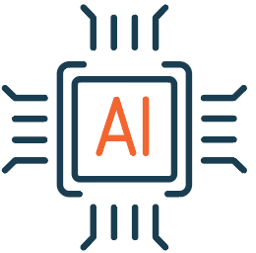
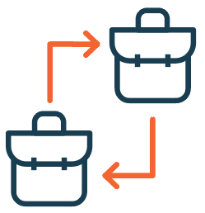
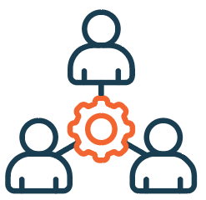
EDI Industry Trends - What we are seeing
AI-assisted Integrations
Push to cloud-based solutions
Enhanced security
Omni-channel B2B integrations
Increased use across industries: Healthcare, Logistics, Government
Support of multiple EDI standards (X12, EDIFACT)
Increased requirement for small and mid-sized companies

Slide 74
EDI user profiles
Developer
Manages the EDI integration within Integration Studio
Sets up and tests trading partners and configurations
Administrator/Business Technologist
Manages the EDI setup and some of the testing
Leveraged by developers as an EDI and ERP resource
Business Owner
Knows the trading partner business requirements
Monitors transactions
Assists with ERP knowledge and business document flow
Notes:
We have built this solution, for the key EDI users and to meet the needs of these profiles, I will walk you through those user profiles

Slide 75
Jitterbit EDI product overview
What is it?
A cloud-based EDI management solution
Fully integrated into Jitterbit iPaaS
An extended service offering on top of Jitterbit iPaaS subscription
What are the components of EDI?
Admin
Transactions
Messaging
Archive
Allows users full control over their EDI trading partner setup
Provides users full control over their EDI transactions
Full logging of all EDI transactions, communications and configuration changes
View all archived EDI transactions as well as the ability to restore them

Slide 76
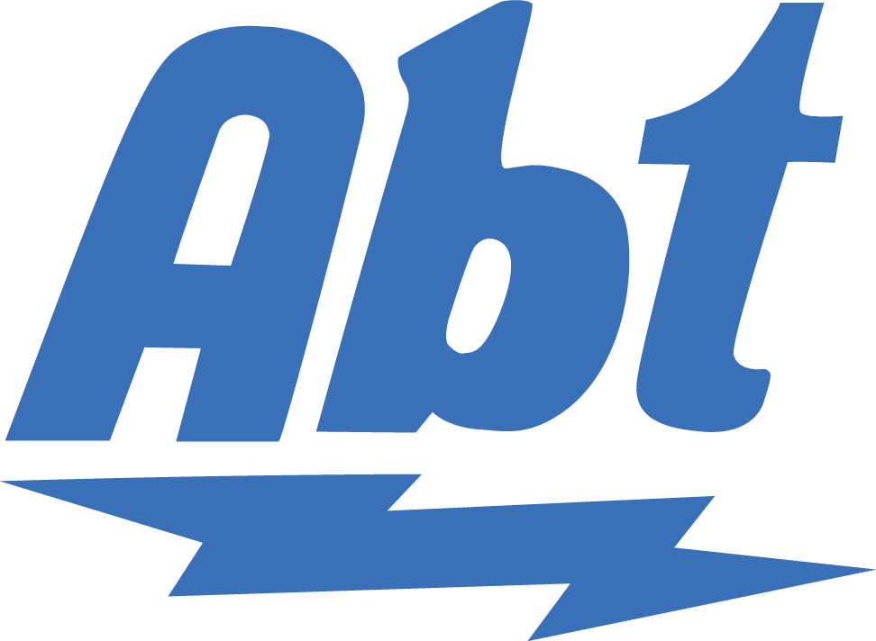
EDI trading partner management
Key Features
Add a Trading Partner - Access a pre-existing library of trading partners or create your own
Create a Workflow - Select your EDI standard (X12, EDIFACT or TRADACOMS), associated documents and versions
EDI Settings - Input envelope settings for use in your integrations
Communication - Associate your preferred communication method with your trading partners
Benefits
Control - Add, create and edit trading partners without the need to submit a request
Efficient - Create workflows easily by directly using EDI instead of relying on maps
Incorporated - Remove the need for additional software or service costs by including VAN, AS2, FTP and SFTP connections
Trading Partners

Slide 77
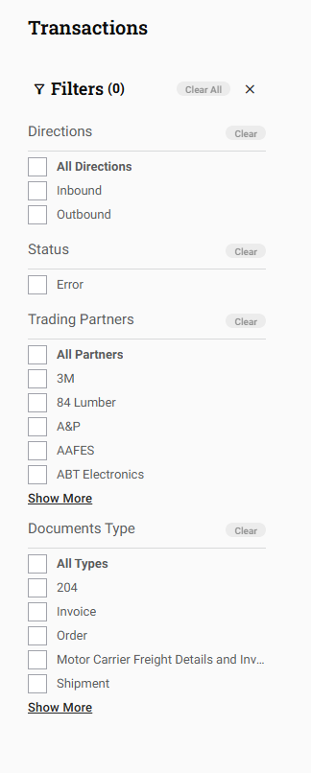
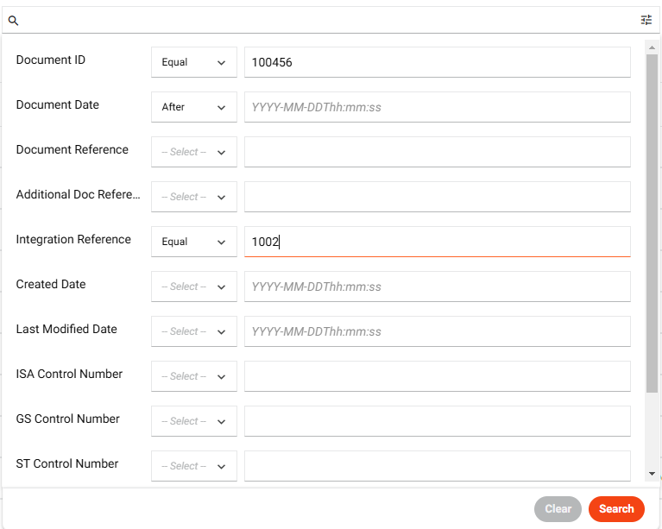
EDI transaction access
Key Features
EDI views - View multiple formats including HTML, EDI and EDIXml
Filters - Use filters to narrow results by Direction, Trading Partner and Document Type.
Advanced Search - Use various options to conduct advanced searches.
Reprocessing - Reprocess transactions that have failed
Benefits
Monitor - Enable non-technical users to monitor and manage their EDI transactions
Locate - Locate specific EDI related transaction data with advanced search options
Options - Compare EDI transactions by downloading, printing, or copying them for integration development

Slide 78
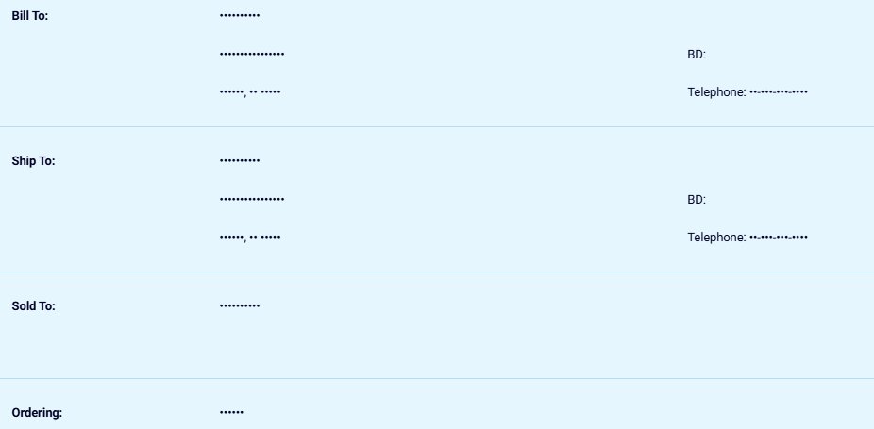
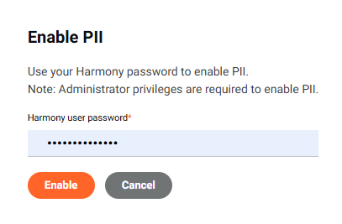
Data protection
Key Features
PII - Empower administrators to enable PII, and to Delete and Purge documents.
Archiving - Automatically archive transactions on an ongoing basis and support unlimited retention of records.
Encryption at rest - Ensure an additional security layer with data encryption
Benefits
Masking user data - Ensures personal user information (PII) is protected
Retention - Retentain archived transactions for additional compliance benefits for customers
Protection - Safeguard against potential data breaches and unauthorized access.

Slide 79
EDI Workflow
Jitterbit EDI allows you to process EDI and integrate directly into your back end systems
Jitterbit EDI
iPaaS
Trading Partner
Admin
Jitterbit EDI Connector
Transactions
Get Document
Messaging
FTP
Send Document
Archiving
ERP/Backend System
AS2
Set Status
Get Status
AS2
VAN
FTP

Slide 80
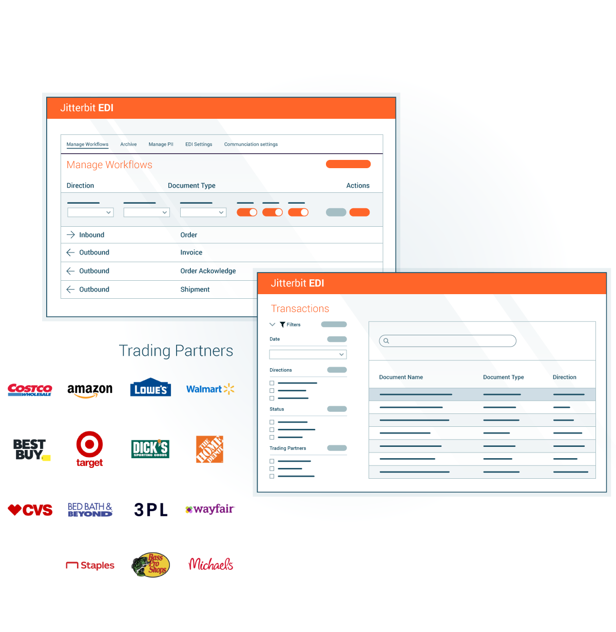
Simplify B2B workflows
Manage B2B transactions in a single, seamlessly integrated platform
Effortlessly connect EDI with ERP systems, automate end-to-end workflows, and easily add new trading partners from our list of more than 1,000 trading partners
Monitor your transactions from a single dashboard
Leverage AI-driven insights to optimize workflows, reduce errors, and improve supply chain visibility
Notes:
Harness EDI integration to connect backend transactions, automate end-to-end workflows and connect new trading partners in minutes.
Streamlines the entire EDI lifecycle; manage trading partners, documents, and transactions
Manage B2B transactions in a single, seamlessly integrated platform
Add trading partners from our list of more than 1,000 … the biggest brands in B2B business
Effortlessly connect EDI with ERP systems, automate end-to-end workflows,
Leverage AI-driven insights to optimize workflows, reduce errors, and improve supply chain visibility

Slide 81
Proven Benefits
10.5
2.68
2024 Bronze Stevie Award
average months to ROI
average months to go-live EDI
business technology category
G2 Easiest
to Use
93+%
Major Player
EDI enterprise
IDC Marketscape B2B Middleware 2024
support agent rating

Slide 82
Simplify B2B/EDI workflows
Unified Platform
AI Infusion
Security First
Ease of Use
Faster Time to Value
Notes:
Simplify B2B/EDI workflows
Unified Platform: Build, manage and monitor B2B transactions, seamlessly integrating with backend applications like ERP and ecommerce.
AI Infusion: Generative AI-powered assistant accelerates development, management and maintenance.
Security First: Adhere to stringent standards, compliances and industry regulations. Prevent unauthorized access through customizable access controls and encryption of data in-transit and at-rest.
Ease of Use: Simplify EDI setup with a modern UI coupled with a pre-built library of over a thousand trading partners, enabling you to rapidly launch and manage EDI transactions.
Faster Time to Value: Rapidly deploy and test your EDI transaction workflows across your many partners.
Essential factors for evaluating an EDI Solution
Cloud-based for better scalability and flexibility
Fast onboarding of trading partners with pre-built connectors
Fully integrated with iPaaS to streamline workflows
Pre-built integrations to backend systems, e.g., ERP
Single dashboard to monitor and manage transactions

Slide 83
Thank You
First Lastname
Job Title Position
first.lastname@jitterbit.com
(877) 555-0987

Slide 84
EDI Appendix

Slide 85
Neom Wellbeing
Retail
Challenge Neom Wellbeing, a UK company that specializes in creating aromatherapy products, had limited visibility and resources when it came to managing their EDI integrations, making it difficult to monitor data flows and troubleshoot issues. Setting up EDI workflows was also a big challenge because it was time-consuming and required advanced coding expertise. Delayed support from their previous provider and manual processes, like invoice submissions, created its own set of obstacles which ultimately led them to Jitterbit EDI.
Solution Neom Wellbeing streamlined and automated their EDI processes with Jitterbit EDI. Leveraging Jitterbit's user friendly interface, line of business users were able to set up workflows using our EDI-to-XML feature. They were also able to automate key processes including POs, shipping notices, and invoicing which took reduced strain on the finance team. Neom Wellbeing had to rely on their previous vendor to set up and configure trading partners, but with Jitterbit EDI they were able to streamline this process and do it all on their own. With the help of Jitterbit, Neom Wellbeing is now set up to scale and expand operations into North America.
Outcomes
Improved Efficiency - Automated key EDI processes
Accelerated Partner Onboarding - Self-add EDI trading partners
Enhanced Visibility - Real-time visibility of EDI messaging and workflows
With Vinyl, we can deploy solutions much faster, and they are easier to support. It has also been nice having the Vinyl team available to quickly build solutions when we don't have the internal bandwidth.”
JIM DECKER / CTO
Notes:
With Vinyl, we can deploy solutions much faster, and they are easier to support. It has also been nice having the Vinyl team available to quickly build solutions when we don't have the internal bandwidth.”
JIM DECKER / CTO

Slide 86
Partnerships
Barnet Associates
A clean, easy-to-use interface
Fast and easy trading partner setup for both testing and production
Our team is able to simulate workflows that aren't live yet, allowing us to accelerate testing
Offers multiple formats, including RAW EDI, to speed up testing
Quick turnaround for any issue with prompt support
Evan Barnet, President & CEO, Barnet Associates

Slide 87
AI-infused low-code architecture
Notes:
Note: For a detailed breakdown of the this slide, please review Elevate Session 167: https://drive.google.com/drive/folders/1kNnTYXDj3bSmwwhth5Q0UZeJkRFa0oD9?usp=drive_link
Platform Capabilities
Low-Code Designers:
Across the top you have six boxes; they are the core UI components tied to the main products covered in the previous slide.
Our low-code designers are built using intuitive and responsive user interface principles, so we think of the user first, even though our audience is technical.
Note: the first box is labeled Integration Studio. It’s the new name for Cloud Studio. Integration Studio is more descriptive and relevant name than Cloud Studio
(Background: Cloud Studio made sense five years ago to distinguish it from our on-prem Design Studio; it’s a downloadable Java Integration Designer that many customers still use, and it's still very capable, but that made sense then when cloud interfaces were novelty.)
Reusable Assets:
Connectors SDK: Used by engineers and partners to build connectors. The connector SDK (software development kit), is used by our own engineers and our customers and partners like BMC to build connectors and make them available in the iPaaS Integration Studio. The SDK is targeted at more technical users.
Low-Code Connector Builder: Wizard-driven experience that any customer can use to create connectors with public REST APIs
Pre-Build Connectors & Applications: Jitterbit and our partners have built and made available today about 250 pre-built connectors, and that number continues to grow.
Recipes: Recipes are simple, unidirectional integrations between two endpoints, like syncing items from NetSuite to products like Salesforce. It's simple. It solves a simple integration use case that's easy for anyone to explain. Our Marketplace includes over 400 recipes and templates today.
Templates: Templates, on the other hand, are bi-directional integrations, so the syncing can go both ways that solve richer and more comprehensive use cases, like opportunity to order between a CRM like Salesforce and an ERP like NetSuite. They might include multiple projects within one template.
Platform Engines: This is where the actual work of running, monitoring and reporting — the integrations, applications, APIs, the B2B transactions — takes place as you would expect.
Integration engines: Run-time engines that run integrations in the cloud, on-premises, or hybrid environments. It’s the customers’ choice.
API Gateway: Manages API requests with options for cloud or on-premises deployment.
App Builder runtime: Manages run-time for thousands of applications customers using today. Entirely cloud-based.
B2B Engine: Handles EDI transactions, also cloud-based (no on-prem option)
Messaging System: Provides users with vital information, particularly if errors occur.
Analytics & Logging: Provides critical diagnostic information on usage and system performance, activity charts, etc.
AI-Infused Services:
AI-infused evolution started years ago.
Enhances ease of use and accelerates time to value.
Infuses AI capabilities into all core components like Integration Studio, API Manager, App Builder, and EDI.
Includes AI-powered assistants (currently in beta) for app and connector building, bringing conversational interfaces for fast and intuitive development.
AI Assistants:
App Builder AI Assistant: Build applications in minutes with a chatbot interface.
Connector Builder AI Assistant: Quickly create connectors for long-tail integrations.
Future AI capabilities: Ongoing development for all components, including real-time guidance through the JBAI chatbot.
Enterprise-Grade Security, Governance, and Scalability
Security and Compliance:
Multi-Factor Authentication (MFA) and Single Sign-On (SSO) for secure access.
End-to-end encryption ensures data security.
Compliance with standards like SOC 1/2, ISO 27001, GDPR, CCPA, and HIPAA.
Governance:
Role-based access control to manage user permissions.
Environment isolation ensures data protection in multi-tenant systems.
Audit history for detailed tracking, essential for industries like banking.
Scalability and Reliability:
High availability (HA) with redundancy and failover mechanisms.
Global data centers ensure consistent service with intelligent routing and load balancing.
Automatic backups and scalable infrastructure allow vertical and horizontal scaling.
Flexibility for deployment: Choose between cloud, on-premises, or hybrid models.

Slide 88
Jitterbit’s layered security foundation
Jitterbit manages the security of the Harmony platform by applying a hybrid framework based on NIST, CISA, CSA, and CERT recommendations.
LOGICAL SECURITY
MFA*
WAF*
Access Control
IDS & IPS
Secure Database
DDOS Monitoring & Mitigation*
FIPS 140-2 Auth
SSO
E2E Encryption
ORGANIZATIONAL SECURITY
Personnel Policy
Penetration Testing
OWASP Checks
Secure SDLC
FIPS 140-2 Auth
SSO
E2E Encryption
PHYSICAL SECURITY
Intrusion Detection*
Video Surveillance
Secure Cloud Redundancy
Biometric Controls
GLOBAL ACCREDITATION & COMPLIANCE
* Provided via AWS security controls.
Notes:
Jitterbit manages the security of the Harmony platform by applying a hybrid framework based on NIST, CISA, CSA, and CERT recommendations. This framework is categorized into three key layers.
Logical Security Logical security is comprised of all the security measures taken within the Harmony platform. These include the system architecture; major components; Harmony users, organizations, and roles; Harmony environments and access control; Harmony data storage; and Harmony security topologies.
Physical Security Physical security involves the hosting of Harmony on cloud infrastructure. This section describes infrastructure compliance; physical and environmental security; high availability and fault tolerance; network security; secure design principles; change management; load balancing security; data storage; and data durability and reliability.
Organizational Security Organizational security covers operational best practices of leading cloud-computing providers around the world. This includes confidentiality; the personnel policy; internal team-specific operating procedures and policies; reporting of system status; identity and access management; patch management and high availability; and capacity management.
In addition, Jitterbit develops and improves its applications by using sound software-development lifecycle (SDLC) practices, including, but not limited to, :
Identifying vulnerabilities from outside sources to drive change and code improvement.
Applying hardware and software patches. Jitterbit is responsible for code changes and Amazon Web Services (AWS) is responsible for providing hardware patches; our virtual environment allows us to apply code changes and hardware patches without any downtime.
Providing secure authentication and logging capabilities.
Ensuring that Personal Identifiable Information (PII) is not used in test environments.
Following secure coding practices according to an SDLC policy and addressing the security training needs for the development team.
Checking for security flaws as prescribed by the Open Web Application Security Project (OWASP), such as injection flaws, buffer overflows, cryptographic errors, error handling, etc.
Assessing for vulnerabilities on every release.
Conducting annual penetration testing.

Slide 89
Jitterbit Harmony: A unified AI, low-code platform
Empowering organizations to compose AI agents and automate business transformation
Knowledge Base Agent
Employee Agent
Sales Agent
Service Agent
Custom Agents
Third-Party Agents

Slide 90
Use Case Examples
Retail / Ecommerce | Manufacturing | Logistics and Transportation | Automotive | Food & Beverage | Telecommunications
Businesses exchange POs, Invoices, inventory Shipping notices | Exchange POs Shipping notifications Inventory acknowledgements | Shipping Information Customs documentation Freight invoices Load tendering | POs Shipping notifications Invoice processing Manufacturer communications Supplier invoices | POs Payment notifications Remittance advice Trading partner reports Delivery notifications | POs Payment notifications Repair requests Service provisioning Inventory processing Logistics & Delivery
Notes:
Retail: Retail/eCommerce businesses exchange POs, invoices, inventory, and shipping notices. EDI/ERP integration automates EDI data between systems.
Manufacturing: Manufacturers use EDI to exchange POs, shipping notifications, inventory and shipping. Integration with back-end systems increases supply chain productivity and accuracy.
Logistics and Transportation: EDI is used to exchange shipping information, customs documentation, freight invoices, and load tendering. Integration streamlines and automates these processes between systems to ensure accuracy and timeliness.
Automotive: EDI is used to manage supply chain processes including POs, shipping notifications, invoices, etc. for manufacturers, suppliers, and distributors. EDI solutions ensure automation of EDI data between back-end accounting and inventory systems, and ensure accuracy, security and compliance with trading partners.
Food and Beverage: EDI enables food/beverage manufacturers to receive POs, payment notifications, remittance advice, and reports from trading partners. EDI integration improves data accuracy to ensure correct orders are delivered to the right place and at the right time.
Telecommunications: EDI aids in reducing inventory costs and daily running costs across the supply chain(e.g., Manufacturers, Suppliers, Customers, and Logistics providers. By integrating EDI with back-end systems time and costs are reduced.

Slide 91
Key Product Features
Function | What is its purpose?
Create Trading Partners | Enables the ability to create a trading partner that will not be accessible through the EDI library it will only exist in the environment it was created in
Add a Trading Partner | Enables the ability to add a pre configured trading partner from the EDI library to the environment
Add Workflows | Enables the configuration of EDI standards, direction, document and version type for a trading partner
Create Communication Connections | Enables the creation and assigning of FTP/SFTP, AS2 or VAN communications methods
Advanced Search | Enables searching by multiple criteria allowing drilling down into the data
Reprocess Transactions | Enables reprocessing of transactions that have failed
Resend Acknowledgements | Enables the resending of acknowledgments in case or transmission or other errors
Upload File | Enables rapid testing of EDI transactions
Restore Transaction | Enables restoration of archived documents

Slide 92
EDI Connector Features
The EDI for Cloud v2 connector establishes access to Jitterbit EDI.
The EDI for Cloud v2 connector provides an interface for creating an EDI for Cloud v2 connection, the foundation used for generating instances of EDI for Cloud v2 activities. These activities, once configured, interact with Jitterbit EDI through the connection.
Function | What is its purpose?
Get Document | Retrieves all documents (from a specified partner) from Jitterbit EDI and is intended to be used as a source to provide data in an operation.
Send Document | Sends documents to Jitterbit EDI and is intended to be used as a target to consume data in an operation.
Set Status | Retrieves the status of documents from Jitterbit EDI and is intended to be used as a source to provide data in an operation.
Get Status | Updates the status of a document in Jitterbit EDI and is intended to be used as a target to consume data in an operation.

Slide 93
Key Terms
Term | What is it?
FTP | File Transfer Protocol is a standard network protocol used to transfer files between a client and a server over a TCP/IP network.
AS2 | (Applicability Statement 2) is a protocol used for securely exchanging electronic business data, such as EDI transactions, over the internet using encryption and digital signatures.
Trading Partner | An organization or entity that exchanges business data or transactions with another organization, often using EDI, APIs, or other communication protocols.
PII | (Personally Identifiable Information) refers to any data that can be used to identify an individual, such as names, addresses, phone numbers, or social security numbers.
X12 | Widely used standard for electronic data interchange (EDI) that defines formats for transmitting business documents like invoices, purchase orders, and shipping notices between organizations.
EDIFACT | (Electronic Data Interchange for Administration, Commerce, and Transport) is a global EDI standard used for the electronic exchange of business documents such as invoices, purchase orders, and shipping notices across industries.
TRADACOMS | A UK-specific EDI standard used for electronic data interchange, particularly in retail and supply chain sectors, to exchange business documents like orders, invoices, and delivery notes.
EDI Library | A searchable library of pre-configured EDI Trading Parnters that can be added to your environment

