Slide 1
Intelligent Automation.
Accelerated Transformation.

Slide 2
How to Use the Jitterbit Corporate (POV) Deck
The deck outlines the market landscape, customer challenges and how the Harmony platform is the path forward. The deck should carry over to all presentations and audiences. It should be used as a “first call” overview of Jitterbit, and a foundation for broader presentations.
It includes a complete set of slides to tell Jitterbit’s story.
Co-Branding This Deck To add your organization’s logo to the cover and footers of this presentation, you must edit the template using master slides (in Microsoft PowerPoint) or theme builder (in Google Slides). In each master slide you would like to co-brand, delete the placeholder box and replace it with your organization’s logo. Correct use can be seen in the example below:

Slide 3
Organizations are under constant pressure to adapt and innovate so they can keep pace with change and stay ahead of the competition.
Notes:
Business transformation is happening across all sectors. Companies are talking about their business transformation in retail, tech, etc.
Regardless of what industry you’re in, you’re transforming it with AI to personalize, globalize, simplify and become more profitable — and it’s happening faster than ever.

Slide 4
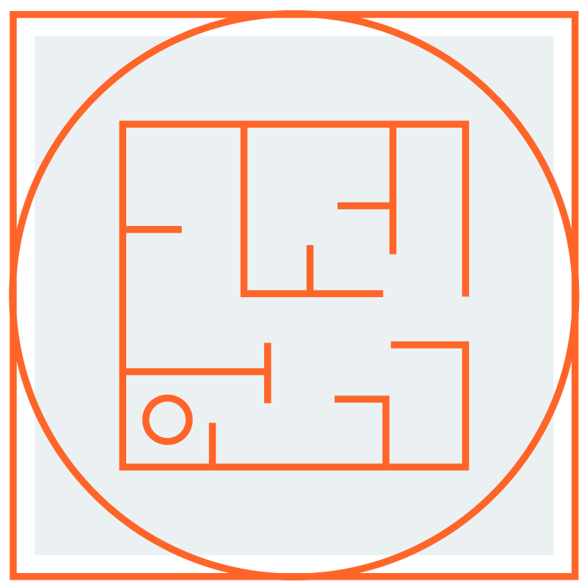
Business transformation is driven by …
Global Economic Change
Complex Hybrid IT Environments
The Need for Automation & Orchestration
Notes:
Everything is truly global today. COVID had a significant impact on retail and our supply chain and other industries worldwide.
Today, IT environments are experiencing profound changes with transformation.
From supply chain to the consumer to employees - what was complex became even more difficult to manage and streamline.
That’s where the need for automation and orchestration arrived.

Slide 5
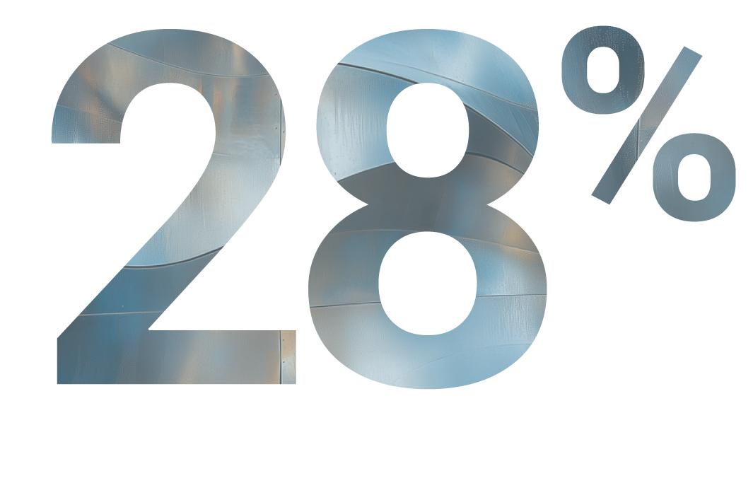
The need for business transformation through automation
The ability to synchronize distributed technology systems, applications, and data sources — seamlessly and securely while maintaining compliance — is the key to improving workflows, operational performance and accelerating business transformation.
Average number of discrete applications in an organization.
of business apps are integrated.
SOURCE: https://www.elastic.io/enterprise-application-integration/application-integration-statistics/
Notes:
We live in an age of unprecedented digital transformation.
Businesses are awash in data, with countless applications, systems, and platforms vying for attention.
This complexity has created a tangled web of interconnectedness, where information is often siloed, leading to inefficient workflows and workforce. The result is a business landscape characterized by friction, delay, and missed opportunities.
The ability to synchronize distributed technology systems, applications, and data sources — seamlessly and securely while maintaining compliance — is the key to improving workflows and operational performance.
On average, an enterprise has about 1,000 applications.
And only about 28% of those are integrated.
Source: https://www.elastic.io/enterprise-application-integration/application-integration-statistics/

Slide 6
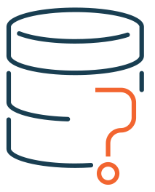
The digital transformation challenge
Application Proliferation
Data
Silos
Lack of Resources
500 Million
82%
64%
of execs report talent shortages are most significant barrier to emerging tech adoption (Gartner)
Number of new applications organizations will build by 2026 (IDC)
of enterprises that report data silos disrupt their critical workflows (IBM)
Notes:
Sources:
500M - IDC:
82% - IBM: https://www.ibm.com/think/topics/data-silos
64% - Gartner - Percentage of tech execs report that talent shortages are the most significant barrier to the adoption of emerging technologies. Gartner Survey Shows Talent Shortages Are the Biggest Barrier to Emerging-Technology Adoption https://www.gartner.com/document-reader/document/4004264

Slide 7
of IT leaders advocate for empowering non-technical users to build, deploy, and maintain applications and integrations
Source - The 2025 Jitterbit Automation Benchmark Report: Insights from IT Leaders on Enterprise Automation & the Future of AI-Driven Businesses

Slide 8
Accelerating AI adoption
of enterprises have integrated AI into their operations. JITTERBIT
of all AI projects fail to achieve their intended outcomes. GARTNER
of IT leaders cite vulnerabilities in AI integrations as top security concern. JITTERBIT
of enterprises are already planning for agentic AI. JITTERBIT
Enterprises require end-to-end AI automation and collaboration between IT/IS teams and line-of-business owners.
Notes:
Sources:
99% - Jitterbit: https://www.jitterbit.com/press-release/jitterbit-study-shows-growing-appetite-for-ai-automation-to-solve-data-divide/
85% - Gartner: https://venturebeat.com/ai/why-most-ai-implementations-fail-and-what-enterprises-can-do-to-beat-the-odds/
31% - Jitterbit: https://www.jitterbit.com/press-release/jitterbit-study-shows-growing-appetite-for-ai-automation-to-solve-data-divide/

Slide 9
Notes:
It’s a true data divide.
How you bridge the data divide becomes important.

Slide 10
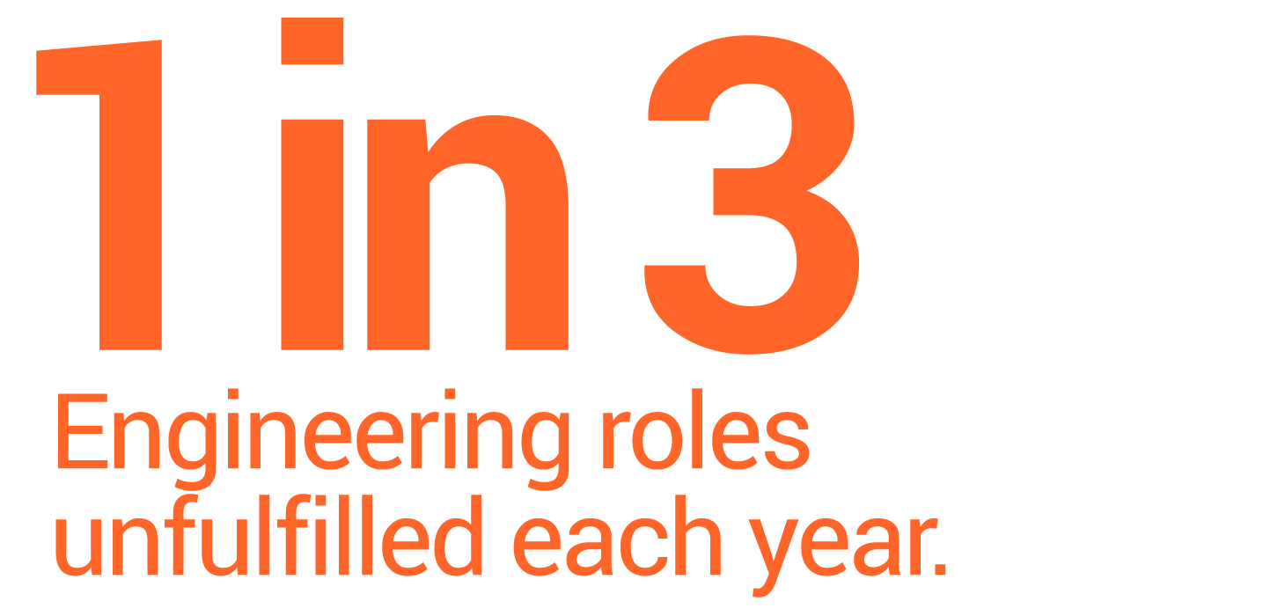
Unfulfilled business and IT requests are growing at an exponential rate
SOURCE: bcg.com/publications/2023/addressing-the-engineering-talent-shortage & morganmcjinley.com/uk/article/skill-shortage-impacts-technology-growth-in-uk
Notes:
Unfortunately, there are not enough technical resources to do the job.
This is not a US issue, or a UK issue, or Europe, South American or Asia issue. It’s a global issue.
Sources:
https://www.morganmckinley.com/uk/article/skill-shortage-impacts-technology-growth-in-uk
https://www.bcg.com/publications/2023/addressing-the-engineering-talent-shortage

Slide 11
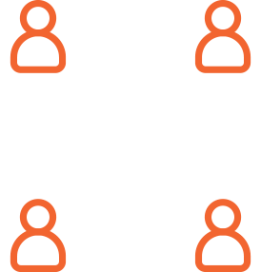
Bridging the ‘data divide’
POINT PRODUCTS & BLOATED PLATFORMS
Line-of-Business
SPEED & INNOVATION
FOCUSED LOW-CODE &
AI-INFUSED PLATFORM
IN-HOUSE SOLUTIONS
IT/IS
DATA DIVIDE
END-TO-END AUTOMATION

Slide 12
Notes:
That's why we believe we need a new approach. The one that's been working doesn't work anymore.
We created a new one - the future state we envision is one where the data has to come together. It has to flow together, seamlessly, perfectly orchestrated.

Slide 13
Notes:
That's why we created Harmony - our unified low-code AI-infused platform.

Slide 14
The modern approach to automation
Unified AI-Infused Platform
Agentic AI
Security First
Ease of Use
Faster Time to Value
Notes:
Harmony is a modern automation platform with five key differentiators:
Unified platform: All components work seamlessly together in a single, integrated platform.
Infused with AI: We believe low-code with AI infusion is the future. It's not AI by itself in an infrastructure product. As Harmony integrates AI, it will further enhance ease of use and speed, creating even more value. This also deliver choice to customers. They can use low-code or AI-infused capabilities for a range of different users and personas.
Security First: Jitterbit manages the security of the Harmony platform by applying a hybrid framework based on NIST, CISA, CSA, and CERT recommendations.
Ease of use: Jitterbit surveyed real customers who said they found Harmony easier and faster to use compared to competitors. This includes both IT and line-of-business users. That's why ‘ease of use’ is becoming more and more important as the experience of the end user evolves.
Faster time to value: Harmony accelerates the process of automating complex, error-prone manual processes. Businesses have to invest resources and services … it’s a significant investment and we can help them scale and see a return faster.

Slide 15
AI-Infused Low-Code Integration, Orchestration, Automation & App Development
iPaaS
API Manager
App Builder
EDI
Marketplace
Management Console
Build, manage and maintain integrations
Create, control and consume your APIs
Build, manage and maintain web and mobile applications
Build, manage and monitor exchange of business documents
Get certified pre-built integrations
Manage, monitor and administer projects in one place
Notes:
Harmony is an AI-infused low code integration, orchestration, automation and app development platform.
iPaaS solution that's AI-infused, where you build and maintain the integrations for your entire environment. Orchestrate workflows that trigger real-time integrations based on external events.
API Manager allows you to create, control and consume that data in the information in those integrations - all in the same platform. Expose and manage APIs using API Manager for real-time integrations.
App Builder (previously known as Vinyl) helps build enterprise applications via low-code or AI-infused approaches. Those 72% of applications that aren't all written for web and mobile - that may need to be rewritten for the current day or new ones. Ideal for internal or customer-facing applications.
Then Jitterbit EDI. Now that you have your applications, you may want to turn to the B2B or commercial landscape. EDI connects you to the long-trusted integration standard. And we have more than 1,000 trading partners built in. And all off the same platform.
Supporting the four cornerstone products we have a Marketplace, where we have over 400 pre-built integrations for the most popular systems, services and use cases.
FInally, the Management Console where you can manage the entire Harmony platform seamlessly in a single console.

Slide 16
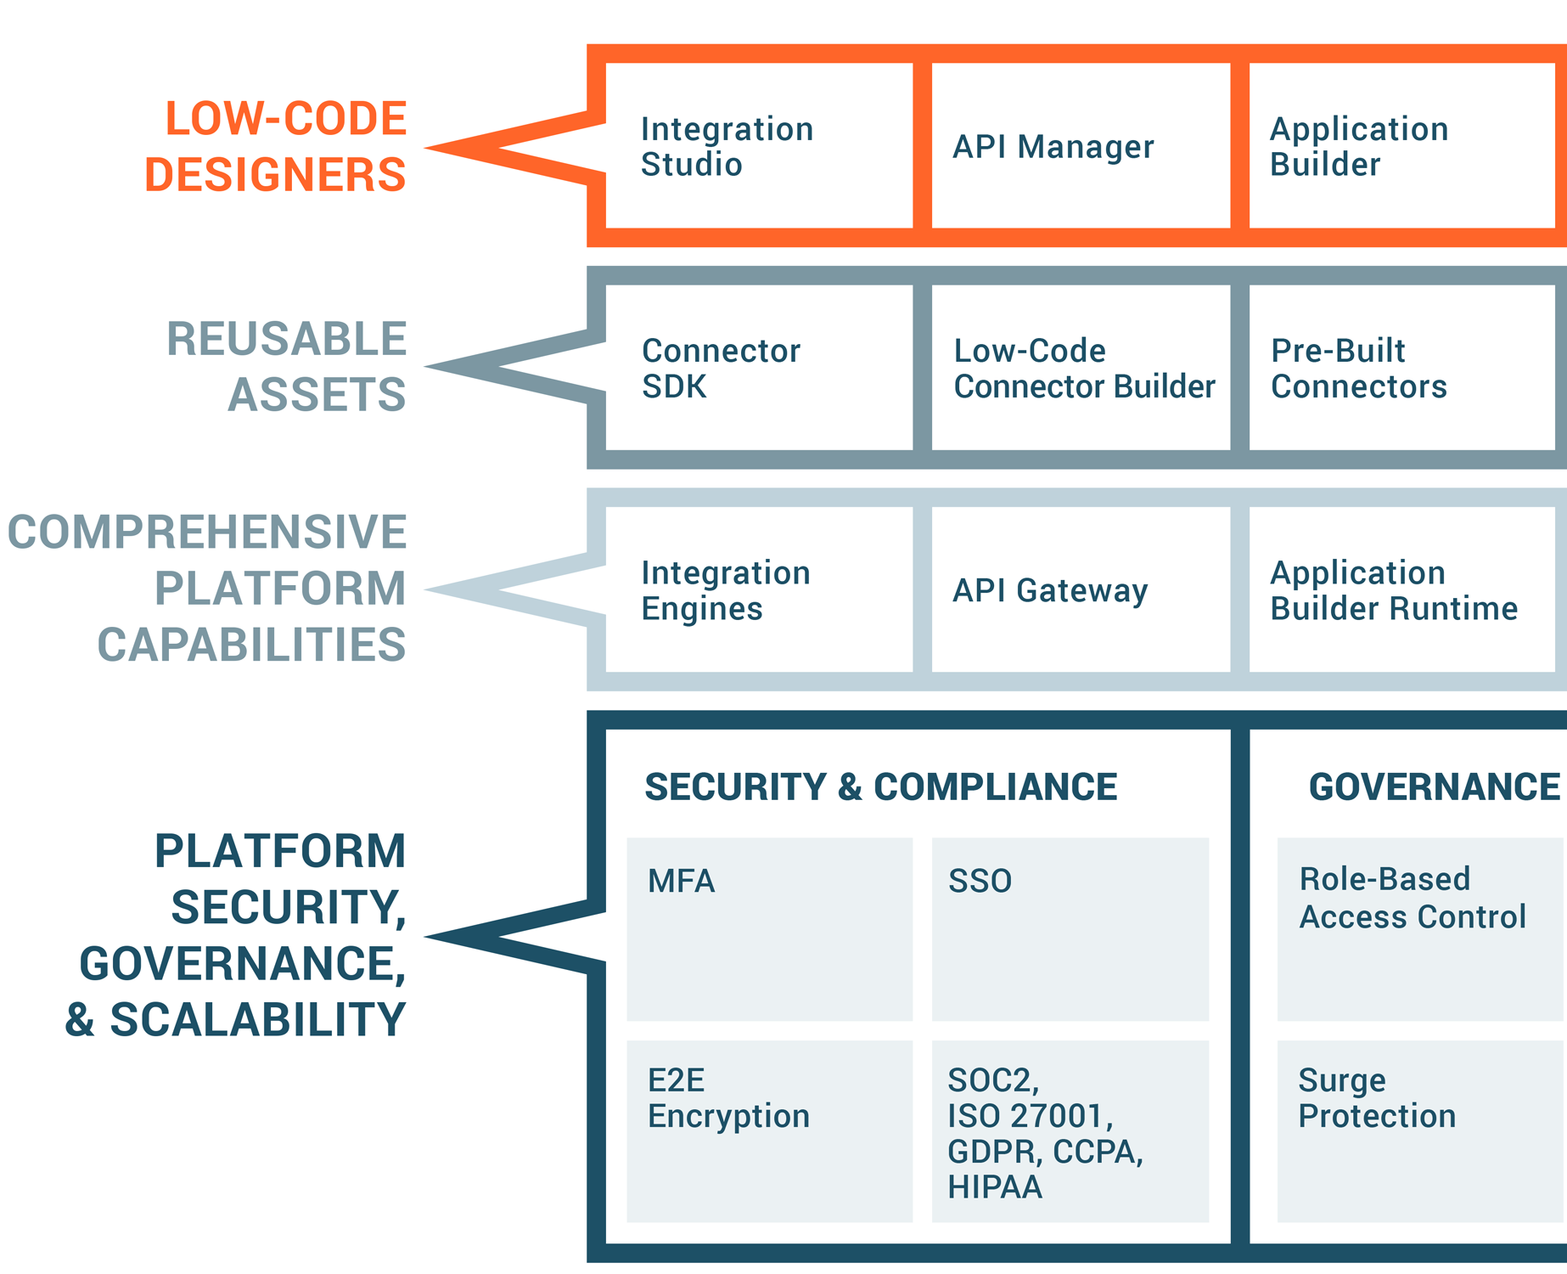
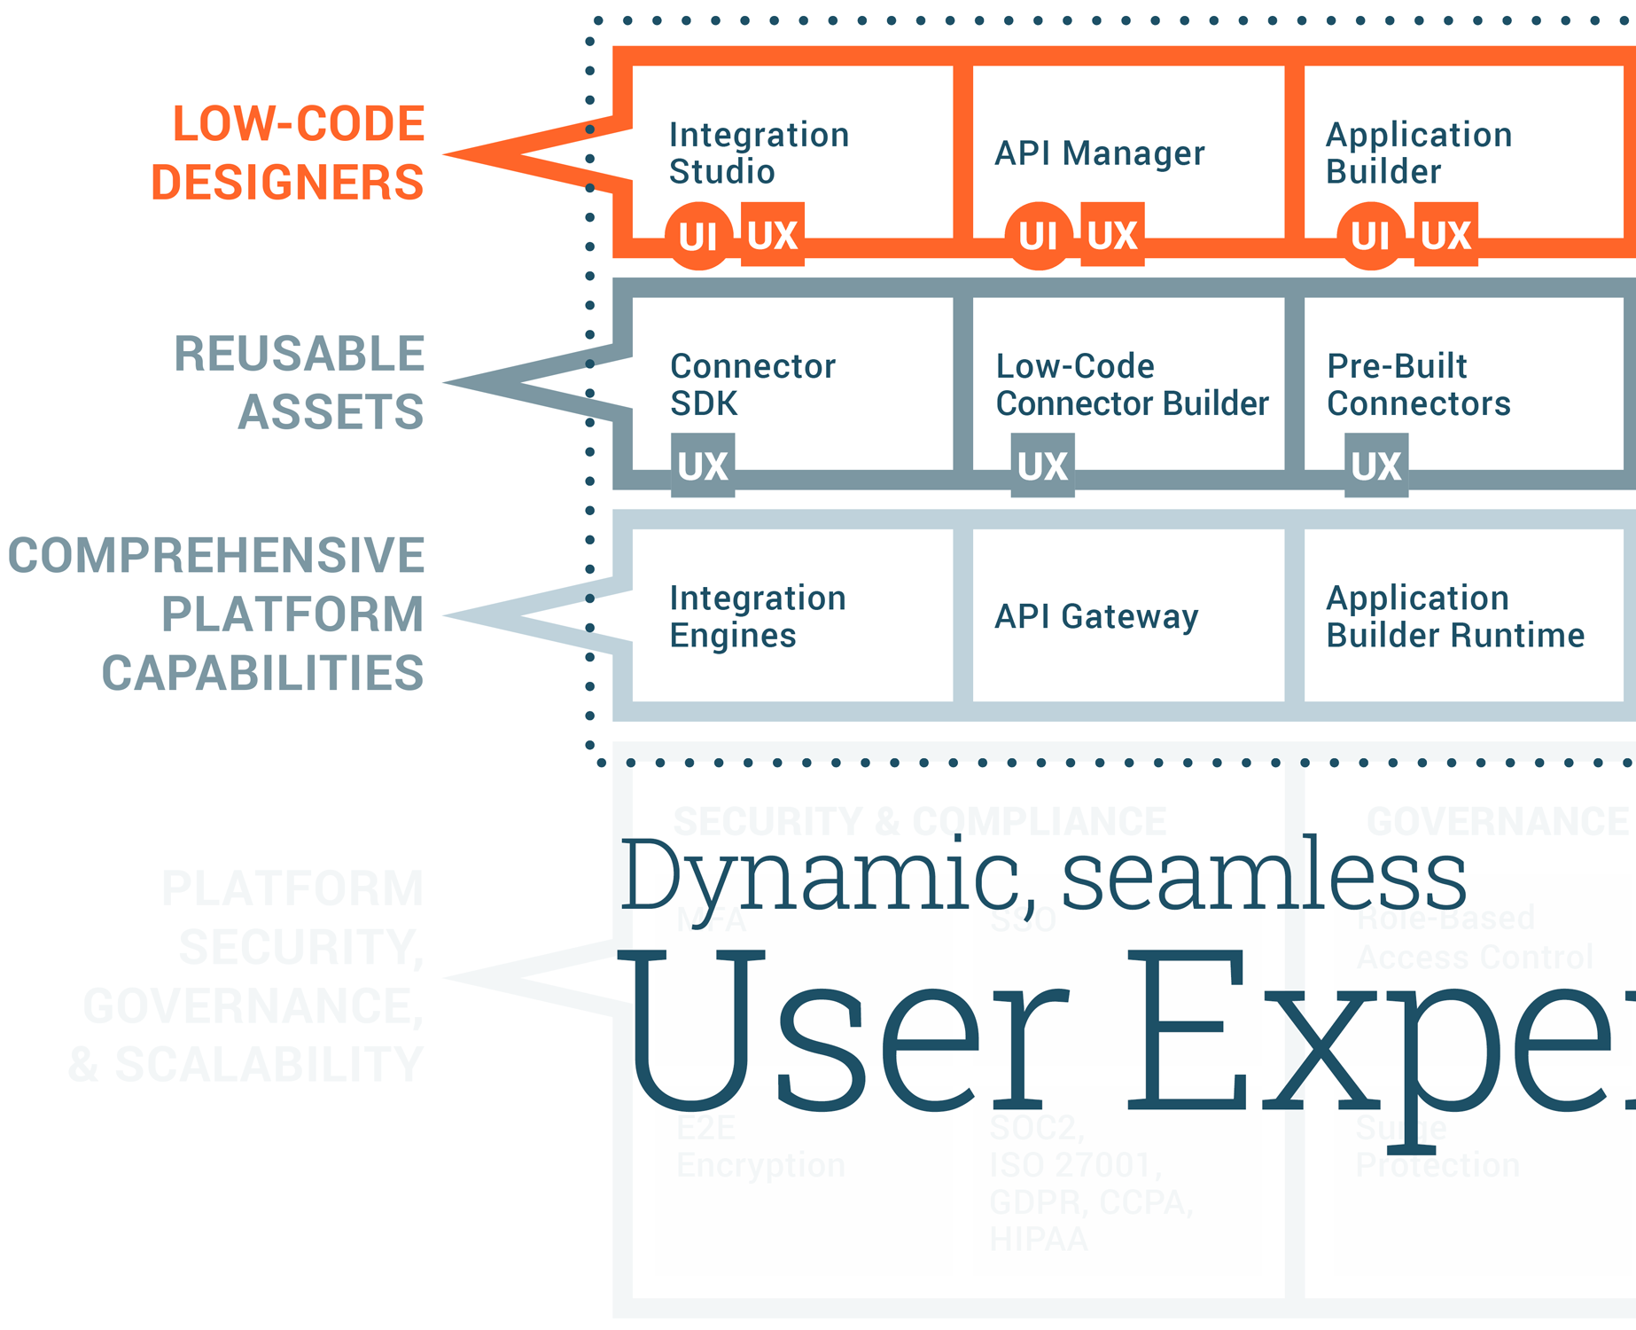
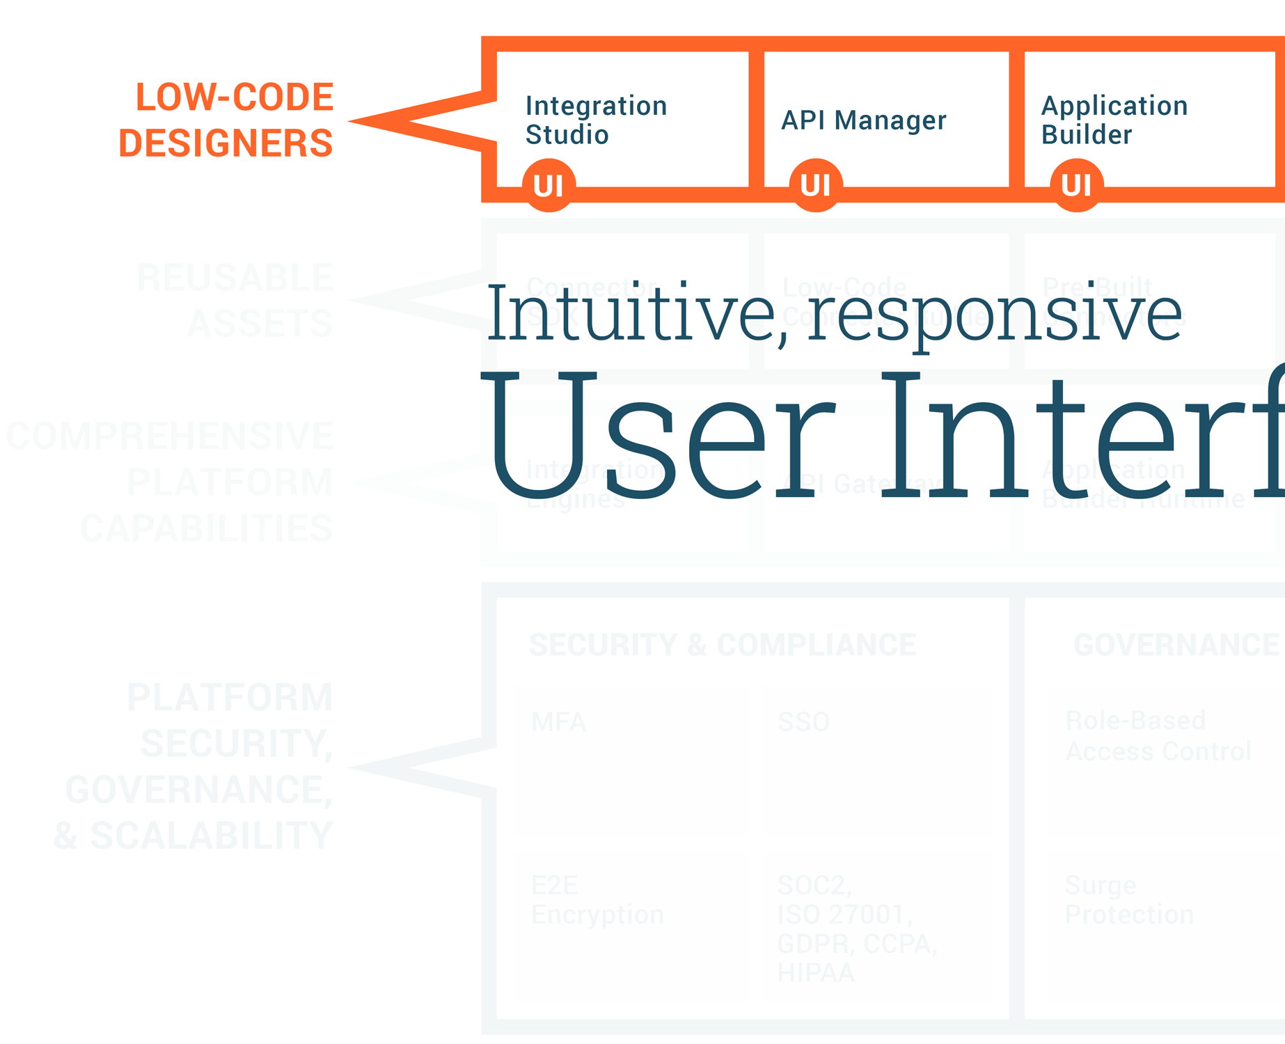
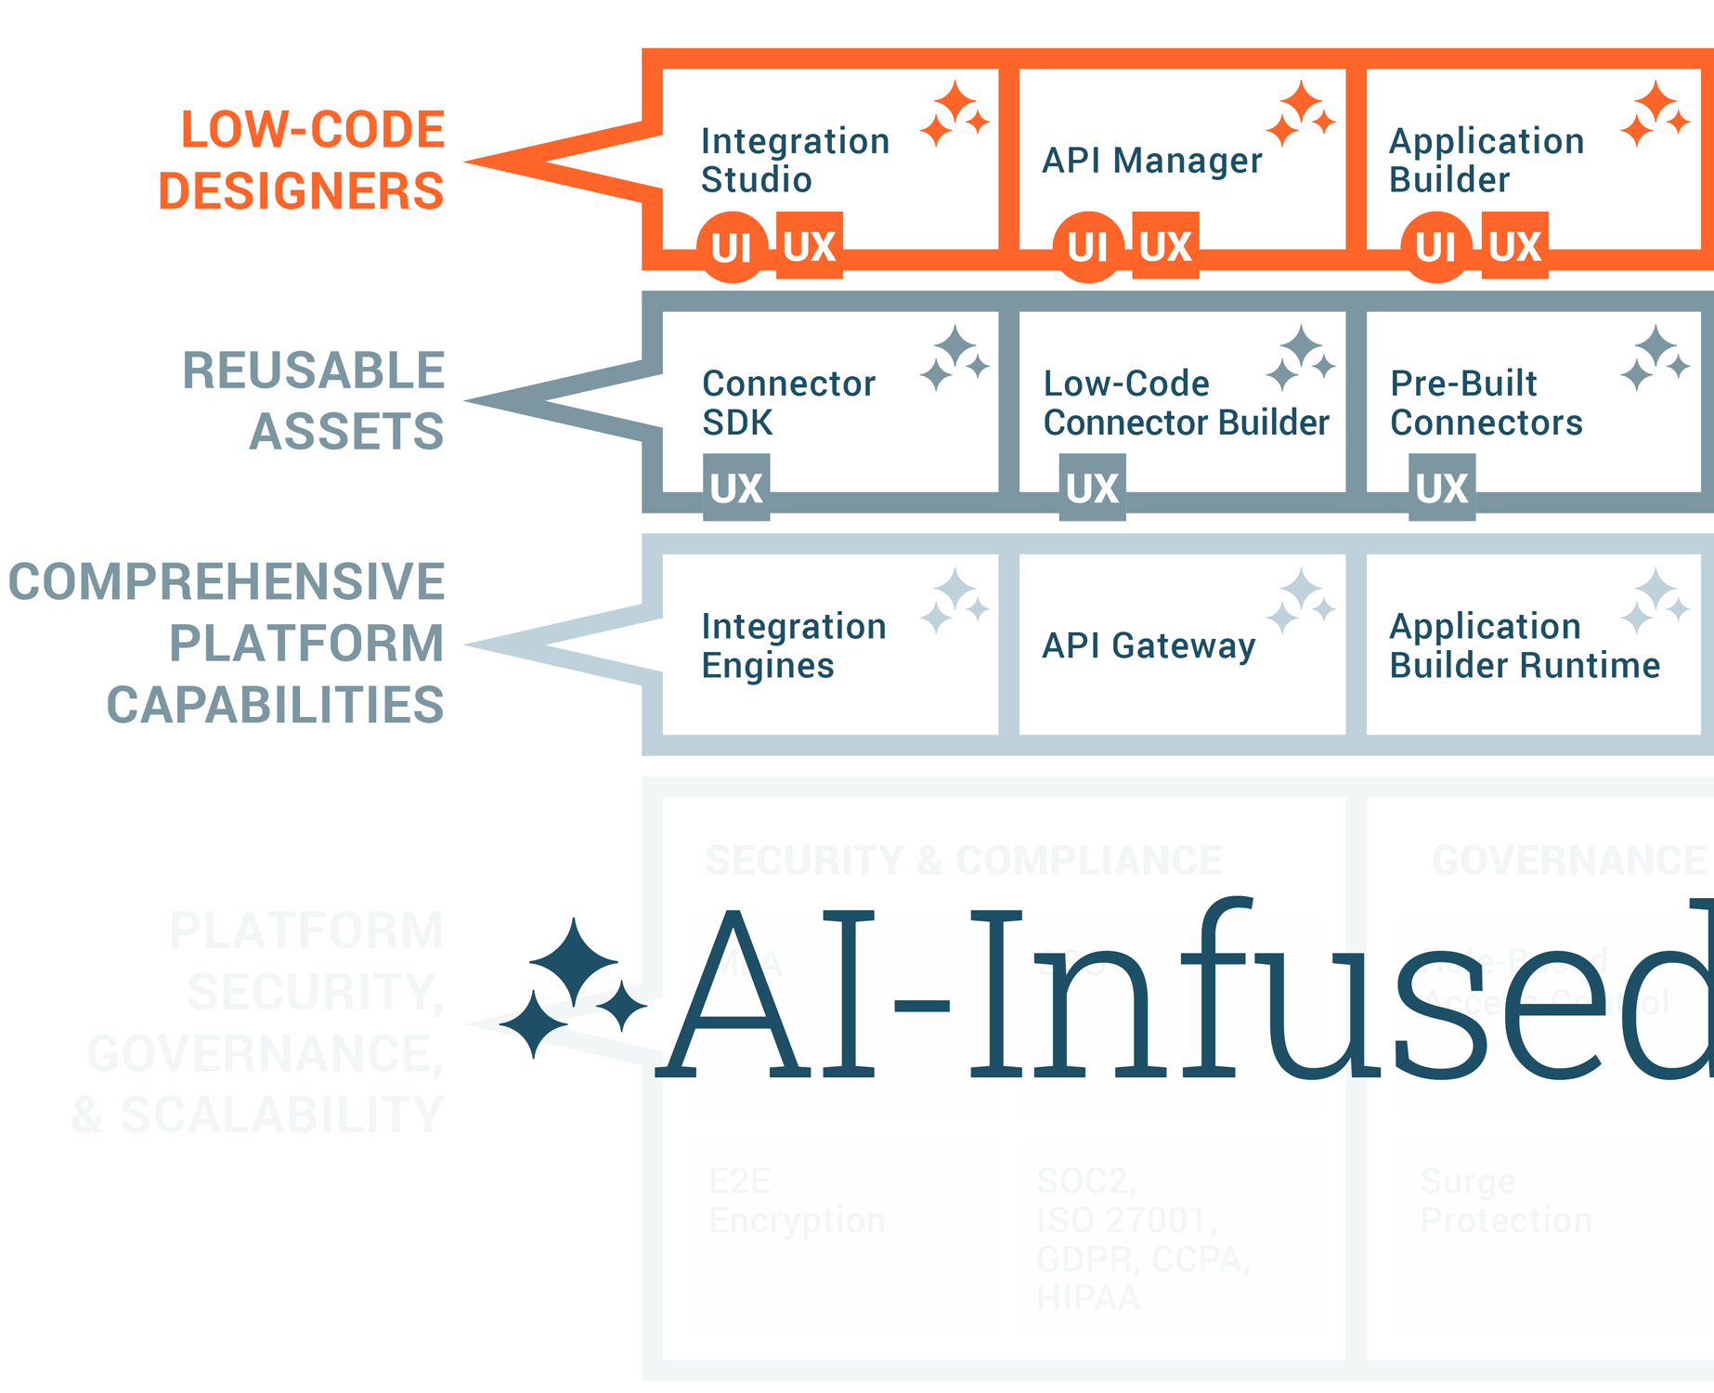
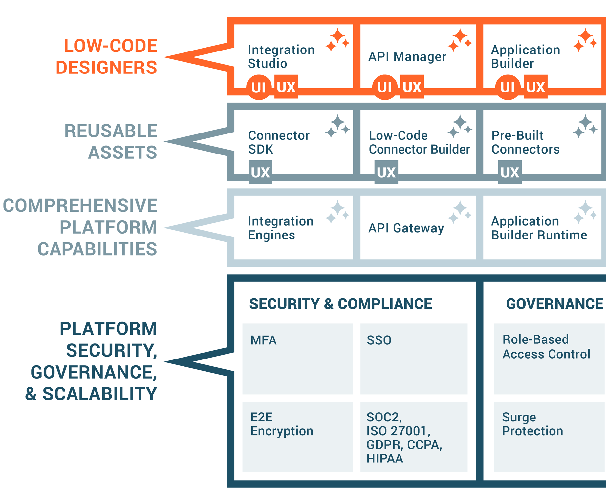
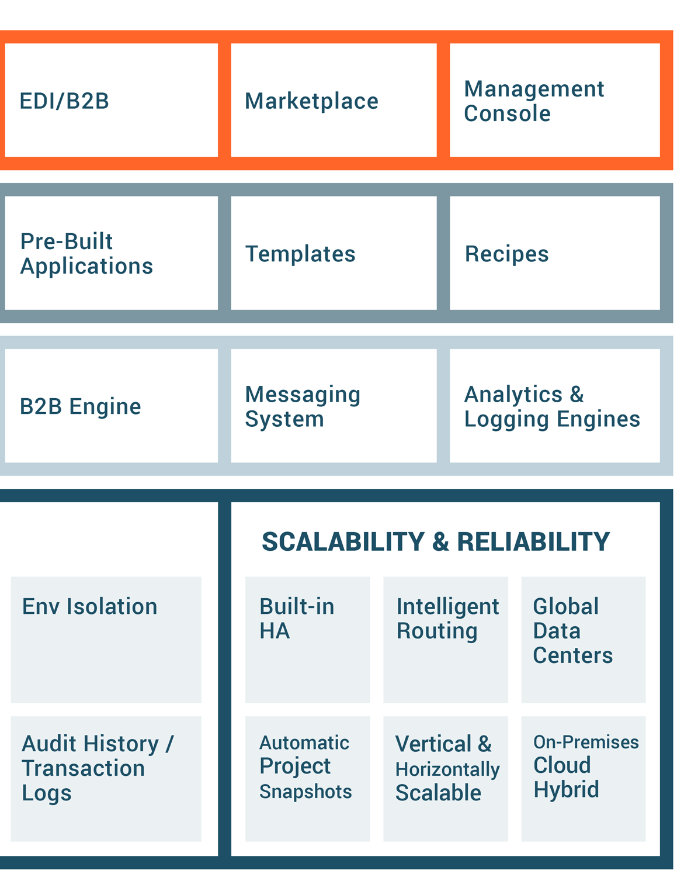
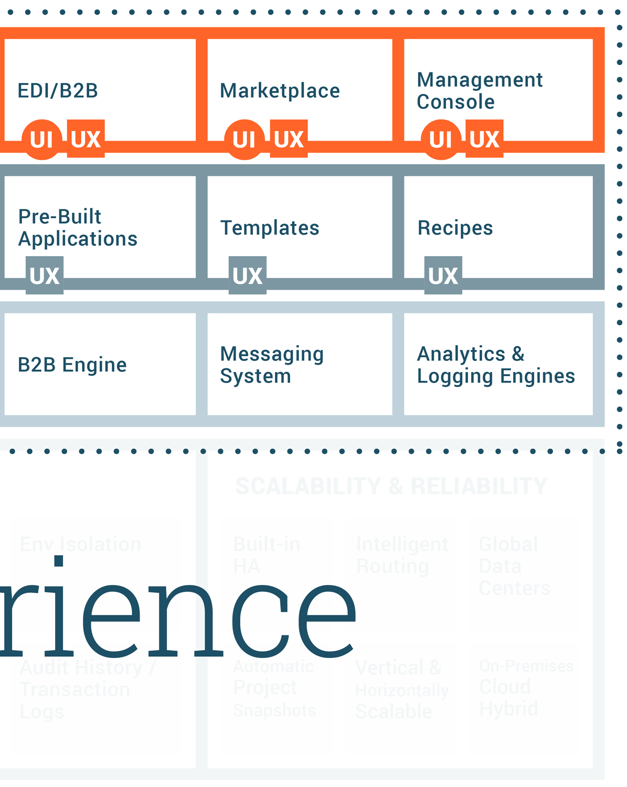
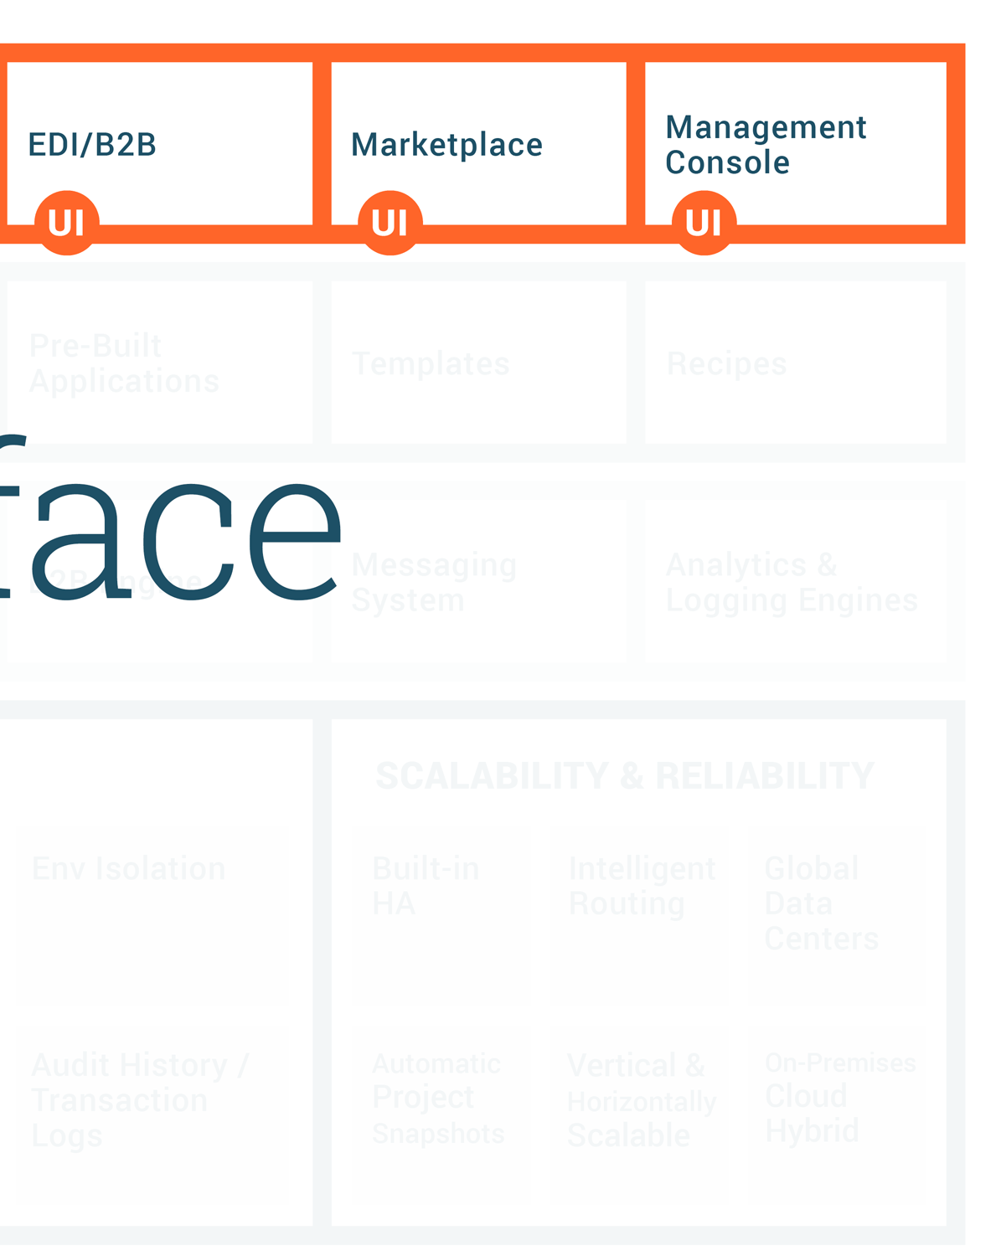
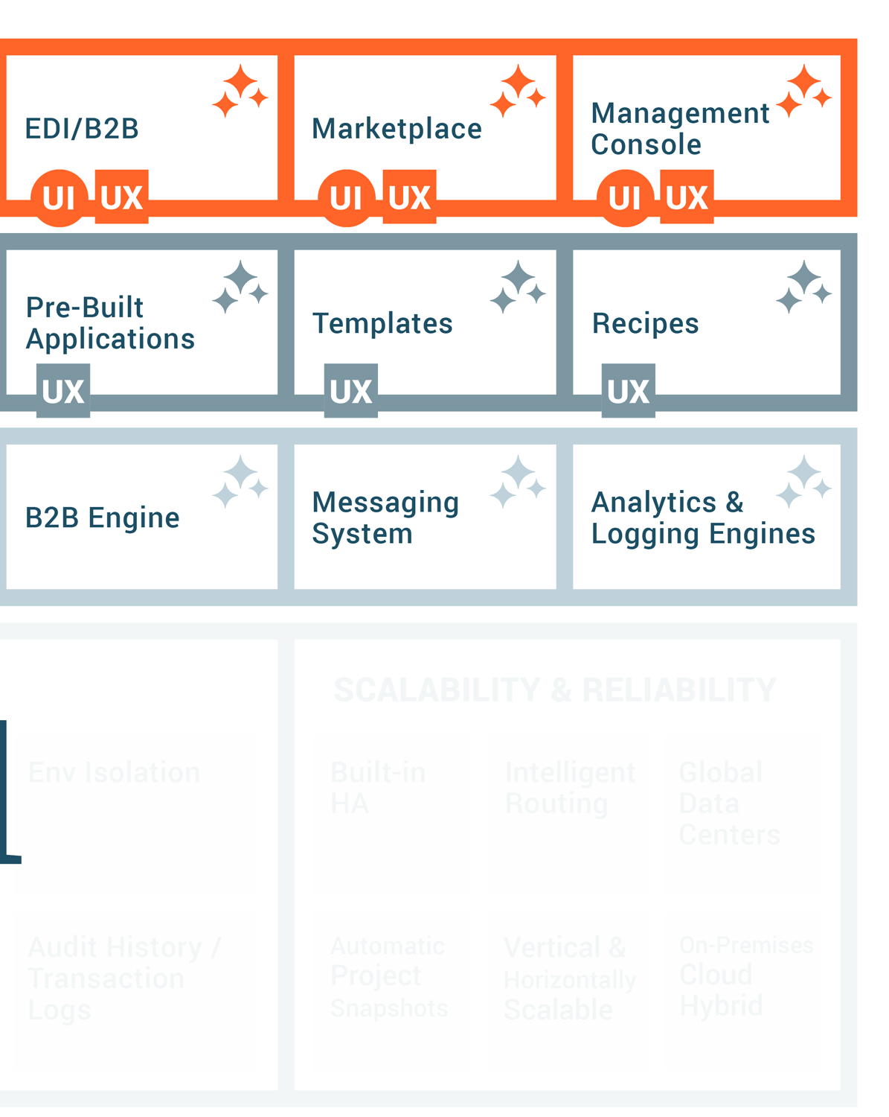
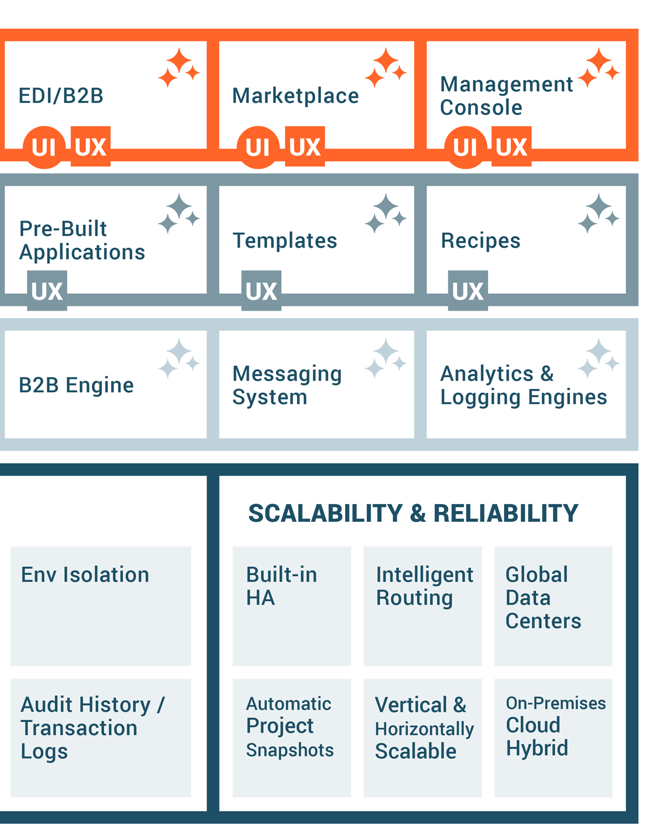
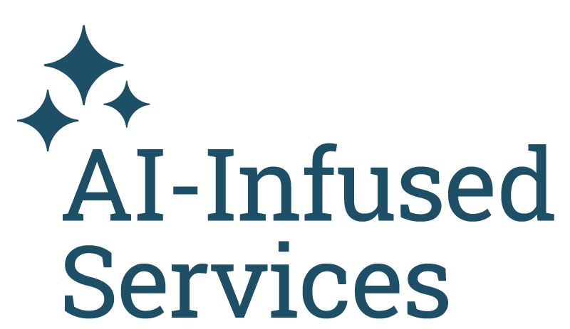
AI-infused low-code architecture
Notes:
Note: For a detailed breakdown of the this slide, please review Elevate Session 167: https://drive.google.com/drive/folders/1kNnTYXDj3bSmwwhth5Q0UZeJkRFa0oD9?usp=drive_link
Platform Capabilities
Low-Code Designers:
Across the top you have six boxes; they are the core UI components tied to the main products covered in the previous slide.
Our low-code designers are built using intuitive and responsive user interface principles, so we think of the user first, even though our audience is technical.
Note: the first box is labeled Integration Studio. It’s the new name for Cloud Studio. Integration Studio is more descriptive and relevant name than Cloud Studio
(Background: Cloud Studio made sense five years ago to distinguish it from our on-prem Design Studio; it’s a downloadable Java Integration Designer that many customers still use, and it's still very capable, but that made sense then when cloud interfaces were novelty.)
Reusable Assets:
Connectors SDK: Used by engineers and partners to build connectors. The connector SDK (software development kit), is used by our own engineers and our customers and partners like BMC to build connectors and make them available in the iPaaS Integration Studio. The SDK is targeted at more technical users.
Low-Code Connector Builder: Wizard-driven experience that any customer can use to create connectors with public REST APIs
Pre-Build Connectors & Applications: Jitterbit and our partners have built and made available today about 250 pre-built connectors, and that number continues to grow.
Recipes: Recipes are simple, unidirectional integrations between two endpoints, like syncing items from NetSuite to products like Salesforce. It's simple. It solves a simple integration use case that's easy for anyone to explain. Our Marketplace includes over 400 recipes and templates today.
Templates: Templates, on the other hand, are bi-directional integrations, so the syncing can go both ways that solve richer and more comprehensive use cases, like opportunity to order between a CRM like Salesforce and an ERP like NetSuite. They might include multiple projects within one template.
Platform Engines: This is where the actual work of running, monitoring and reporting — the integrations, applications, APIs, the B2B transactions — takes place as you would expect.
Integration engines: Run-time engines that run integrations in the cloud, on-premises, or hybrid environments. It’s the customers’ choice.
API Gateway: Manages API requests with options for cloud or on-premises deployment.
App Builder runtime: Manages run-time for thousands of applications customers using today. Entirely cloud-based.
B2B Engine: Handles EDI transactions, also cloud-based (no on-prem option)
Messaging System: Provides users with vital information, particularly if errors occur.
Analytics & Logging: Provides critical diagnostic information on usage and system performance, activity charts, etc.
AI-Infused Services:
AI-infused evolution started years ago.
Enhances ease of use and accelerates time to value.
Infuses AI capabilities into all core components like Integration Studio, API Manager, App Builder, and EDI.
Includes AI-powered assistants (currently in beta) for app and connector building, bringing conversational interfaces for fast and intuitive development.
AI Assistants:
App Builder AI Assistant: Build applications in minutes with a chatbot interface.
Connector Builder AI Assistant: Quickly create connectors for long-tail integrations.
Future AI capabilities: Ongoing development for all components, including real-time guidance through the JBAI chatbot.
Enterprise-Grade Security, Governance, and Scalability
Security and Compliance:
Multi-Factor Authentication (MFA) and Single Sign-On (SSO) for secure access.
End-to-end encryption ensures data security.
Compliance with standards like SOC 1/2, ISO 27001, GDPR, CCPA, and HIPAA.
Governance:
Role-based access control to manage user permissions.
Environment isolation ensures data protection in multi-tenant systems.
Audit history for detailed tracking, essential for industries like banking.
Scalability and Reliability:
High availability (HA) with redundancy and failover mechanisms.
Global data centers ensure consistent service with intelligent routing and load balancing.
Automatic backups and scalable infrastructure allow vertical and horizontal scaling.
Flexibility for deployment: Choose between cloud, on-premises, or hybrid models.

Slide 17
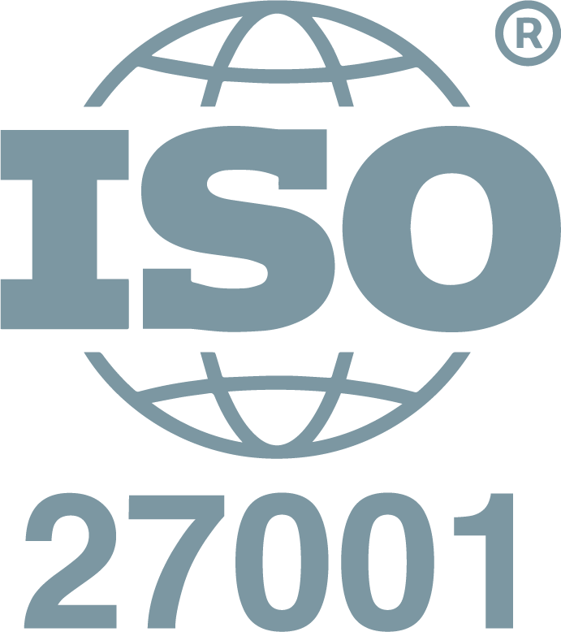
Jitterbit’s layered security foundation
Jitterbit manages the security of the Harmony platform by applying a hybrid framework based on NIST, CISA, CSA, and CERT recommendations.
LOGICAL SECURITY
MFA*
WAF*
Access Control
IDS & IPS
Secure Database
DDOS Monitoring & Mitigation*
FIPS 140-2 Auth
SSO
E2E Encryption
ORGANIZATIONAL SECURITY
Personnel Policy
Penetration Testing
OWASP Checks
Secure SDLC
FIPS 140-2 Auth
SSO
E2E Encryption
PHYSICAL SECURITY
Intrusion Detection*
Video Surveillance
Secure Cloud Redundancy
Biometric Controls
GLOBAL ACCREDITATION & COMPLIANCE
* Provided via AWS security controls.
Notes:
Jitterbit manages the security of the Harmony platform by applying a hybrid framework based on NIST, CISA, CSA, and CERT recommendations. This framework is categorized into three key layers.
Logical Security Logical security is comprised of all the security measures taken within the Harmony platform. These include the system architecture; major components; Harmony users, organizations, and roles; Harmony environments and access control; Harmony data storage; and Harmony security topologies.
Physical Security Physical security involves the hosting of Harmony on cloud infrastructure. This section describes infrastructure compliance; physical and environmental security; high availability and fault tolerance; network security; secure design principles; change management; load balancing security; data storage; and data durability and reliability.
Organizational Security Organizational security covers operational best practices of leading cloud-computing providers around the world. This includes confidentiality; the personnel policy; internal team-specific operating procedures and policies; reporting of system status; identity and access management; patch management and high availability; and capacity management.
In addition, Jitterbit develops and improves its applications by using sound software-development lifecycle (SDLC) practices, including, but not limited to, :
Identifying vulnerabilities from outside sources to drive change and code improvement.
Applying hardware and software patches. Jitterbit is responsible for code changes and Amazon Web Services (AWS) is responsible for providing hardware patches; our virtual environment allows us to apply code changes and hardware patches without any downtime.
Providing secure authentication and logging capabilities.
Ensuring that Personal Identifiable Information (PII) is not used in test environments.
Following secure coding practices according to an SDLC policy and addressing the security training needs for the development team.
Checking for security flaws as prescribed by the Open Web Application Security Project (OWASP), such as injection flaws, buffer overflows, cryptographic errors, error handling, etc.
Assessing for vulnerabilities on every release.
Conducting annual penetration testing.

Slide 18
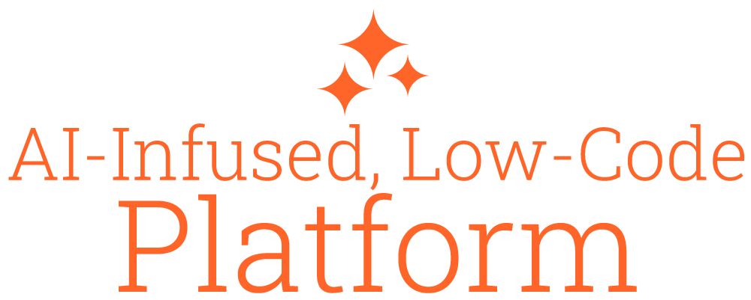
Jitterbit Harmony: A unified AI, low-code platform
Empowering organizations to compose AI agents and automate business transformation
Knowledge Base Agent
Employee Agent
Sales Agent
Service Agent
Custom Agents
Third-Party Agents
Notes:
Important notes: Is ‘AI Studio’ different from Integration Studio? No. It’s the same product feature. The use of ‘AI Studio’ is forward-looking to help communicate where AI agents will be designed and built within the Harmony platform.
Is ‘AI Marketplace’ different from Jitterbit Marketplace? No. It’s the same product feature. The use of ‘AI Marketplace’ is forward-looking to help communicate where AI agents and related services can be sourced from Jitterbit and other vetted third parties.
Please reference this FAQ for additional details: https://docs.google.com/document/d/1V1InybpUctqxaRIJtAfA1nui8Rytf2p95OsVUrIVUKo/edit?usp=sharing

Slide 19
Jitterbit Harmony: A unified AI, low-code platform
Empowering organizations to compose AI agents and automate business transformation
Knowledge Base Agent
Employee Agent
Sales Agent
Service Agent
Custom Agents
Third-Party Agents
AI Accountability
Notes:
AI accountability ensures that AI applications or agents operate as intended by verifying that their decisions are correct, appropriate, transparent, and ethical. This process can involve human oversight (human-in-the-loop) or be automated.

Slide 20
Jitterbit Harmony: A unified AI, low-code platform
Empowering organizations to compose AI agents and automate business transformation
Knowledge Base Agent
Employee Agent
Sales Agent
Service Agent
Custom Agents
Third-Party Agents
Notes:
Jitterbit's layered AI architecture strategically integrates complementary layers — including intuitive AI assistants, autonomous AI agents, and user-friendly low-code/no-code automation tools — to empower businesses to effortlessly create, deploy, and manage seamless, intelligent automations. This modular approach enables users of all technical backgrounds to rapidly build, maintain, and govern secure end-to-end automations, from standard business workflows to advanced AI agents.

Slide 21
Agentic AI, inside and out
AI Agents
Custom AI Agents
Marketplace AI Agents
Built by Jitterbit
Built by Jitterbit
Built by Jitterbit or Third Party
Notes:
Organizations can leverage Harmony to deploy AI agents via three distinct methods:
Build new AI agents with ease. Design AI agents with natural language or low-code in the Harmony platform with the same easy-to-use studio where organizations orchestrate powerful system integrations and automations today.
Leverage trusted AI agents. Source AI agents in the expanded Jitterbit Marketplace. This allows organizations to leverage agents created by Jitterbit, as well as third-party AI agents already vetted by Jitterbit.
Outsource AI agent development. Jitterbit will design, test and deploy custom, purpose-built and accountable AI agents for organizations. Jitterbit Agentic AI Professional Services offering will allow businesses to outsource the development of custom agents specifically designed to solve their core automation and orchestration needs. Jitterbit’s agentic AI professional services offering is available to customers beginning in May 2025.

Slide 22
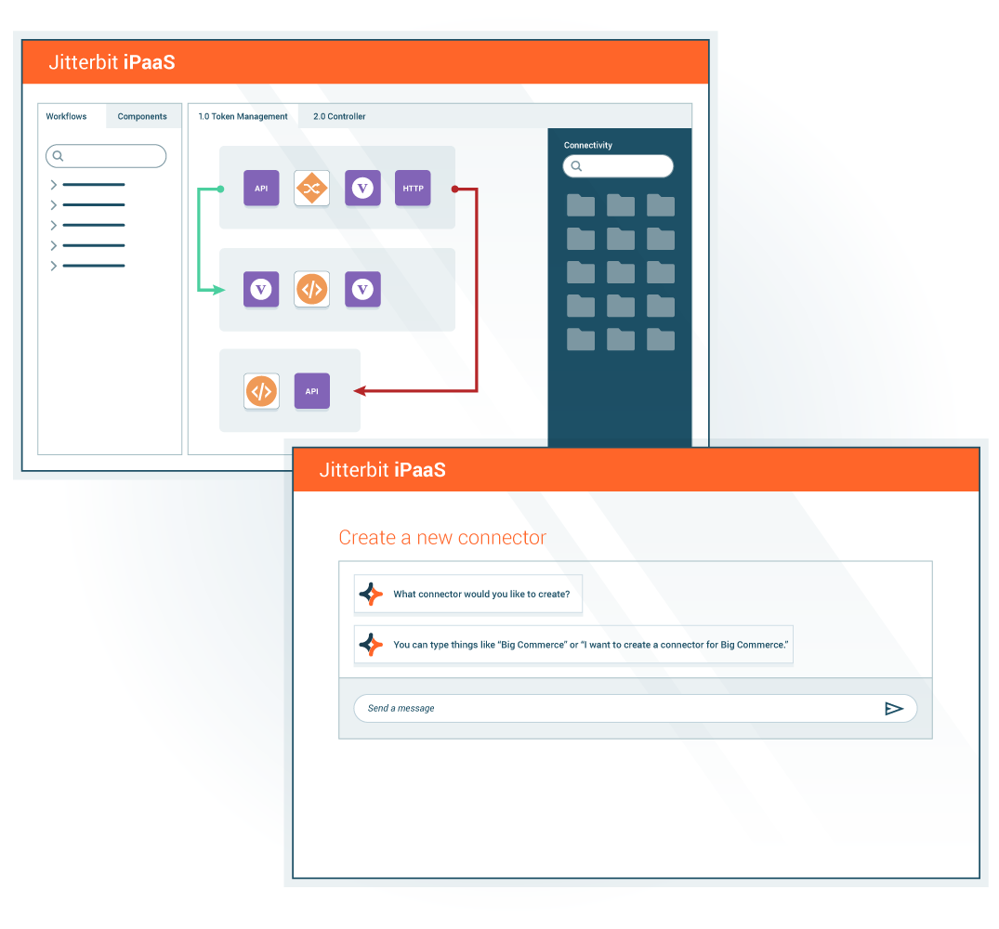
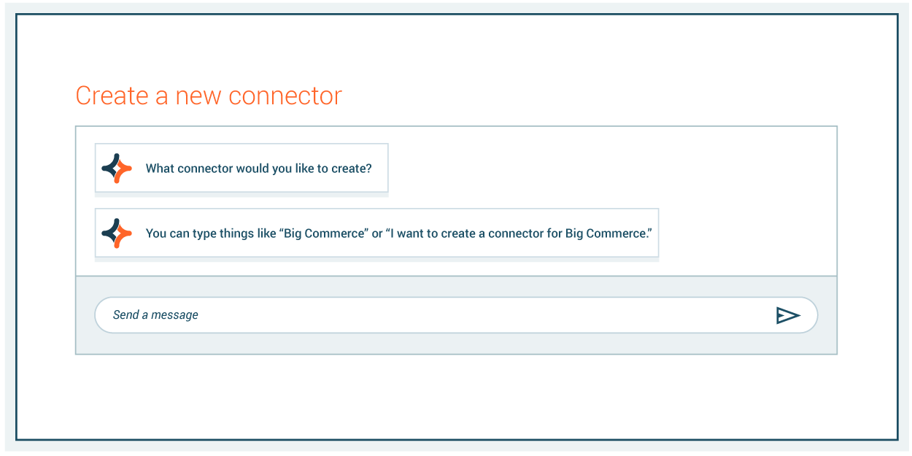
Integrate. Orchestrate. Automate.
Provide secure, scalable, cloud-native integration, enhancing operational efficiency through seamless connectivity across on-premises and cloud systems with over 250 connectors
Intuitive, low-code interface and AI-powered chatbots empower IT and business teams to accelerate deployment, reduce costs, automate processes, drive faster time-to-market, improve agility, and reduce technical barriers
Notes:
Accelerate digital transformation with an enterprise iPaaS that delivers secure, scalable, and AI-driven integrations, enabling seamless connectivity across your organization.
We start with integration and Jitterbit iPaaS. You can’t orchestrate or automate if you can’t integrate.
If you don’t have one of the 250 connectors, you can use SDK and soon with our AI-infused capabilities, customers can let AI build it for them.
Why is that important? You have to connect the 72% of systems and applications that aren’t integrated.
Values for integration - you can seamlessly work across it, drag and drop, go hybrid, AI, low-code. Whatever the customer needs.
Jitterbit delivers incredible time to value and future-proofs your business simultaneously.
Note: The corporate deck has an additional hidden slide for each product that aligns across the four differentiators. You may use these optional four slides as you see fit.

Slide 23
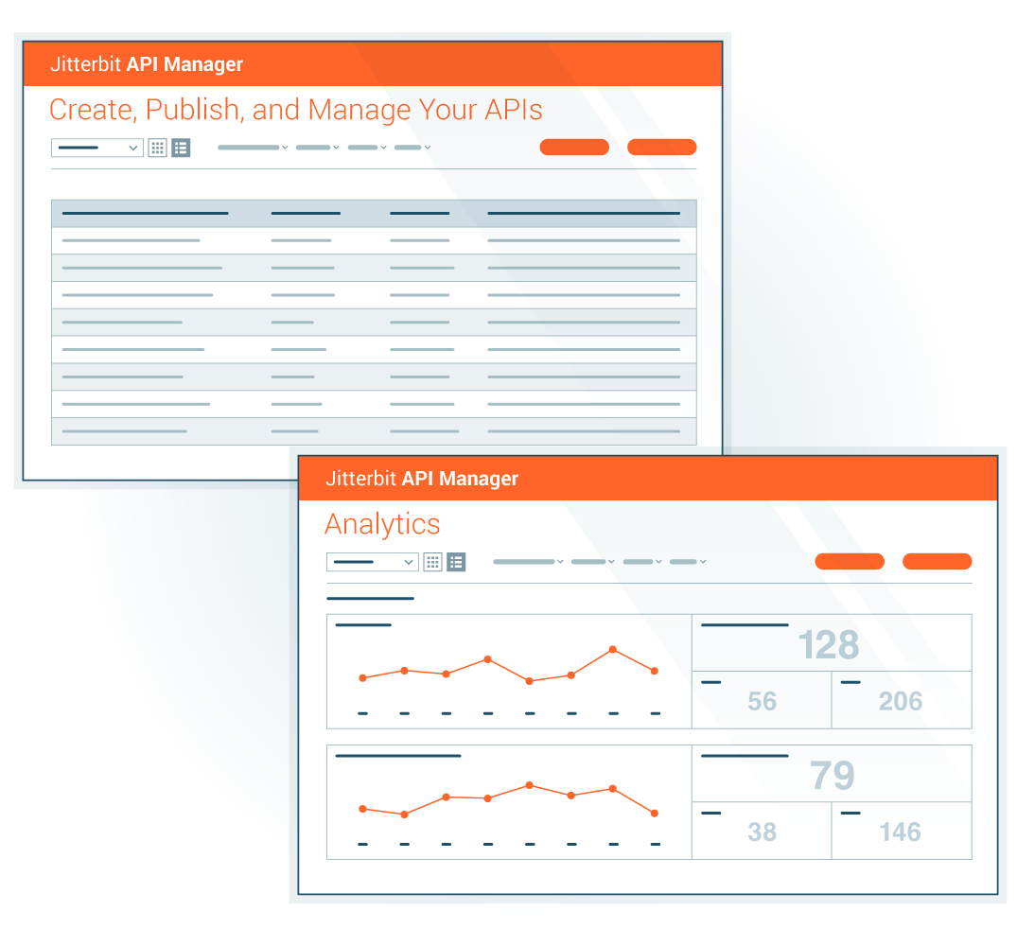
Enable real-time operations
Quickly expose integrations as APIs with an easy-to-use wizard
Accelerate digital transformation by streamlining API creation, control and consumption
Empower IT and business users to rapidly build, secure, and manage APIs from iPaaS integrations, driving real-time workflow automation
A centralized approach offers comprehensive control, visibility, and security over API lifecycle management, fostering innovation and agility
Notes:
Empower real-time workflows with an API manager that delivers comprehensive control, visibility, and security over the entire API lifecycle.
Now that you’ve got your systems integrated, you can use API Manager to expose the APIs easily and quickly.
That’s what APIM allows you to do in an automated way.
Sold almost exclusively to iPaaS customers; tight integration with iPaaS
It’s the next step to workflow automation and true digital transformation. Faster with APIs and easier to do (we have the awards and use cases to prove it). Time to value.
It’s future proof - you don’t have to purchase something else. Just turn it on. Click the build. It helps you scale your business.

Slide 24
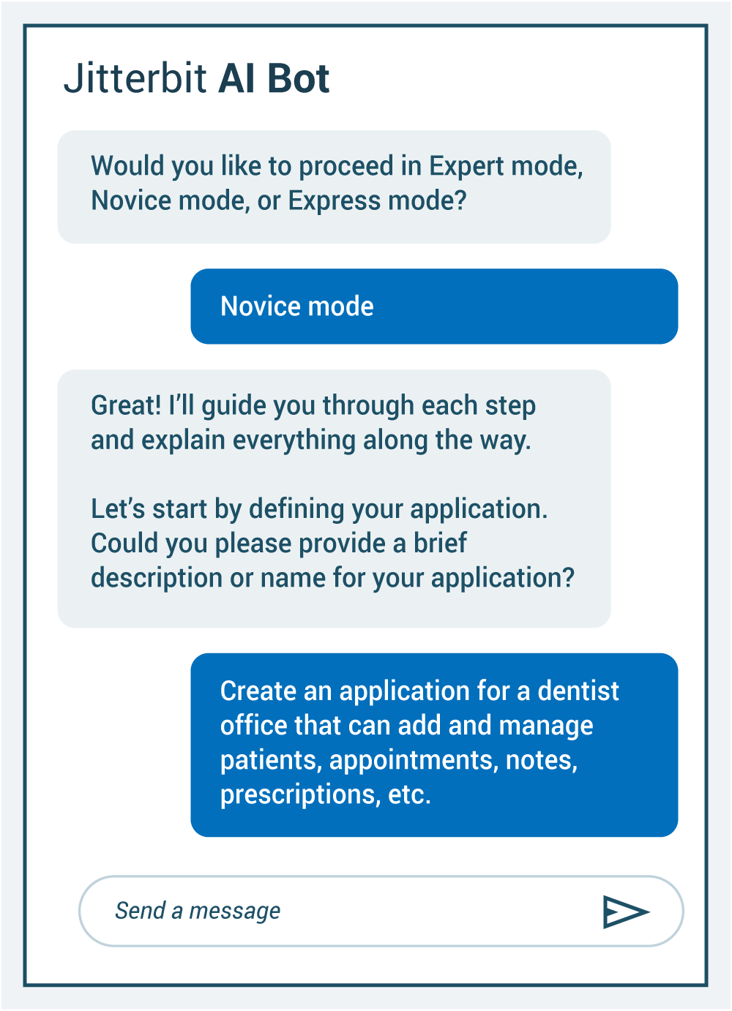
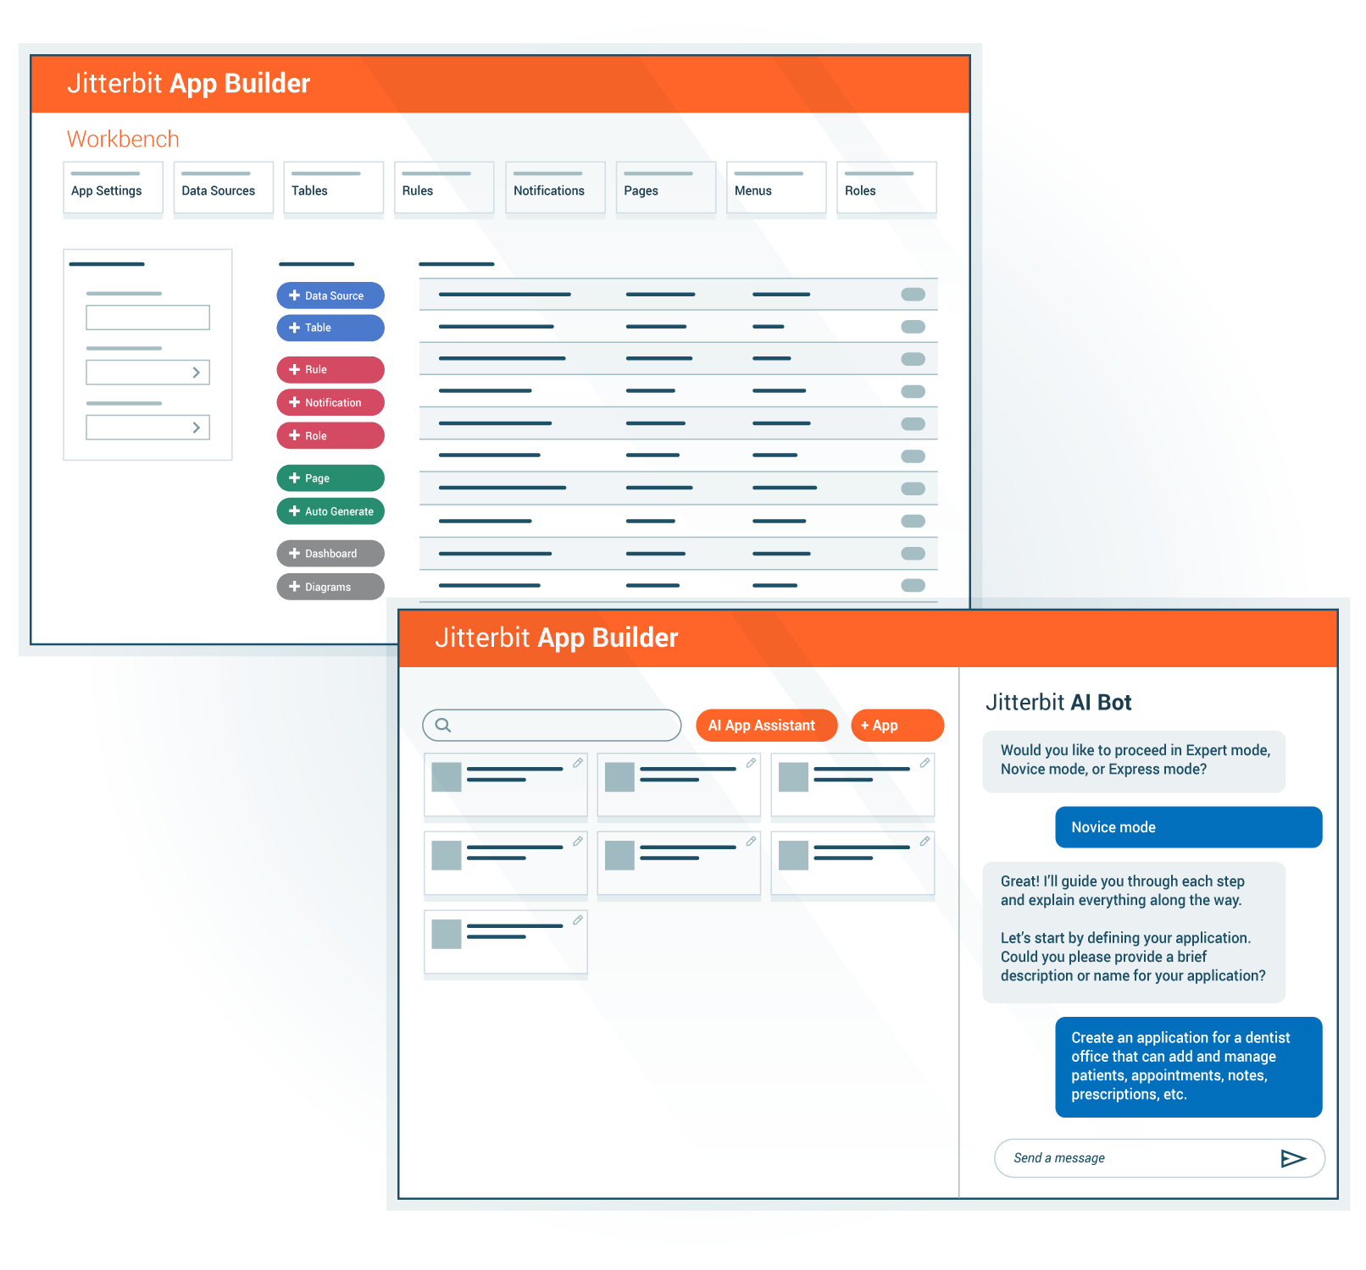
Accelerate application development
Empower IT and line-of-business teams to create scalable, secure, and compliant end-to-end applications fully integrated into your tech stack
Solve complex business problems at scale simply and quickly with web and mobile applications that run on any device
Create system-level enterprise applications
Notes:
Jitterbit App Builder empowers teams to easily create and deploy secure custom web and mobile applications that integrate data and functionality from multiple disparate systems. Organizations can build user interfaces, portals, workflows, and map out decision-making processes quickly though a low-code interface, enabling both citizens and developers to deliver custom solutions at velocity.
Solve complex business problems at scale simply and quickly with web, mobile and offline applications that run on any device
Operate as a system for your business processes
Resource constraints - if you’re a line of business owner who has the expertise, go to IS/IT department with an idea - mobile app, web app, etc. What do you think you’re going to hear?
Here’s what is unique about our AI-infusion on App Builder - you have three levels:
Express level: Fast track
Novice: Guides you through the databases and asks you about your business
Expert: For the savvy user or dev
It's a time-saver that cuts down tasks by a factor of 1,000 — what would normally take months or weeks is now days. Think of the training requirement.

Slide 25
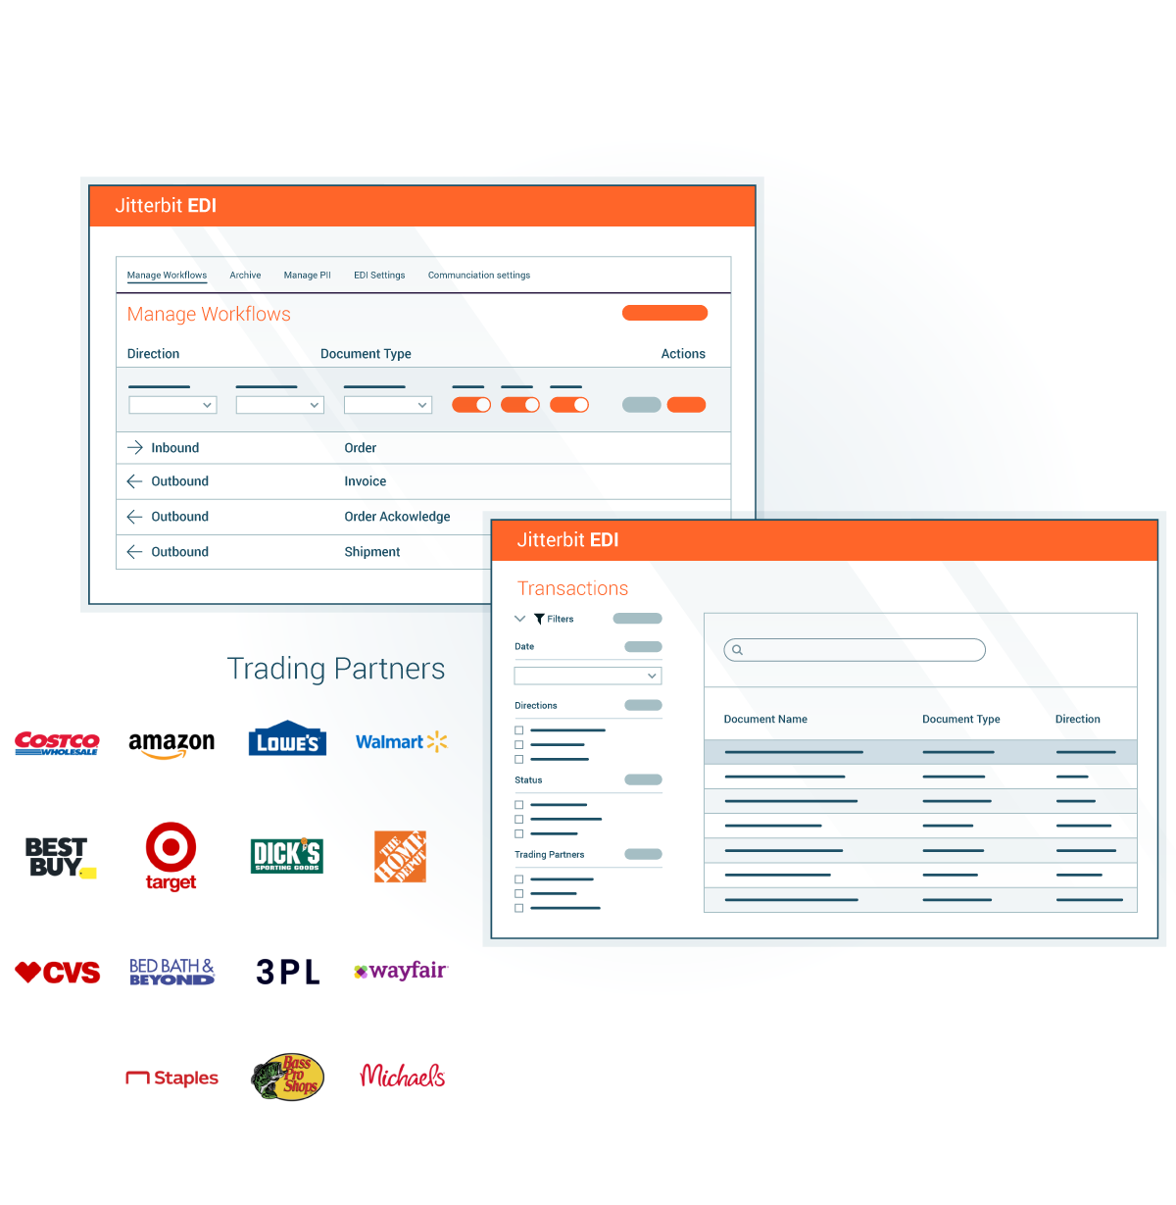
Simplify B2B workflows
Manage B2B transactions in a single, seamlessly integrated platform
Effortlessly connect EDI with ERP systems, automate end-to-end workflows, and easily add new trading partners from our list of more than 1,000 trading partners
Monitor your transactions from a single dashboard
Leverage AI-driven insights to optimize workflows, reduce errors, and improve supply chain visibility
Notes:
Harness EDI integration to connect backend transactions, automate end-to-end workflows and connect new trading partners in minutes.
Streamlines the entire EDI lifecycle; manage trading partners, documents, and transactions
Manage B2B transactions in a single, seamlessly integrated platform
Add trading partners from our list of more than 1,000 … the biggest brands in B2B business
Effortlessly connect EDI with ERP systems, automate end-to-end workflows,
Leverage AI-driven insights to optimize workflows, reduce errors, and improve supply chain visibility

Slide 26
Highly skilled. Highly responsive.
Highly personalized.
%
We provide a team of passionate technologists, at your fingertips, ready to guide you through and beyond any integration challenge, across our entire platform of products. Tailor the level of support to best suit your team’s needs.
93+
Support agent rating
With Jitterbit, you’re not only getting a product platform; you’re gaining a partner dedicated to accelerating your success.
SOURCE: Internal Customer Value Add (CVA) Surveys
Notes:
The platform’s core technology is phenomenal
But we’re also making an impact in support and service.
Service matters. We’re infrastructure software. Service choices matter, too.
Now they have a choice of service levels that match their business needs.
And our support agents have a 90+% rating.
Our passionate technologists are available to guide you through every step of the integration process across our platform.

Slide 27
Jitterbit by the numbers
11 consecutive years recognized in Gartner’s Magic Quadrant for iPaaS
4.6 out of 5 stars
2024 SIIA CODiE Award winner in the iPaaS category for a second year in a row
20 ‘Leader’ and ‘High Performer’ badges in 2025 G2 Spring report
Notes:
We have the accolades, too
With Gartner, 11 consecutive years in the top right or visionary quadrant. This is invite-only. Jitterbit is a respected name in this space.
The Harmony platform takes us to that next level.
Great reports on G2 … 4.6 out of 5 Stars
Won two consecutive CODiE awards for iPaaS.
Also won a Silver Stevie for best platform as a service in May 2025

Slide 28
Jitterbit, founded in 2003
20+
600+
2K+/60+
years of automation innovation
customers / countries
technology & channel partnerships
99.
99
1
1
20B
%
1.5M+
product uptime
lines of low-code
API calls per month
Notes:
We have a vision and we’re recognized for it. We have 20 years of experience and great technology.
Over 2,000 customers in 60+ countries.
More than 600 technology and channel partnerships.
99.99% product uptime.
We have 10M+ lines of code in the platform.
We have enterprise customers and small business customers.
The platform delivers for all. It scales with the biggest and services the smallest.

Slide 30
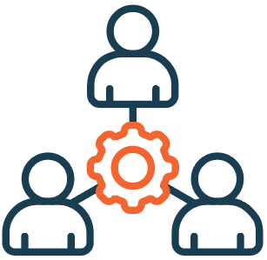
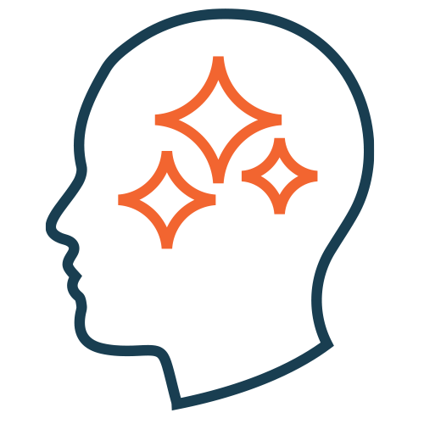
Jitterbit Agentic AI Services
A dedicated team of AI and ML experts design, develop, test, and deploy custom, purpose-built, and accountable AI agents tailored to an organization's specific needs.
Expertise
Seasoned AI experts develop custom agents, rigorously tested and accountable.
Seamless Deployment
Leverage the power and ease of Jitterbit’s low-code Harmony platform for rapid deployment.
Custom AI Agents
Tailored and designed AI agents to support an organization’s unique challenges and goals.
Notes:
Imagine a team of seasoned experts laser-focused on crafting custom AI agents – not just any AI, but intelligent agents meticulously designed, rigorously tested, and seamlessly deployed to conquer your organization's unique challenges and fuel your specific goals.

Slide 31
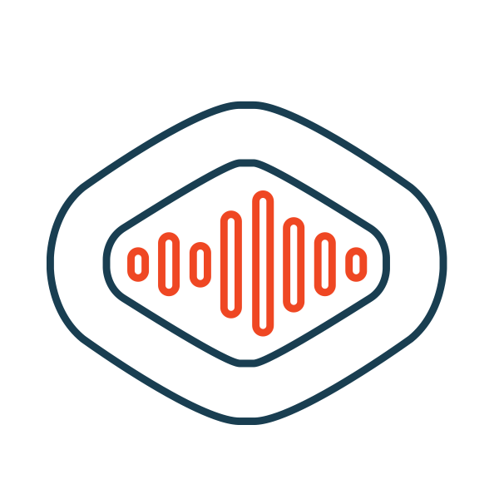
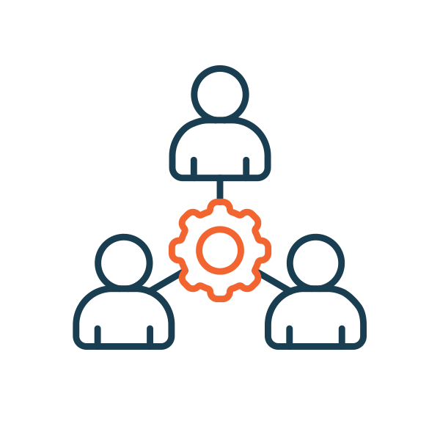
Jitterbit AI agent offering
AI ACCOUNTABILITY
AskJB Agent
HR Agent
Sales Agent
Notes:
Autonomously streamlines the employee onboarding journey with a comprehensive agent that manages pre-boarding, first-day experience, first-month training, and continuous engagement.
Leveraging an organization's own secure LLM, AskJB empowers both technical and non-technical users to find answers quicker and solve problems faster, reducing reliance on IT teams, support, etc.
Automate key sales operations by building account plans, predicting churn, managing renewals, and providing instant access to and analysis of contract details.

Slide 32
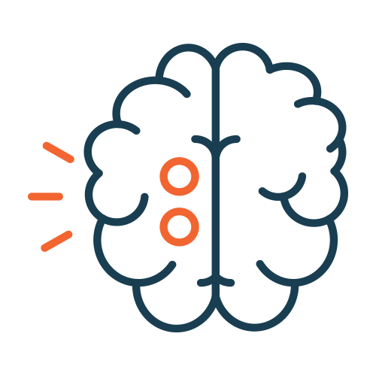
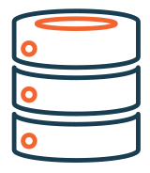
Understanding AI agents
AI Agent
Reason & Plan: LLM with Chain of Thought (CoT)
Autonomously decides how to best accomplish objectives
Autonomous decision-making AI systems
Independently determine optimal methods to achieve goals
Can adapt and strategize to complete complex tasks
Tools
Data
Notes:
AI Agent as discussed is Autonomou AI Application but lets look at right which give the key components that AI Agent consist of LLM → Tools → Data. Going back to example Input

Slide 33
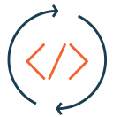
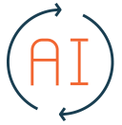
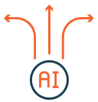
Automation: Traditional Workflow vs. AI Agent
INPUT
INPUT
Rule/Code Based
Processing
AI Processing
Workflow
AI Agent
Rule/Code Based Decision
AI Decision
Action
Action
OUTPUT
OUTPUT

